Slide 1

Pack __
to Cub Scouting!
Notes:
NOTE: REVISE TO REFLECT YOUR PACK PLAN – AND CUT OUT THINGS YOU DON’T NEED TO COVER NOW … later slides allow you to list, if you want:
fun weekend activities,
Your meeting location and schedule
show your Pack Dues,
and announce your next fun event.
Say (in your own words):
Welcome everyone, and introduce any helpers, current parents and Scouts, and leaders …

Slide 2
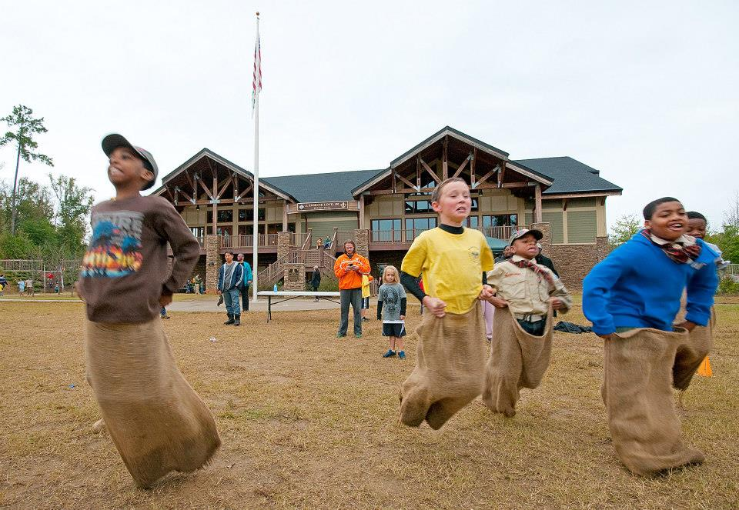
What is Cub Scouting?
Notes:
Say (in your own words):
Explain that we’re going to take 10 minutes to quickly explain:
What Cub Scouting is …
What fun activities we have planned so far for the upcoming school year and next summer
How we organize into “Dens” so that your Sons can have “Adventures” with guys their age, using their Cub Scout Handbooks
A little bit about Rank Advancement and the Badges and Recognition that Scouts like to receive.
When we meet and how we pay for Cub Scout programs.
And we’re asking everyone if they want to join … if your children want to be Cub Scouts and complete the Youth Application, and how you as a Parent can join the fun and help lead your kids and their friends in these adventures.

Slide 3
Cub Scouting … is FUN! and …
for kindergarten through fifth grade kids
  Packs can be all boys, all girls, or both
family oriented ...
  ... but also building independence
fosters participatory citizenship, character and personal fitness
has age-appropriate activities and lessons
  useful “life skills”
Notes:
Say (in your own words):
Briefly discuss each point on the slide.
Do:
From your own personal experience, you might briefly explain how Cub Scouting fulfills some points.

Slide 4
Cub Scouting … is FUN! and …
Safe.
www.AtlantaBSA.org/safety-health
Youth Protection Training + Rules
Other Safety Procedures
Notes:
Say (in your own words):
Briefly discuss each point on the slide.
Do:
Describe how you’re handling COVID-19 concerns.

Slide 5
Cub Scouts follow the Scout Law
A Scout is…
Trustworthy,
Loyal,
Helpful,
Friendly,
Courteous,
Kind,
Obedient,
Cheerful,
Thrifty,
Brave,
Clean, and
Reverent
Notes:
Say (in your own words – Very Briefly):
The Cub Scout Motto is “Do Your Best” – words every Parent tells every child – and the twelve points of the Scout Law are good goals for all.
5

Slide 6
Cub Scouting FUN!
Fun Family Activities: like hiking, biking, field trips, camping, fishing, Derbies, Awards, as Pack events
Den Adventures: small group events with fun and serious activities
Advancement activities – in Dens and by families on their schedules
Recognition at Den and Pack Events
Notes:
Say (in your own words):
This is a sneak preview of HOW the Fun of Cub Scouting comes about: Den Adventures (sometimes called meetings, but let’s focus on adventure, Pack Parties (sometimes called meetings, but let’s focus on family fun) and Events, and Scouts Earning Adventures.
Yes, this doesn’t highlight “Meetings” as in “Den Meetings” or “Pack Meetings”, because if it’s just a meeting, you’re likely not aiming for fun. So call your Den gatherings “Den Adventures” … hey, that lines up with the program built around “Adventures”, and call your Pack events “Pack Parties”, because … they should be more like a party than a “meeting”. Yes, you’ll still do the parts of a meeting like Opening and Closing, but if you call it a Party you might be more mindful of having fun.
Say (in your own words):
Explain that Cub Scout activities take place in a den of up to eight kids where they have fun doing the things listed in the slide. The den is their Scouting home. Families work together to make sure the kids and the den succeed.
6

Slide 7
Our Fun Activities (so far)
August ___:
Family Bike Rides
Pack Fishing Derby
September:
Family + Den Hikes
OA Trailblazer Camping (or just come Saturday)
October:
Spooky Ree Campout! (or just come Saturday)
November ___:
Day Hike at _______
Service Project at ___
December ___:
__Holiday Den Parties__
January ___:
___Trip?___
February ___:
Pack Pinewood Derby
March:
Scouting for Food
Den Bike Rodeos
April:
Spring Campout
Blue + Gold Banquet
May:
Den Graduation Party
June/July:
District Day Camp
Cub Adventure Camps
Notes:
REVISE TO REFLECT YOUR PACK PLAN
Say (in your own words):
Here’s our “big activities” for the upcoming year … but we can add more fun if we have interest.
Do:
Point out the events on the slide.

Slide 8

Being in a Den
Cub Scouts belong to parent-led dens of 6 to 8 Scouts at their grade level, with their own Handbooks:
Kindergarten works towards “Lion”
1st Grade towards “Tiger”
Parents/Guardians a “must” at this age!
Notes:
Say (in your own words):
Cub Scouting programs are age appropriate. Scouts’ activities are based on their age and school grade. Adult involvement is also aged based. Parents need to be highly involved with their Scouts’ activities in the Tiger den – younger guys need more attention and direction. By the end of Webelos, the guys can be ready to camp with little direct supervision. Parents at all levels take on roles in the den and pack.
Say (in your own words):
Each Den Level gets their own “Handbook”.

Slide 9

2nd and 3rd Grade Dens
The parent-led dens of the next grades of Cub Scouts are:
Wolf = 2nd Grade
Bear = 3rd Grade
Dens can have “co-leaders” and need assistants and parent help
Notes:
Say (in your own words):
Cub Scouting programs are age appropriate. Scouts’ activities are based on their age and school grade. Adult involvement is also aged based. Parents need to be highly involved with their Scouts’ activities in the Tiger den – younger guys need more attention and direction. By the end of Webelos, the guys can be ready to camp with little direct supervision. Parents at all levels take on roles in the den and pack.
Say (in your own words):
Each Den Level gets their own “Handbook”.

Slide 10

4th and 5th Grade Dens
The parent-led dens of older Cub Scouts are:
4th Grade works on Webelos (means: WE’ll BE LOyal Scouts) = 4th Grade
5th Grade works towards the Arrow of Light Rank
Notes:
Say (in your own words):
Cub Scouting programs are age appropriate. Scouts’ activities are based on their age and school grade. Adult involvement is also aged based. Parents need to be highly involved with their Scouts’ activities in the Tiger den – younger guys need more attention and direction. By the end of Webelos, the guys can be ready to camp with little direct supervision. Parents at all levels take on roles in the den and pack.
Say (in your own words):
Each Den Level gets their own “Handbook”.

Slide 11
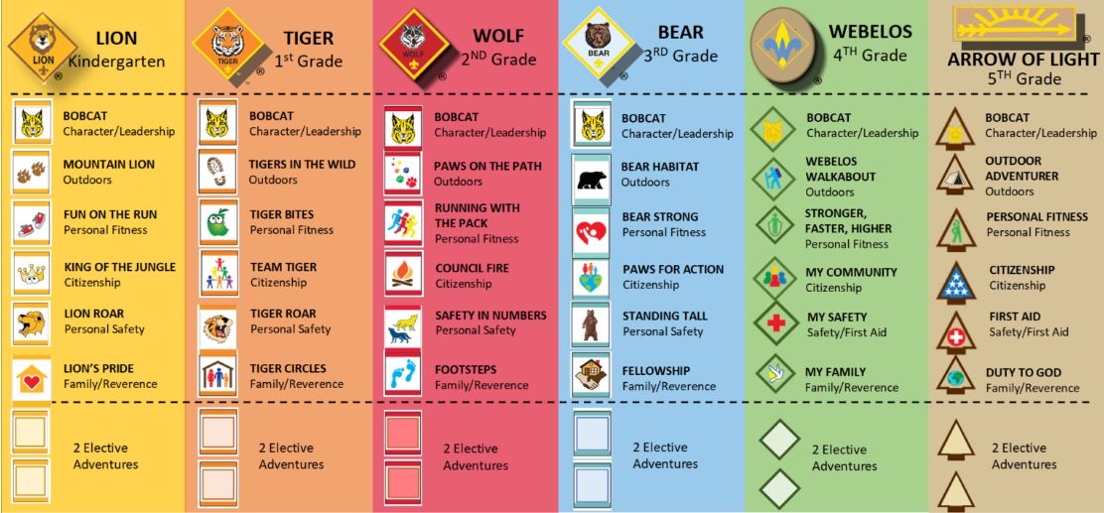
Earning A Rank = Eight Adventures
Six Required Adventures plus two “Electives”
Notes:
The new program is built around “Adventures”, so that every “Adventure” has fun stuff to do. So while there may be an Adventure based around something like Hiking, there will be other elements of games, leadership, stewardship (conservation) and outdoor skills built into it.
Each Rank has the same structure … 7 Adventures (6 “required” and one “elective” that you choose) gets you to the Rank Badge. One “Adventure” in each rank is a family faith Adventure that in almost every case will be done at Home with the family, not at a Den Adventure.
Note that the “Advancement Method” is a “method” of Cub Scouting, not a “requirement”. Some Packs will focus on Adventures that might not line up with the Rank Badge, and that’s OK: the delivery of the “Advancement Method” can be focused on the Adventure Loops, not the Rank Badges. This may be common in “Mixed Dens”, Dens with a mix of Lions, Tigers, Wolves and Bears and more. Because Adventure Loops can be bought without an advancement report, there is no barrier to recognizing, for example, a Wolf who earns a Tiger Loop, or a Tiger who earns a Bear Loop – but note that you can only earn the Rank that is appropriate for your Grade (age) … you cannot “work ahead” or “work behind” … and if you earn an Adventure Loop early, you’ll need to repeat it again when you get to the right age level (it will mean more, and the Scout will experience more, when the Scout is at the age designed for the Adventure).
11

Slide 12
Adventures include:
Stuff Families Want Kids to Know
Family Responsibility:
  Knowledge of Family
  Skills to help at home (tools, chores)
Neighborhood Facts
  Maps, Directions
  Key local places
Health and Safety
  First Aid + Fire Safety
  Bike + Weather Safety
  Cooking/Meal Planning
Fitness and Sports
  Basic fitness, health
  New Games and Old
Citizenship
  Community, Flag
  History, Stories
  Using Resources Wisely
Outdoor Experiences
  Hiking, Biking, Nature
  Camping/Knots/Knives
Special Interests
  Building Things
  Collections
  Storytelling
Character Building
  Making good choices
  Family Faith tradition
Notes:
Say (in your own words):
The Cub Scout Advancement program covers fun things that kids are interested in . . . and important things that Parents want kids to learn and know.
Do:
Briefly note one or two of the points on the Slide.

Slide 13
In Our Pack … “Every Parent Helps”
Every Adult can have a Den or Pack Role:
  If not Den Leader or Cubmaster …
  Then a Helper or Committee member
In Cub Scouting,
you’re either a Den Leader …
or your main job is to help Den Leaders.
So … Every Parent Helps
Notes:
Say (in your own words):
We need Den Leaders and Cubmasters and Assistants.
Many Hands Make Light Work … and if you’re not a Den Leader for your Son’s Den, you owe it to help the Den Leaders!

Slide 14
Den Leadership Options
Den Parents can use any of these Models
One Den Leader, running most events with Parent helpers doing parts of each
  Ideally with multiple Assistants
  Two registered leaders @ each meeting, and a registered female if girls are present
Den Co-Leaders (2, 3, 4?), alternating events, with Parent helpers doing parts
Full Shared Leadership / Family-Led – leadership rotates among families, and/or run a full “family-led program”

Slide 15

You Can Lead and Succeed
Notes:
“You can be a leader when you share what you know and do … Do you help coach a sport? Or play one? You would be a great helper when it’s time to learn and play a sport! … Do you cook at home or grill out? You can help these Scouts learn that too. … Have you taken care of cuts and scrapes? Teach these Scouts, so that they can help take care of themselves as they grow up. What are your Hobbies, what’s your Job, what did you used to do? Can you sing, tell jokes, tell stories? You can share all of that with your child and the other Cub Scouts.
“Scouting isn’t “me” leading “your” Scouts … it’s “we” leading “our” Scouts.
In our Pack, we have an “Every Parent Helps” policy … each Parent leads in some way, as we can. Each parent and guardian is a leader in the ways you can help – you will enjoy it.

Slide 16
Den Meeting Schedule Options
Dens can set their own meeting schedule or all meet at the same time (depends on parent/leader schedules + space available):
Every Other _XX_Day at __:__:
Once a Month on the Weekend, picking a convenient date/time that may change
Alternate Weekdays/Weekends – maybe one weekday and another weekend day
It’s always possible to add more activities.
Notes:
[OPTION (if you have any Den Leaders at the Event): “We have some Den Leaders already for some of our dens. Let me introduce them: _________. They’ll need helpers and assistants, plus we still need some den leaders in some of our other levels.” End OPTION]
“As we get together for our fun events like ______ on ______, we’ll discuss how to form one or more Dens at each grade level to get the full Cub Scout Adventure experience.
Now, if you’re worried about being a leader, know this: I’ve never heard a parent say, “I wish I never got involved in Cub Scouting with my child.” But I’ve heard many say, “I wish I would have spent more time with my kids when they were young.” Which kind of parent are you?
“In the meantime, to see how Den Adventures can be done, each family will receive a “Bobcat Adventure Plan”, and we ask families at each table to plan who will do which parts next time we meet – each of you can easily lead part of that Adventure if you share the lead.
“Dens need to be the right size to work for kids and leaders … ideally 6 to 8 kids (not more than 10). Too few, and it’s not enough fun – too many, and it’s hard for leaders. When a grade level goes over 10 kids, it’s best to split into two dens – but you can still do some joint activities, games and field trips with the whole grade.
“Girls can join our Pack too [OPTION (if in a different Pack): Girls can join Cub Scouts too, and Pack __ is here too – they will have dens of girls end OPTION]. Ideally, we’ll have strong signups from boys and girls … hopefully enough for good strong dens of 6 to 8 Scouts each at each rank level. Boys and girls be in the same den and do activities together.”

Slide 17

“The Uniform”
[Tell your Pack’s Uniform Goals …
“Do Your Best”]
Notes:
Say (in your own words):
The uniform lets the Kids show that they are part of Cub Scouting. Webelos Scouts may wear the blue Cub Scout shirt and trousers, or the den may choose to wear the tan and green uniform. Switching to the BSA Troop–style uniform can give them a sense of that growth and may be practical, since the Webelos Scouts are getting ready for being in an older BSA Troop.
IMPORTANT:
Add any “Pack Goals” … some Packs are “Above the Waist” (no Cub Scout pants, neckerchiefs and hats optional) others are “T Shirt only” … Uniforms should not be a “barrier to joining”.
17

Slide 18
Costs to Do Cub Scouting
$85 National BSA Registration Fees:
  The 2024 fee is $85, and enrolls you for a full 12 months
  ScoutLife Magazine (optional) is $15
$___ Pack Program Fees:
  Covers Pack and Den program costs
  Like Recognition Loops + Rank Badges, Pinewood Derby Cars, event supplies, Adult Leader National Registration Fees, Blue + Gold Award Banquet costs, and other local program items.
Notes:
There’s two parts of payment to be in Cub Scouts. One part is National BSA Registration Fees and the other is local Pack Program Fees.
The national BSA Registration Fee to join up is $85 for the next 12 months.
[ADAPT: For local Pack Program Fees, we collect $__ 40 / 60 / 80 __ for the school year. The Pack Program Fee (or dues) pays for items that the Pack provides, like ___ (pick what you pay for) Adventure Loops + Pins + Rank Badges, Pinewood Derby Cars, thrifty event supplies, Adult Leader National Registration Fees and background checks, Pack T Shirt, Blue & Gold Award Banquet costs, and other items needed for a fun program ____.
To get you signed up today as a member of our Pack:
[Option One: Just BSA Fees: To get you signed up tonight all we need to collect is $85, the national BSA Registration Fees. If you do online registration, you’ll be prompted to pay that amount. We’ll collect Pack Program Fees or dues during the year.]
[Option Two (Some Dues and BSA Fees): What we want to collect today is in two parts, the national BSA Registration Fee of $85 plus a partial payment of $___ of our Pack Program Fees or Dues. The rest of the Pack Program Fees can be paid in a few months.]
“To help pay the costs, Scouts can participate in fundraisers like popcorn sales this fall or camp card sales in the spring. [NOTE: Explain how your Pack applies the revenues collected from fundraisers … ] There are also ways to access “ScoutReach” funds to help pay a portion of costs if that is a barrier to joining.

Slide 19
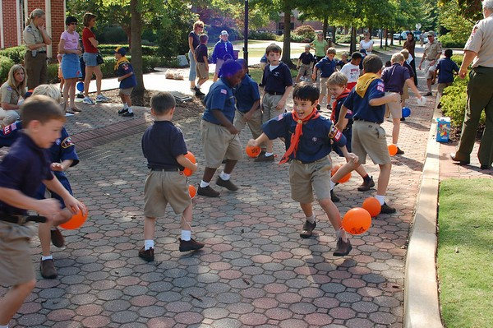
Our Next Fun Event is:
__________________
Will Your Family Join Us? Please complete your Applications now!
Notes:
REVISE TO REFLECT YOUR NEXT FUN EVENT

Slide 20

Questions
Contacts:
________, at ____@_____, ___.___.____
________, at ____@_____, ___.___.____

