Slide 1

Pack __
to Cub Scouting!
Notes:
NOTE: REVISE TO REFLECT YOUR PACK PLAN – AND CUT OUT THINGS YOU DON’T NEED TO COVER NOW … later slides allow you to list, if you want:
fun weekend activities,
Your meeting location and schedule
show your Pack Program Fees
and announce your next fun events.
Say (in your own words):
Welcome everyone, and introduce any helpers, current parents and Scouts, and leaders …

Slide 2

Pledge of Allegiance
Notes:
First, let’s open with the Pledge of Allegiance

Slide 3
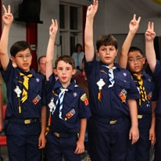
The Scout Law
A Scout is…
Trustworthy,
Loyal,
Helpful,
Friendly,
Courteous,
Kind,
Obedient,
Cheerful,
Thrifty,
Brave,
Clean, and
Reverent
Notes:
Now, let’s recite the Scout Law … repeat after me.
Say (in your own words – Very Briefly): These are good things that we would like to see in our children. And ourselves. This is Cub Scouting!
3

Slide 4
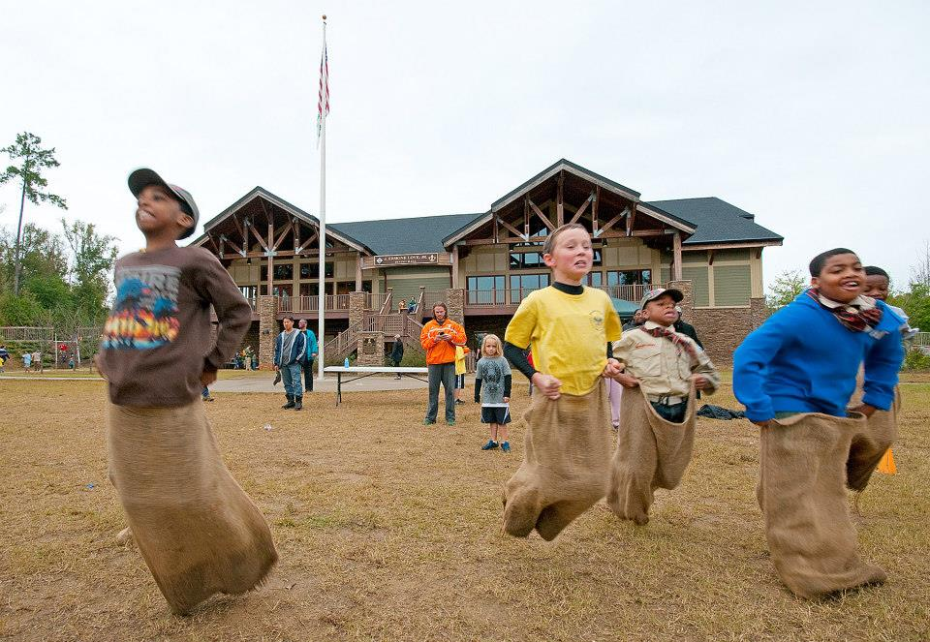
What is Cub Scouting?
Notes:
Cub Scouting is pretty simple: If it’s fun for kids, fun for families, and safe – then it’s Cub Scouting. Scouting is called a “Game with a Purpose” … in Cub Scouting, our game is to have fun with families while raising our kids …for our kids to make friends and also for parents to make friends with other parents … so we’re here for the whole family as we raise our kids.
“When we do Scouting, we also teach the lessons of the Scout Law: Trustworthy, Loyal, Helpful, Friendly, Courteous, Kind, Obedient, Cheerful, Thrifty, Brave, Clean and Reverent.

Slide 5
Cub Scouting FUN!
Fun Family Pack Activities: hiking, biking, field trips, camping, fishing, Derbies, Awards – with all grades
Den Adventures: smaller grade level events – fun and serious activities
Advancement activities – in Dens and by families on their schedules
Recognition at Den and Pack Events
Notes:
Let’s Talk About What We Do! We’ve got some handouts with our calendar of fun events that we hope to do. Please hang onto this, and call me or any other leaders if you think of questions afterward.
5

Slide 6
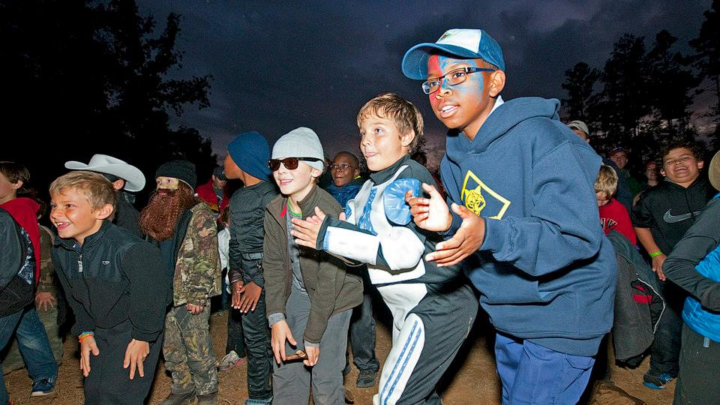
Fun!
Our Fun Activities and Program:
Be sure to get our Pack Handout
Includes Key Big Fun Event Dates
Also Den Activity Schedules (so far)
Notes:
“In our handouts you’ll see that our fun events and weekend activities are for the whole family … not just the kids, but parents, brothers, sisters, aunts/uncles/grandparents (briefly pump up a few key fun activities for the year: like camping trips, pinewood derby, summer camp, hikes, biking, fishing, etc.).
“Now, these are just what’s planned so far – you guys will also have great ideas of more fun things we can all do together.
If there is something you like to do or want to do, let’s try to do it.

Slide 7
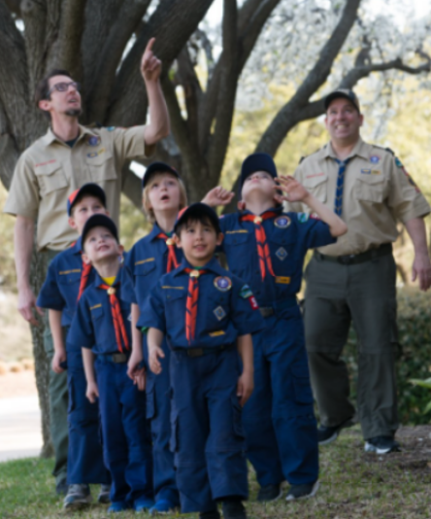
Being in a Cub Scout Den
Cub Scouts belong to parent-led dens:
6 to 8 Scouts at their grade level
with their own “grade appropriate” Handbook
Fun adventures and new skills
Notes:
Let’s cover how our Cub Scout Pack is organized. We do age-appropriate activities and advancement that your child will do with others from the same grade, in groups we call Dens.

Slide 8





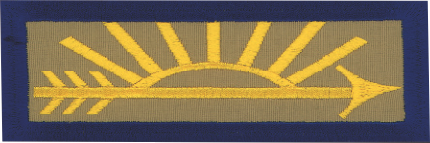
Ranks (Handbooks) and Grades K through 5
(5th Grade Scouts can join a Scouts BSA Troop in the Spring)
Notes:
Dens should have from 6 to 8 Scouts at the same or similar grades:
Kindergarteners and their adult partners are in a Lion den working on Lion Rank.
1st graders and their adult partners form a Tiger den working on the Tiger Rank.
2nd graders are Wolves working on the Wolf Rank.
3rd Graders are Bears working on the Bear Rank.
4th graders work towards Webelos Rank (Webelos stands for We’ll Be Loyal Scouts).
5th Graders in an Arrow of Light den work towards the Arrow of Light rank and will aim to join a Scouts BSA Troop of older Scouts between January and May next year.
“The fun of Cub Scouts is that Scouts are encouraged to try lots of different things, and they earn recognition for completing adventures about those things.
Science, hiking, camping, family life, government, sports, you name it … Cub Scouting has a badge for it at some level.
8

Slide 9
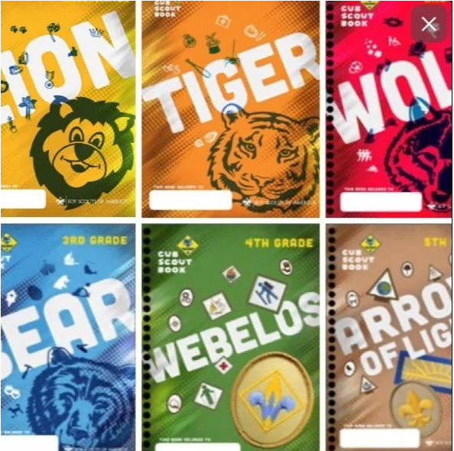
Cub Scout Handbooks
Notes:
Each Den level has a handbook of adventures [show the handbooks____].
These handbooks have fun “Adventures” for your kids – and important information, skills and values you want your kids to learn and know.
If you register and pay the BSA fee tonight, you get a free Handbook at the Checkout Station! If we run out, we’ll have more at our next event.

Slide 10
In Our Pack … “Every Parent Helps”
Every Adult can have a Den or Pack Role:
  If not Den Leader or Cubmaster …
  Then a Helper or Committee member
In Cub Scouting,
you’re either a Den Leader …
or your main job is to help Den Leaders.
So … Your Children Need Every Parent’s Help
Notes:
“Each Den needs volunteer leaders from among the parents to help Cub Scouts do handbook adventures in their Dens. Cub Scouting is a family program … you need parent participation.
“When you participate, you’ll have fun and make new adult friends while we do fun Scouting adventures. We’re all in this together as we raise children into adults.
[ADD THIS FOR A “HARD” LEADER PITCH: Every parent should have our “Every Parents Helps” policy and our “How I’ll Help” pledge card that lists a menu of ways to help your child have Cub Scouting in your Den and the Pack – we ask every parent to complete that today when you sign up your child.]

Slide 11

You Can Lead and Succeed
Notes:
“You can be a leader when you share what you know and do … Do you help coach a sport? Or play one? You would be a great helper when it’s time to learn and play a sport! … Do you cook at home or grill out? You can help these Scouts learn that too. … Have you taken care of cuts and scrapes? Teach these Scouts, so that they can help take care of themselves as they grow up. What are your Hobbies, what’s your Job, what did you used to do? Can you sing, tell jokes, tell stories? You can share all of that with your child and the other Cub Scouts.
“Scouting isn’t “me” leading “your” Scouts … it’s “we” leading “our” Scouts.
In our Pack, we have an “Every Parent Helps” policy … each Parent leads in some way, as we can. Each parent and guardian is a leader in the ways you can help – you will enjoy it.

Slide 12
Den Meeting Schedule Options
Dens can set their own meeting schedule or all meet at the same time (depends on parent/leader schedules + space available):
Every Other _XX_Day at __:__:
Once a Month on the Weekend, picking a convenient date/time that may change
Alternate Weekdays/Weekends – maybe one weekday and another weekend day
It’s always possible to add more activities.
Notes:
[OPTION (if you have any Den Leaders at the Event): “We have some Den Leaders already for some of our dens. Let me introduce them: _________. They’ll need helpers and assistants, plus we still need some den leaders in some of our other levels.” End OPTION]
“As we get together for our fun events like ______ on ______, we’ll discuss how to form one or more Dens at each grade level to get the full Cub Scout Adventure experience.
Now, if you’re worried about being a leader, know this: I’ve never heard a parent say, “I wish I never got involved in Cub Scouting with my child.” But I’ve heard many say, “I wish I would have spent more time with my kids when they were young.” Which kind of parent are you?
“In the meantime, to see how Den Adventures can be done, each family will receive a “Bobcat Adventure Plan”, and we ask families at each table to plan who will do which parts next time we meet – each of you can easily lead part of that Adventure if you share the lead.
“Dens need to be the right size to work for kids and leaders … ideally 6 to 8 kids (not more than 10). Too few, and it’s not enough fun – too many, and it’s hard for leaders. When a grade level goes over 10 kids, it’s best to split into two dens – but you can still do some joint activities, games and field trips with the whole grade.
“Girls can join our Pack too [OPTION (if in a different Pack): Girls can join Cub Scouts too, and Pack __ is here too – they will have dens of girls end OPTION]. Ideally, we’ll have strong signups from boys and girls … hopefully enough for good strong dens of 6 to 8 Scouts each at each rank level. Boys and girls be in the same den and do activities together.”

Slide 13

“The Uniform”
[Tell your Pack’s Uniform Goals …
“Do Your Best”]
Notes:
“Let’s talk uniforms. Kindergarten Lions can wear a T Shirt. First through 4th Grade Scouts wear the Blue Cub Scout Shirt, and move into the Tan or khaki one in 5th Grade. Buy them with room to grow – you can shop for them at the Scout Shop at 1800 Circle 75 Parkway (across from Truist Park). The uniform helps your child wear the badges they earn and feel like a part of the Pack. It isn’t necessary to get one before our next event, but kids would want to have them soon. If you need help with a uniform, let us know.”
[NOTE: explain any local Pack practice, like if you have an “above the waist” uniform practice to “keep it simple” and thrifty, or similar policies that make Scouting more affordable. Share any Pack or District details about “uniform banks” as well.]
13

Slide 14
Costs to Do Cub Scouting
$85 National BSA Registration Fees:
  The 2024 fee is $85, and enrolls you for a full 12 months
  ScoutLife Magazine (optional) is $15
$___ Pack Program Fees:
  Covers Pack and Den program costs
  Like Recognition Loops + Rank Badges, Pinewood Derby Cars, event supplies, Adult Leader National Registration Fees, Blue + Gold Award Banquet costs, and other local program items.
Notes:
There’s two parts of payment to be in Cub Scouts. One part is National BSA Registration Fees and the other is local Pack Program Fees.
The national BSA Registration Fee to join up is $85 for the next 12 months.
[ADAPT: For local Pack Program Fees, we collect $__ 40 / 60 / 80 __ for the school year. The Pack Program Fee (or dues) pays for items that the Pack provides, like ___ (pick what you pay for) Adventure Loops + Pins + Rank Badges, Pinewood Derby Cars, thrifty event supplies, Adult Leader National Registration Fees and background checks, Pack T Shirt, Blue & Gold Award Banquet costs, and other items needed for a fun program ____.
To get you signed up today as a member of our Pack:
[Option One: Just BSA Fees: To get you signed up tonight all we need to collect is $85, the national BSA Registration Fees. If you do online registration, you’ll be prompted to pay that amount. We’ll collect Pack Program Fees or dues during the year.]
[Option Two (Some Dues and BSA Fees): What we want to collect today is in two parts, the national BSA Registration Fee of $85 plus a partial payment of $___ of our Pack Program Fees or Dues. The rest of the Pack Program Fees can be paid in a few months.]
“To help pay the costs, Scouts can participate in fundraisers like popcorn sales this fall or camp card sales in the spring. [NOTE: Explain how your Pack applies the revenues collected from fundraisers … ] There are also ways to access “ScoutReach” funds to help pay a portion of costs if that is a barrier to joining.

Slide 15
Applications – Two Routes
Online: through BeAScout.org
  Set Up Account (My.Scouting)
  Under “Youth”, enter your contact data and your child’s information
  Pay National BSA Registration Fee online
Paper Application
  Complete all, sign and turn in tonight
  $85 (if by check, payable to “Atlanta Area Council, BSA”)
Adult Leader Applications too
  Either Online (BeAScout.org) or Paper
Notes:
“We are ready for YOU to join US on a Cub Scouting adventure! All you have to do is turn in your registration – your completed and signed Youth Application and payment.
“If you sign up tonight, in a week or so your Scout will receive a Cub Scout Launch Kit with items to help them get starting on the Scouting Trail.
[IF YOU HAVE THEM: And you get a free Handbook too when you join tonight!]
“[IF YOU DO ONLINE APPS: Check your email for an invitation to complete a Registration Online – follow the instructions, complete the Registration, and pay the BSA registration fees with a Credit Card. We’ll follow up with you for Pack Program Fees later.
{Explain how to complete the application, and where to turn it in tonight}. [OPTION: “we have helpers guide you through online signup at BeAScout.org if that is easier and a “How to Sign Up Online” handout.”]

Slide 16
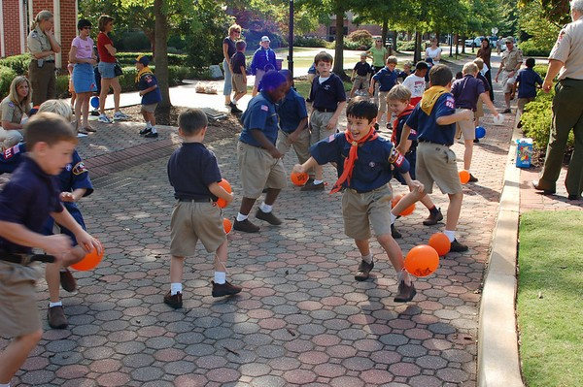
Our Next Fun Event is:
__________________
Will Your Family Join Us? Please complete your Applications now!
Notes:
REVISE TO REFLECT YOUR NEXT FUN EVENT
“We also have Adult Applications for those who will join our Team of Leaders – we want you all on our team, whether as Den Leaders or Assistants or Co-Leaders or helpers on the Pack Committee. You’ll need to take Youth Protection Training, which is very valuable.
“Some of you are clearly ready to join and you can pay your registration and Pack Program Fees today – we welcome you! If you are uncertain, please attend our next Pack and Den activities and see for yourself what a great program Cub Scouting is.”
“We look forward to seeing you when we go to _________ on ______, and when we go to ________ in September and to ________ in October! I will be here along with our Den leaders for a few minutes if you have any questions. Thanks and welcome to the Pack!”

Slide 17

JOIN US!
Any Questions
Contacts:
________, at ____@_____, ___.___.____
________, at ____@_____, ___.___.____

