Slide 1

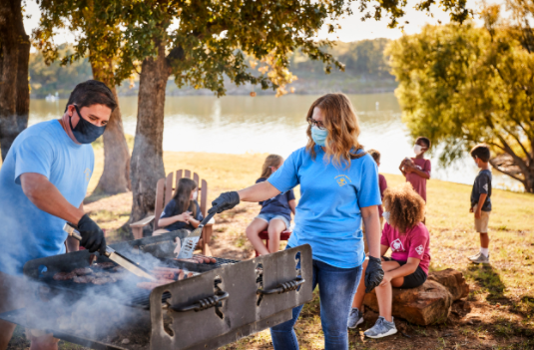
Motivating Parents
Notes:
Motivating Parents: Ways to get Parents fired up and ready to go Scouting with their Cubs. Special focus on engaging parents during times of physical distancing – and tips to use during “normal” times when you want to develop “drop off” parents into “tuned in” promoters and helpers

Slide 2
Issues You See …
Get them excited, willing to help
  One on one as a solution
Don’t know how to do it! So I can’t Lead!
Disenchantment with Group + Virtual
Notes:
What issues or concerns do you have about parent motivation?

Slide 3
You Might See …
Uninvolved or Disinterested Parents?
Parents who don’t “get it”
Not willing to do __ (what we know they can do)
At events, but nose in phone
Problem Parents (bulldozers, derby dads)
Quiet COVID quarantining – not connecting
The opposite of quarantining – space invaders
Other
Notes:
Here are some common ones.

Slide 4
Get Motivated!
Primary Angle Today – Successful Dens + Packs:
Get All Parents Involved, Active and Excited
Every Parent is Akela! So … Every Parent Leads
Other Motivation Support:
Ways to Support Leaders – Avoid Burnout
Ways to Share the Leadership Role
KISMIF: “Keep It Simple, Make It Fun”
Sustainable Recruiting of Families
Notes:
Many of the ideas found here are from the “Turning Parents into Helpers, and Helpers into Leaders” page at https://www.atlantabsa.org/RecruitingLeaders, including the “Fifty Ways to Lure a Leader” piece at https://www.atlantabsa.org/LeaderRecruiting

Slide 5

Motivation – and the Six Steps to Successful Recruiting
Calendar of Fun – and Safe – Activities
Let People Know -- Promote Your Program!
Recruit More Leaders and Helpers
School and Community Presence
Sign Up Events: Pack Events, maybe School Sign-Up Night
More Fun Activities
Notes:
A lot of Motivation is found in the Recruiting Steps.
Do you have activities families like?
Do they know about your activities – what they are, how they’ll do it, what they need to bring, how they will be safe?
Have they been given a role – something they can do?

Slide 6
Do Your Activities Motivate?
Are you doing exciting and appealing activities?
Is Your Den and Pack:
“Meeting” … or Doing Activities
“Same Ol’ Same Ol’” … or Scouting out New Places?
“How We Always Do It” … or maybe some new activity ideas?
If it isn’t fun … don’t
Notes:
The Marie Kondo theory of Pack Activities Planning:
First, put your hands on everything you own, ask yourself if it sparks joy, and if it doesn’t, thank it for its service and get rid of it.
Second, once only your most joy-giving belongings remain, put every item in a place where it’s visible, accessible, and easy to grab and then put back.
Only then, Kondo says, will you have reached the nirvana of overcoming clutter.
In Scouting, you might look at what you do and how you do it, because Scouting clutter often accumulates as “this is what we’ve always done” or “that’s how the last leader did it”. So …
Look at every event you do, ask yourself if it sparks joy, and if it doesn’t, thank it for its service and get rid of it. Or find a way to do it that sparks joy.
Then, once only your most joy-giving events remain, make them visible, accessible, and easy to participate in.
Because when more events spark joy, your families will enjoy Scouting more, and participate more.

Slide 7
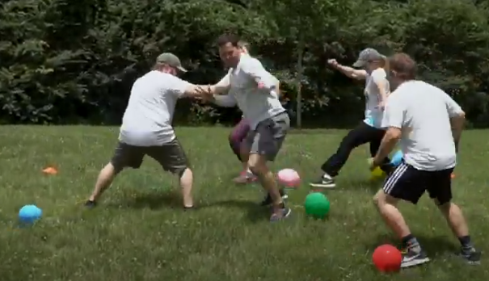
Is Cub Scouting a Family Program?
Is Game Time only for Scouts, or for Parents Too?
Notes:
OK, maybe not this game now during covid time – but almost every game that kids play could be played by adults, and some could be played “Scouts version Adults” or … are you Smarter than a Third Grader?

Slide 8
Is It Safe?
Is That Holding Families Back?
Maybe Smaller Activities?
A menu of smaller outdoor activities will allow families to Spring Into Scouting, safely – Get Ideas from Families
Like hiking, biking, kiting, fishing, rockets, skating, Pinewood Derbies, golf, disc golf, cooking, service
Pack Activities – maybe satellite by Den groups?
Some Will Want to “Opt Out” but “Stay In”
Families will look at the Menu of Activities and say “yes, this”, but “oh, not that” depending on safety factors
Share resources to do Adventures from home
Notes:
Are Parents Not “Motivated” because they are scared or unsure?

Slide 9
Are Parents Welcomed?
Welcome and Greet
Use “New Member Coordinator” helpers:
Any Parent who likes Scouting can do this
Have a Welcome Toolkit Package to Onboard New Families
  Contacts / Calendar
  FAQ Answers
  Pack/Den Policies?
Maybe Welcome Photo Gatherers
  Welcome families in news blast or website
Help New Parents find a Role to Help in the Den or Pack
Relay Feedback to Den and Pack Leaders
Notes:
Oh, You’re New story.

Slide 10
Do Parents Understand How Your Den/Pack Work?
Have Your Parents been to a Pack Orientation?
Topics Might Include:
  “The Talk”: parents must be leaders (we have scripts for that)
  Bobcat and other Cub Adventure plans that let parents lead easily
Do You Have An “Every Parent Helps” Policy:
And Do You Provide Opportunities to Help?
  Not Just “Big Jobs”
  Small Tasks, Maybe “Team Assignments”
Do you Keep It Simple + Make It Fun?
Not “KICMEH”
Notes:
Resources at https://www.atlantabsa.org/NewParentOrientation
KICMEH is “Keep It Complicated, Make Everything Hard”, pronounced “Kick Me!”

Slide 11
Are Parents Recognized?
Say + Share Thank You:
When Someone Volunteers
    And When They Follow Through
Prizes for Helping
  Like Overstock Patches
  Their Scout Will Be Very Impressed!
Yes, Thank Even the “Prodigal Parent”:
Even if they don’t help until late in the year
All of this Helps Build “Stronger Families Through Scouting”
When the Parent Succeeds, Kids Love Them More
Notes:
Thank You is Powerful

Slide 12



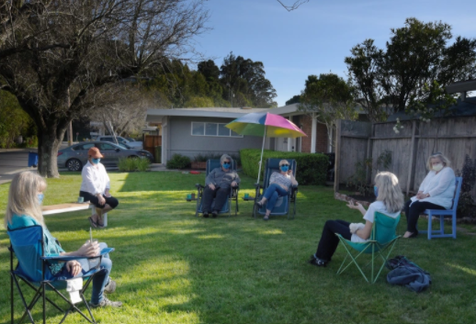
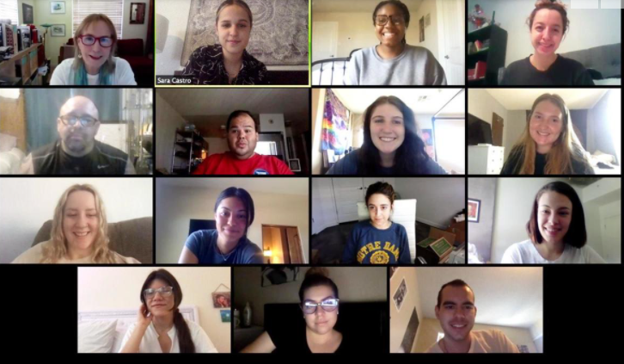
Are Parents Connected?
Call Parents Up:
How is it Going?
Are You All Right?
Any Scout Questions?
Parent Social Time?
Notes:
Be a Community – not just a Den or Pack

Slide 13
What Did We Miss?
The Lifetime Demo (Yardstick / Adding Machine Tape)
What Did You Do Before Kids (Maybe Add to Pack Program?)
Too Motivated Parents
Did You Ask Families For Feedback?
Parent Den/Patrol
Feed the Beast
Are There Barriers to New Ideas, Leaders?
Teams
See the Future (after Leaders cross over)
Less Is More?
Why Pack “Meetings”?
Your Ideas …
Notes:
Thank You is Powerful

Slide 14
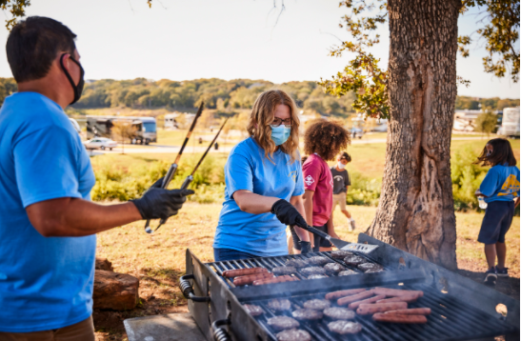
Questions for the Group?

