Slide 1

Fifty Ways to Lure a Leader
Part of the Steps to Successful and Sustainable Recruiting
Notes:
Recruiting and Retaining Adult Leadership: This is all about Recruiting More Leaders and Helpers – call it “50 Ways to Lure a Leader”. Successful and Sustainable Recruiting requires recruiting families, and turning parents into helpers, and turning helpers into leaders. There is no magic bullet, but there are a lot of arrows in your quiver, so ready, aim and fire the ones that work for you.

Slide 2
👏 “Our 👏 Den/Pack 👏 Had 👏 Poor 👏 Leadership!” 👏
Why Is Recruiting Leaders So Important?
Voice of the Scout Survey asked “Why is your child no longer in Cub Scouts?” – the Number One Answer was:
Notes:
After “Poor Leadership” (31%), the next answers were:
“Other” (28%) -- a “word cloud” explanation highlighted “leader”, followed by “meeting”, “covid” and “leadership”.
Next (after aged out) were “our family did not feel welcome” (20%) and “my child was no longer interested in the program” (18%).
Then “too expensive” (16%), followed by “never received any Organize: Tailor Your Job List from leaders or were not contacted about meetings” (15%).

Slide 3
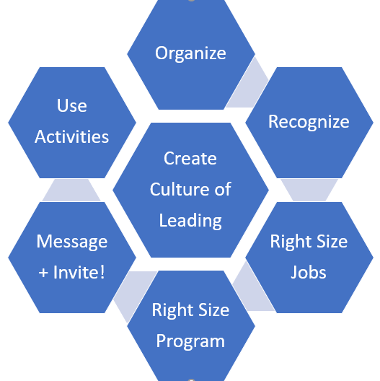

Arrows
Notes:
More Resources are found at https://www.atlantabsa.org/RecruitingLeaders and surrounding pages. The presentation is based on a document called “Fifty Ways to Lure a Leader” posted at https://www.atlantabsa.org/LeaderRecruiting.
There must be fifty ways / To lure a leader …
You ask the whole Pack, Jack
Every woman and man, Stan
You don't need to be coy, Roy
Not just one, two or three …
Every new one’s a plus, Gus
You don’t need “group discuss” much
Do a ”one on one” plea, Lee
Each new helper is key

Slide 4
Create a Culture of Leading
👏 We 👏 Are 👏 Not 👏 Recruiting 👏 Youth 👏
We 👏 Recruit 👏 Families! 👏
Notes:
Recruiting Messaging: You’re Recruiting Families, not Just Youth. Make it clear that the family is joining the Pack (and the Den) to do activities as a family with their Scout.

Slide 5
Create a Culture of Leading
It takes a Village …
Have an “Every Parent Leads” Policy
(or “Every Parent Helps”)
Notes:
It Takes a Village – Every Parent Leads. Have and promote an “Every Parent Leads” (or “Every Parent Helps”) policy. Let families know that Cub Scouting is a family program with shared leadership, not a “drop off” program.
We’re Building Stronger Families Through Scouting – and that means stronger parent leaders too.
One example of an “Every Parent Helps” policy is in the downloads here.

Slide 6
Create a Culture of Leading
No Quarter …
Recruit Leaders Right Away
(Everyone Can Help – As An Assistant or Helper)
Notes:
Recruit Right Away. Don’t let people believe ‘oh I’m too new to help’… everyone was new once. They can help.
Recruit for Assistant roles, or small roles, to start. Ideas about designing small roles in Organizing below.

Slide 7
Create a Culture of Leading
Be Specific …
Explain What It Means to Lead (in your Policy) – What You Expect from Parents
Notes:
Explain What It Means to Lead – What You Expect from Parents. Be sure the “Every Parent Leads” policy is specific. Like “if you are not active in a registered role (Cubmaster, Den Leader, Assistant, Committee), then you need to both
lead or co-lead { one? Two? } den activity/meeting for your Scout’s den
plus active help on a program or event team (like Pinewood Derby, Campout, Blue & Gold Awards Banquet, Advancement Support, Membership, Fundraising, Communications, Snacks, etc.)

Slide 8
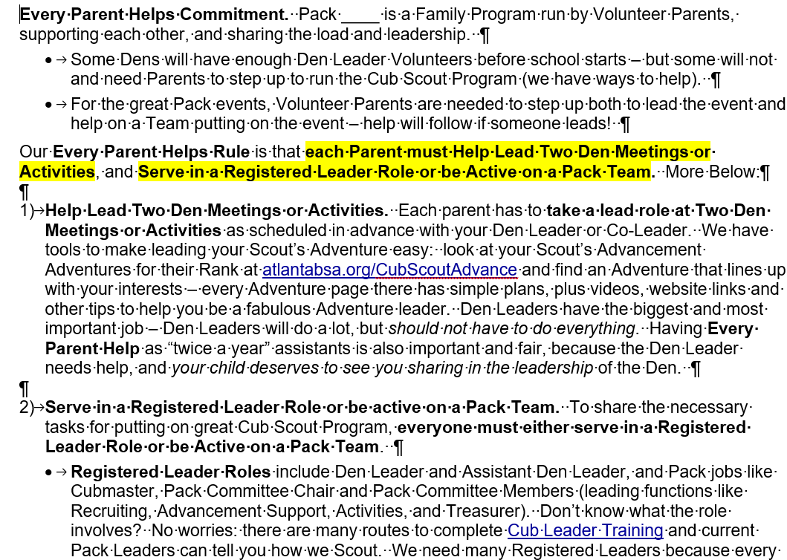
Every Parent Helps Specifics
Notes:
It Takes a Village – Every Parent Leads. Have and promote an “Every Parent Leads” (or “Every Parent Helps”) policy. Let families know that Cub Scouting is a family program with shared leadership, not a “drop off” program.
We’re Building Stronger Families Through Scouting – and that means stronger parent leaders too.
One example of an “Every Parent Helps” policy is in the downloads here.

Slide 9
Create a Culture of Leading
Find the Right Role …
Connect Positions to People’s Passions
Notes:
Connect Positions to People’s Passions. Fill jobs based on what people prefer to do, not what you need to fill.
You may have a “gaping hole” at Popcorn Kernal, but if you talk someone who doesn’t like organizing or sales into that job, they will either not do it well or not at all. Or get embarrassed and leave the Pack.
Cultivate leadership in people by finding something that they’ll love to do.

Slide 10
Create a Culture of Leading
Don’t Throw Your Wolf Leader to the Wolves …
Take Your Team To Live Training
Notes:
Don’t Throw Your Wolf Leader to the Wolves. Go with her to training & train the whole team by bringing along more parents who can help that den leader. Showing up with her shows that “this is a team effort”.
FYI, there’s some information in BSA training that won’t apply to your Pack because All Scouting is Local.
If you do training as a team event, you’ll have better results, because your team can collaborate about “how we do it” or “how we will do it” right at and after the training program.

Slide 11
Create a Culture of Leading
It Takes Two …
Turn Joining Leadership into Joining The Team
Notes:
Turn Joining Leadership into Joining The Team: It Takes Two (Me And You). Many folks fear “leading all alone”. And for good reason: too often if someone “steps up” everyone else “steps back” and lets the leader do it all.
Recruit a “team”, like Den Co-Leaders … a pair of friends or spouses can be a team of leaders.

Slide 12
Create a Culture of Leading
It Takes Two …
Two Deep Leadership
Notes:
It Takes Two (Deep). Let people know about the rule – two registered leaders present for each activity – and let them know that means every den will need more than two registered for when one of the registered can’t make it.

Slide 13
Create a Culture of Leading
Good, and Good For You …
Share the Benefits of Leading
Notes:
Benefits of Leading. And don’t be just “about the rule” but be sure parents know why it is important to participate.
Scouting is a family program, a parental support program, teaching life skills, to prepare young people to make ethical and moral choices over their lifetimes by instilling in them the values of the Scout Oath and Law.
Leadership training like Youth Protection is valuable for protecting a parents biggest investment: their kids!

Slide 14
Create a Culture of Leading
Make Leading Fun …
Schedule Social Time for Leaders
Notes:
Make Leading Fun – Have Social Time for Leaders. Make some unit parent events just fun + social time to bond with no work … a reward for leaders, and a lure for parents. All work and no play makes … a dull Scout leader.

Slide 15
Create a Culture of Leading
Find Good Role Models …
Use Mentors
(Maybe From A Troop)
Notes:
Use Mentors – Use Good Role Models. The person who did something successfully last time can often give advice to those who follow, and be an inspiration by helping a new leader.
This is another reason to “use term limits” as described in Organizing below: run it year one, mentor year two.
This is another reason to keep Troop Leaders connected to your Pack – those current Troop Leaders who are former Pack and Den Leaders can help continue a culture of helpful leadership and mentoring.
Registration in “multiple” units is free in the BSA – no extra charge for being a registered leader in a second unit.

Slide 16
Create a Culture of Leading
Quantify Contributions …
Maybe Use a “100 Points Policy”?
Notes:
100 Points Policy? Some Packs use (and 2022 BSA Cub Chat chatter promotes) using a “100 Point Plan” as a goal or expectation of parent participation. For example, Cubmaster or Den Leader is 100 points, but smaller roles – including bite sized bits of jobs described in Organizing below can be combined to hit the total.
One example of a “100 Points Policy” is in the downloads here. Download and edit for your needs.

Slide 17
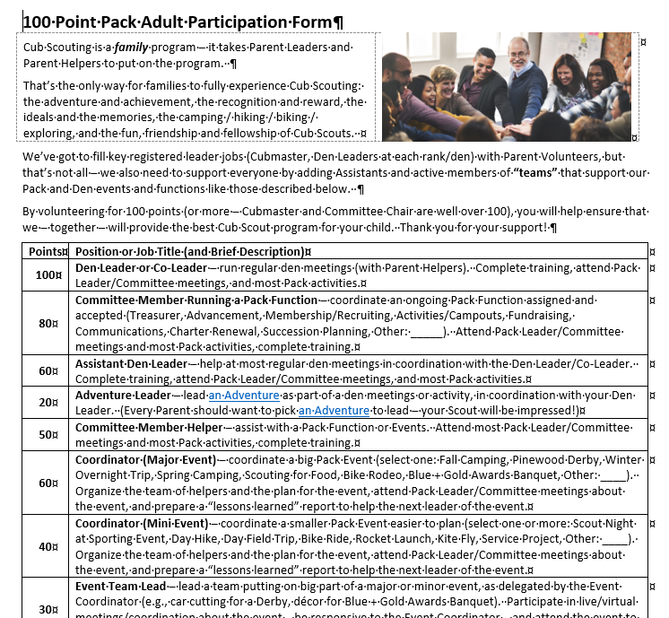
An Example 100 Point Plan

Slide 18
Create a Culture of Leading
Got Committee People Who Need a Job? …
Make “Succession Planning” a Committee Priority
Notes:
Got Committee People Who Need a Job? Make “Succession Planning” a Committee assignment – with the Chair.
Maybe this Committee Lead can organize the “Big Job” recruiting process for Selecting Cub Scout Leadership.

Slide 19
Create a Culture of Leading
“Help” Policy failed? …
Hold People to Obligations – Enforce Your Policy
Notes:
Hold People to Obligations. Circle back to those who haven’t helped to remind them of your policy of “Every Parent Leads” … they may have a good excuse or maybe they thought you didn’t mean it. Mean It!

Slide 20
Organize: Tailor Your Job List
List Ways to Help …
Share a Unit Job Chart or “Help Wanted” List
Notes:
Unit Job Chart or “Help Wanted” – List Ways to Help. Yes, you’ve got to list the big leader jobs (Cubmaster, Den Leaders at each rank/den), but show space for Assistants – advertise being Den Co-Leaders! – and give parents a chance to help on “teams” (sounds more fun than “committees”) that support events and functions like Campouts, Pinewood Derby, Fundraising (popcorn/camp cards), Banquet/Court of Honor, Advancement, Paperwork, Snacks.
A Pack Leadership & Volunteer Roles Chart is in the downloads on this page.
You can download it, tailor to your Pack Program, and share.

Slide 21
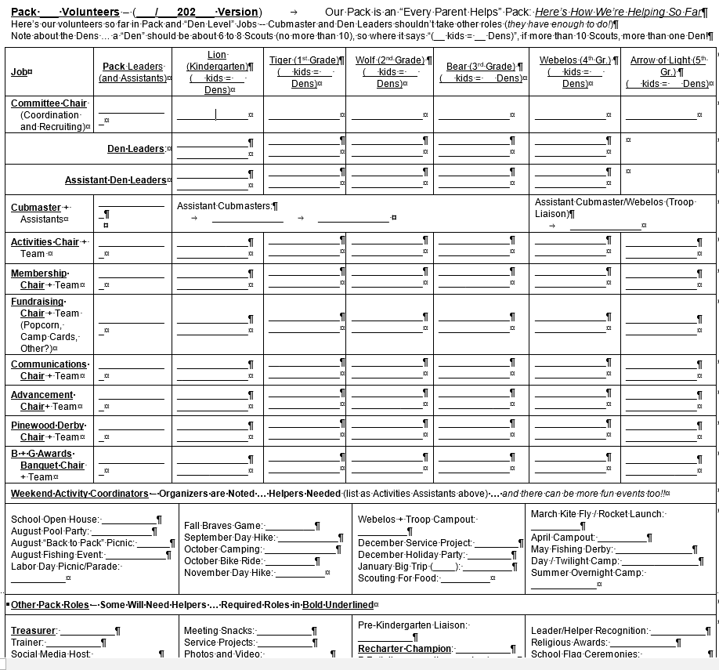

Slide 22
Organize: Tailor Your Job List
Light Work for Many Hands …
Break Down Jobs and Roles into Small Parts
Notes:
Break Down the Job into Parts. Whether ongoing like Den Leader or event specific like Derby, carve up small roles.
No Leader has the full “tool kit” or “bandwidth” to do it all – get help where you can or need to be successful.
Certainly true for event leaders: “run the Pinewood Derby” doesn’t mean “do it all”. It means organize teams. Have a Car Cutting Team, some Design/Painting advisors, a “Check In” team, a “Pit Crew” for running the track and race, an “Awards Team” for race awards and design awards, maybe Concessions, Driver’s License, more?
A Den Leader might break out regular roles where she needs help (or has help) like communications (reminders by text/email/phone/etc. of upcoming meetings), advancement detail (who did what + how to catch up if you missed a meeting), advancement bling (buying loops/pins), snacks, doing crafts, doing outdoor nature stuff (if you’re afraid of spiders or snakes, find an outdoor helper who isn’t), leading games. More ideas here.
Share the “lead” of Adventures by having parents lead an Adventure that fits their interest. More next …

Slide 23
Organize: Tailor Your Job List
Make It Easy to Lead Dens …
Share Streamlined/Simpler Adventure Plans with Parents
Notes:
Share Adventure Resources to Make It Easy to Lead. If you ask a parent to “lead this Adventure”, don’t just say “it’s in your child’s handbook – look it up”. Help them out! We have plans – you need to share them with parents!
Share the Adventure Resource page for the Adventure with plans and videos and other ideas.
Print the Streamlined plan and walk the parent/leader through the plan and discuss how to lead. They can do it!

Slide 24
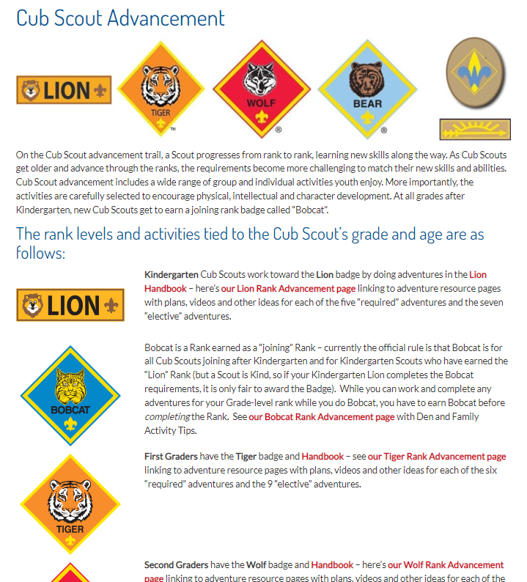

Helping Parents Lead Den Activity:
Resource Pages with Simpler Streamlined Plans + Family-Led Plans
Easy to Share with Parents
  Word Versions Posted
  Parent Participation Prompts
Resource Page Adds Videos, Resources and More Ideas
Found Through AAC Cub Scout Advancement Page at AtlantaBSA.org/CubScoutAdvance
Notes:
And we have tools to succeed – through these Streamlined plans (for most required adventures) and Family Led plans.
The streamlined plans for required adventures and Bobcat prompt a leader to assign parents to small bits of meetings.
After all, if you’re doing a hike, a parent could explain the 6 Cub Scout Essentials. Wait. Actually, I can’t name them all. But if you gave me a short plan for Adventure and showed me the little bit about what the 6 Cub Scout Essentials are and asked me to talk about that, I will absolutely be pretty decent at being an expert on hiking safety. And there again, my Scout will think I’m a hero.

Slide 25
Organize: Tailor Your Job List
Make It Easy to Lead Events …
Share Event Plans + Ideas for “Next Time”
Notes:
Share Event Plans + Ideas for “Next Time”. If you’ve done something before (campout, Pinewood Derby, Blue + Gold Awards Banquet, etc.), hand down the plan. Write up “lessons learned” about what worked and what didn’t.
Don’t limit events to “how we did last year”. Be open to new ideas so this year’s parent leader can do it better!

Slide 26
Organize: Tailor Your Job List
Job Not Filled? …
Show Open Roles in Your Unit Job Chart
Notes:
Unit Job Chart – Show Open Roles. List only people really doing the job, not just “holding the title”.
You want people to see the real needs of the Unit … if you’re a Cubmaster doing 3, 4 or 11 jobs on the chart right now because nobody else signed up, leave that blank (but do the work) until you get a volunteer.
Always show space for assistants, so that the list always shows a new way to join a team.

Slide 27
Organize: Tailor Your Job List
No Leader Yet? …
Collect Assistants until you have a Leader
Notes:
Collect Assistants until you have a Leader. For big jobs that are hard to fill, accept anyone who says “no, but I’ll be the ‘assistant’ – I just can’t be the one in charge” … every helper helps fill the team.
If you have enough “helpers” – if you have a big team – someone can step up to be the leader or co-leaders.

Slide 28
Organize: Tailor Your Job List
No Assistants Yet? …
Get Volunteers from Each Den to “Join a Team”
Notes:
Recruiting Assistants? Get Den Volunteers. For big Pack events (Banquet, Pinewood Derby, Popcorn, Campouts) having “den volunteers” can help. It doesn’t sound as daunting – and it helps fill an event team.
That will allow one of the team to step up and say “OK, I’ll run it with the help of all the den volunteers”.

Slide 29
Organize: Tailor Your Job List
Share an Exit Strategy …
Use Term Limits
(Cubmaster … for 2022-23)
Notes:
Term Limits / Exit Strategy / Waiting in the Wings. Make it clear a job is for this program year, and someone new needs to step up next year. If people think “I’m signing up to be the den leader forever” they will say “no”.
Welcome the volunteer who says “I’ll assist this year and learn the ropes, and lead it next year”.
Having a clear term helps families stay with the program – sometimes if a Leader must step back they think they need to pull the family out of the program completely because they stepped down. Don’t let them think that.

Slide 30
Organize: Tailor Your Job List
Doing Too Much? Quit! …
Actually … Resign Early (and Just Assist)
Notes:
Doing Too Much? Resign Early (and Just Assist). Yes, quit, but announce you’ll be the assistant to the next person … this doesn’t mean that “you’re gone”, it means you’re there to give “on the job” training and support.
Maybe require all fifth grade parents who are Pack Leaders (and who will cross over) to just be “assistants” to parents of younger Scouts who will be there longer.

Slide 31
Organize: Tailor Your Job List
They Won’t Volunteer …
Show “Available Volunteers” on your Unit Job Chart (Those Who Haven’t Volunteered Yet)
Notes:
Unit Job Chart – Show “Available Volunteers” (Those Who Haven’t Volunteered). After asking a bunch, list those “not signed up and not exempt” so that (hopefully) those parents see “I’ve got to find a role”. It’s a good idea to exempt spouses of key leaders like Cubmaster and Den Leader, and special circumstances (e.g., health, deployment).

Slide 32
Organize: Tailor Your Job List
Get Feedback …
Ask your Volunteers:
How’s it Going?
(Fix it Before it Breaks)
Notes:
Feedback. Ask your volunteers how it’s going, and if something isn’t right, try to fix it before they leave.
You don’t just organize one time – you’ll do it in reaction to what’s happening now!

Slide 33
Communication About Leading
Signing Up …
Use Online Sign-Ups and Share Progress Reports
Notes:
Sign Up Sheets. Give people the chance to sign up at events … and make your Unit Job Signup Chart public.
Include the “small job” roles that you identify in Organizing above.
Sign Up Online. Some people are more comfortable online … use your resources. Signup Genius is transparent and will show “who signed up” right away. There are more tools – use one you like!

Slide 34
Communication About Leading
From Each According to His Abilities …
Use a Talent Survey
Notes:
Talent Survey. Ask what people can do. A BSA survey is the last page of this Bobcat/First Meeting Adventure Plan.
Make it a brag sheet … “this is what I like to do” and “this is what I want to do more when I get time”.
Or “this is what I used to do before I had kids”! Turn those interests into ways those parents can support the kids in the Pack. “You like doing this, can you help the Den doing that?”

Slide 35
Communication About Leading
Even Better Than a Survey …
Get to Know Parents
Notes:
Get to Know Parents. Survey or not, talk and listen, and let parents open up about themselves, jobs, interests. Ask what they like to do, used to do, fun places they’ve been, sports, hobbies … favorite books, apps, whatever!
Be Facebook friends, and you can find out a lot about people …

Slide 36
Communication About Leading
The Best Way …
One on One Ask
Notes:
One on One Ask. Once you know a person, make a one on one pitch for a job … if you ask a group, or even two people (even spouses), each thinks “oh, you were really asking her, not me” or “someone else will do it”.

Slide 37
Communication About Leading
Look ‘em in the Eye …
Ask in Person
Notes:
Ask in Person. For a critical job, it’s easy to say “no” by email, text, phone, ghosting … harder if you’re in person.
For big jobs that are hard to fill, get a group of respected stakeholders to help with the “in person” ask.
Maybe take the prospect out for coffee or lunch.

Slide 38
Communication About Leading
For Best Results …
Make a Specific Ask / Make a Small Ask
Notes:
Specific Ask / Small Ask. Make sure your request is specific … give them a request they can say “yes” to by being really specific about the job details. Show that they can take it and succeed.

Slide 39
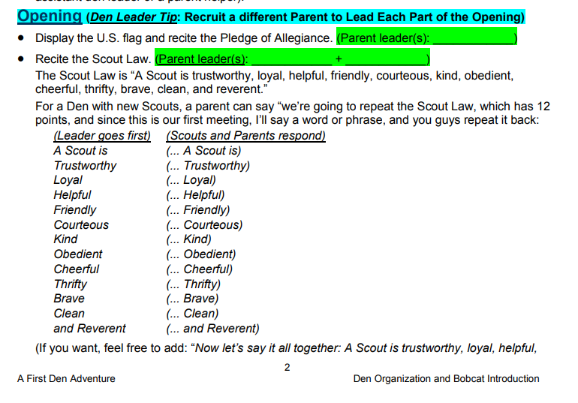
Small Part of a Den Meeting

Slide 40
Communication About Leading
At Parent Orientation …
Find the Right Ways to Make a “Group” Ask
Notes:
Find the Right Ways to Make a “Group” Ask. At some point you will have to do a “Group Ask”, and the “ask” is different depending on whether you have few leaders or lots of leaders and just need backup.
Some Den Leader Recruiting Scripts are in the downloads on this page.
Download and tailor that to your local Pack and Dens and the existing leaders and mentors you might have.

Slide 41
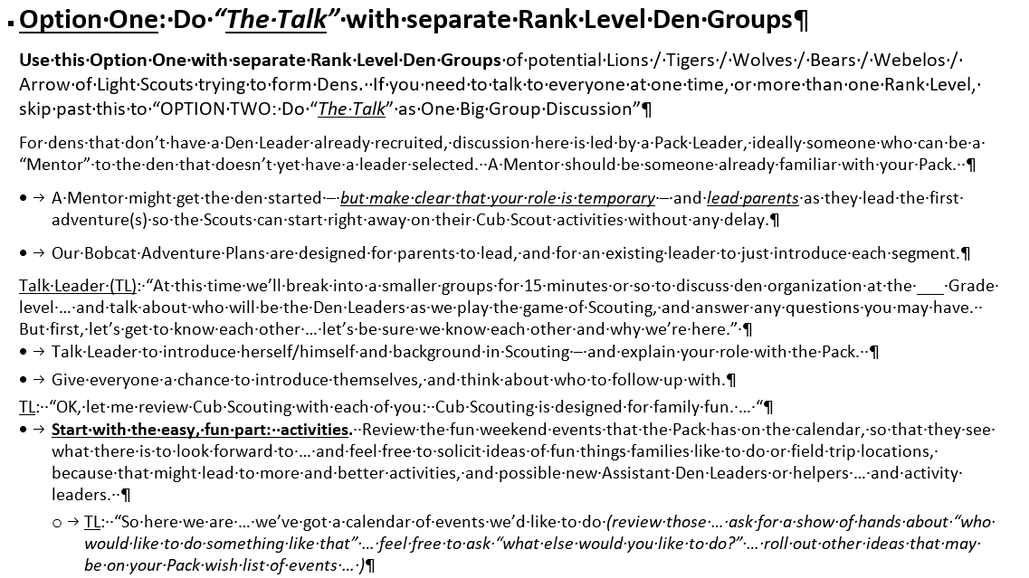
“The Talk”

Slide 42
Communication About Leading
It Works for FOS …
Maybe a Pack “Helping Out” Pledge Card?
Notes:
Be Prepared Pledge Card. Take some jobs and put them out there for signup on a “pledge card” … as one way to gather interest … just put the jobs that might gather people in, or that you need the most right now.
An example of a Troop Pledge Card is in the downloads on this page and could be adapted to a Pack

Slide 43
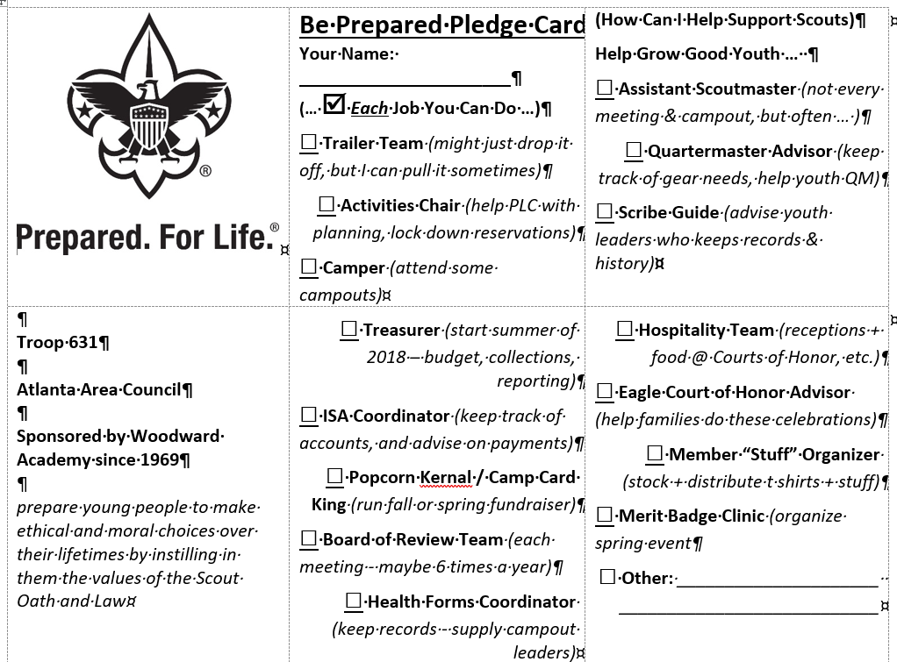
Example Pledge Card

Slide 44
Communication About Leading
Tick Tock …
The “Lifetime” Demo (a/k/a Yardstick) is Effective
Notes:
The Lifetime Demo. Whether yardstick or adding machine tape, show how little time is left to make a difference in a young person’s life … we get them from about age 6, and by age 11 or so they will be too independent …
An example of this is the “Yardstick Timeline Pack Family Recruiting Script” in the downloads on this page.

Slide 45

Lifetime Demo

Slide 46
Communication About Leading
Visualize the Present …
At Orientation, Post All Parent Names
Then Have Everyone Write In Their Pack Role
Notes:
Visualize the Present. As part of a Pack Orientation, in a room around the parents, tape up an image of each parent – simplest is a sheet of paper with name and hand outline, but you could have full body outline too.
As they get the Unit Job Chart or “Help Wanted” List, encourage them to write on their sheet their role(s).
Congratulate those who volunteer, and focus on everyone else to do the same and sign up for something.

Slide 47
Communication About Leading
Visualize the Future …
Show All Leaders Up Front … Then Let The Fifth Grade Parents Step Out
Notes:
Visualize the Future. If you have a leadership transition coming, show everyone what the future holds:
At a Pack Event, have the leaders step forward. Then show who is gone next year by having them step back.
Let parents see that they need to step up and take their places.

Slide 48
Communication About Leading
I’ll Trade …
Play Support Jobs Trading Cards – a Job “Swap Meet”
Notes:
Play Support Jobs Trading Cards. Have cards naming Pack and Den jobs, enough for everyone in attendance -- big jobs and small jobs – have multiples of some.
Hand out cards to every parent and say “this is your job, but you have 15 minutes to trade with someone else so that everyone finds a job they like”.
A set of Pack Leadership & Volunteer Role Cards can be found in the downloads on this page.

Slide 49
Communication About Leading
Dealt a Bad Hand …
Play “Cards on the Cubmaster”
Notes:
Play “Cards on the Cubmaster”. If you think your group won’t play that game and share nicely, show them how it plays out if you cover up the Cubmaster with job cards or dump on the den leader in the same way.
Take those cards naming Pack and Den jobs – call out each one – hand them to the Cubmaster.
Get dramatic about it: with each card, add “I guess this is another job the Cubmaster has to do for you”.
Bottom line: it’s not fair to cover up the Cubmaster or dump on the den leader. We need to share the jobs.

Slide 50
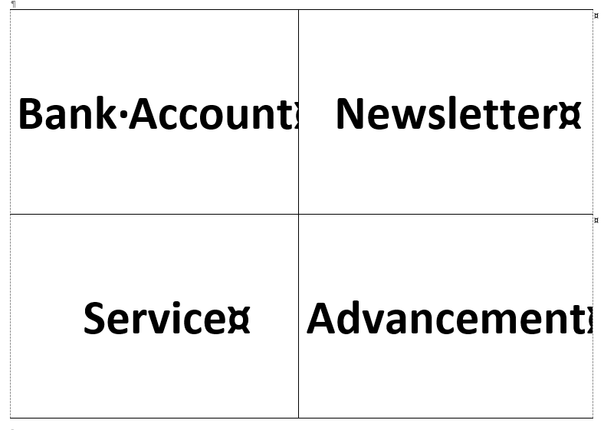
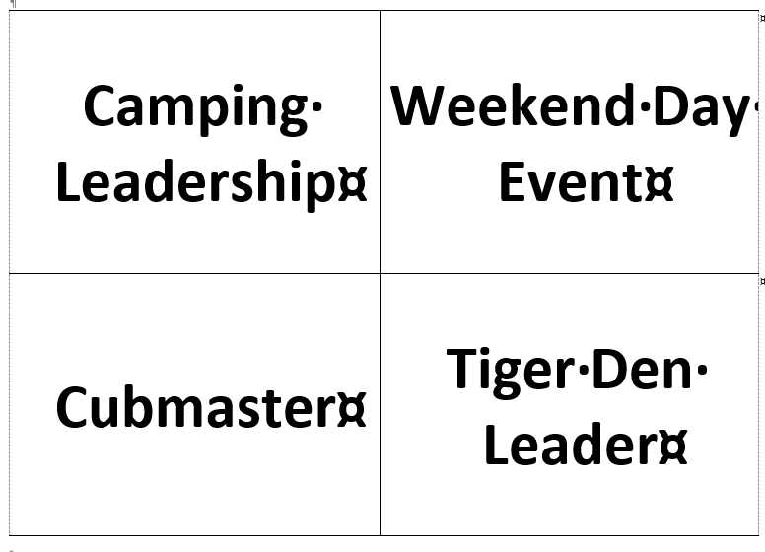
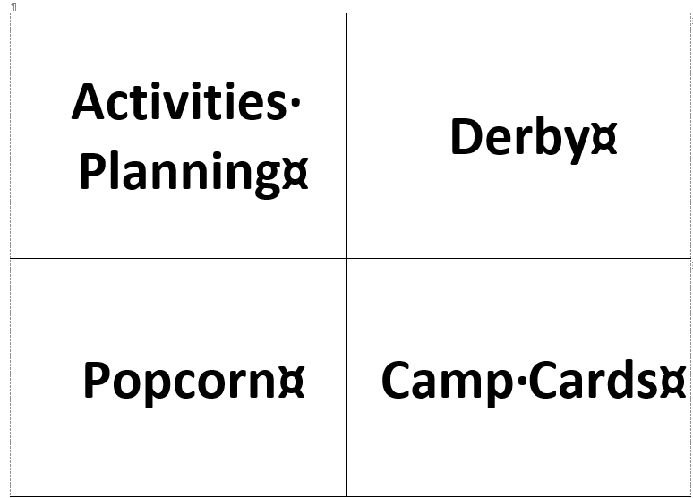
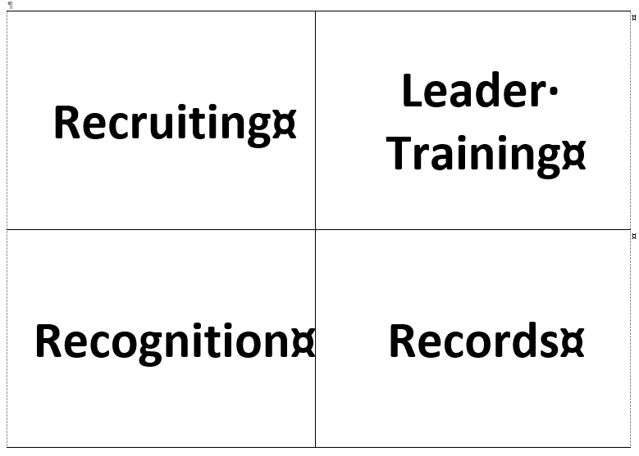
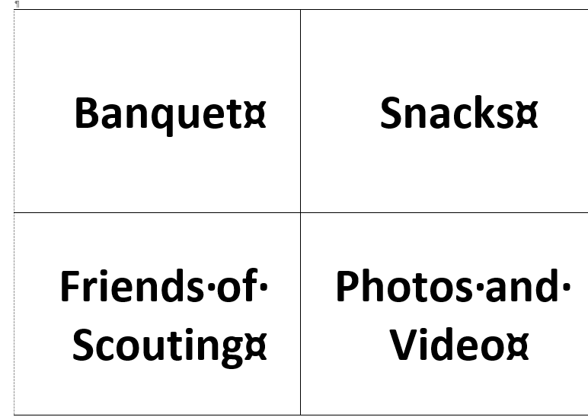
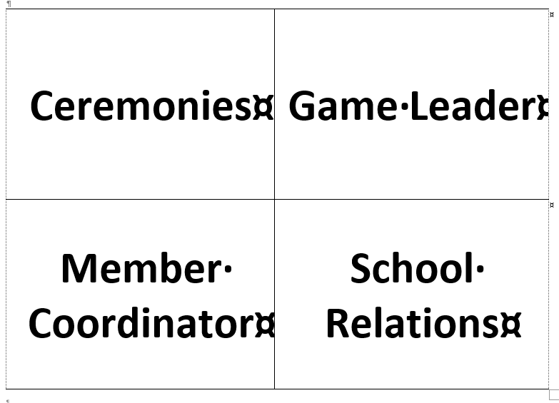
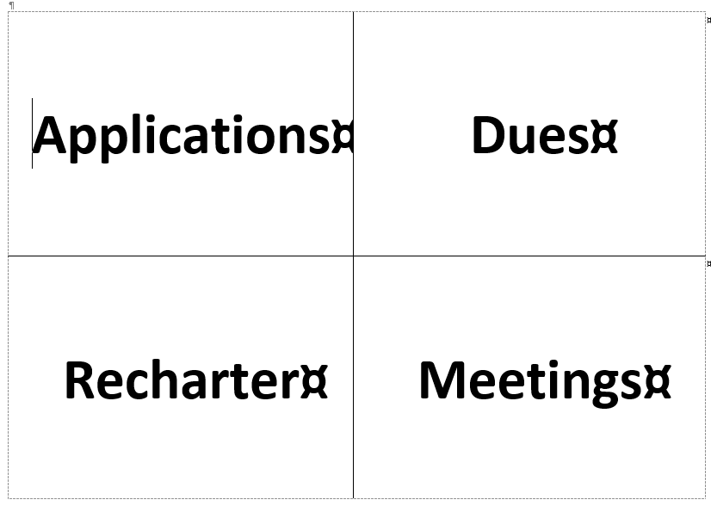
Cards On The Cubmaster

Slide 51
Communication About Leading
Juggling Jobs …
Play Balloon Job Juggling
Notes:
Juggling Jobs. A fun variation on “Cards on the Cubmaster” to show what it’s like if the Cubmaster has every role.
Toss balloons to the Cubmaster for each Unit Role and see how long it takes for the Cubmaster to drop the ball.
Throw in some wild cards like “taking care of ill parent” or “big project – longer hours at work”.

Slide 52
Communication About Leading
Ha Ha …
Play Too Many Hats On The Leader
Notes:
Too Many Hats. Ha Ha, we always talk about leaders wearing many hats. It’s funny – until it’s not.
Like Juggling Jobs … get party hats with the Job Cards on the hat, and try putting the hats all on one person.
Share the hats until every parent in the room has a hat and a job.

Slide 53
Communication About Leading
Next up…Cubmaster! …
Job Lottery
(To Send a Message)
Notes:
Job Lottery. Just to make it clear that everyone helps, pack a job, then pull a name to assign to the job.
P.S., this is not a way to actually fill jobs, but to make it clear someone’s gotta do it.

Slide 54
Communication About Leading
Keep Inside Goals Inside …
Don’t Give People an “Out” by Limiting How Many Leaders Need to Step Up
Notes:
Don’t Give People an “Out” by Limiting How Many Leaders Need to Step Up. Yes, your goal may be “we need one registered leader for every 5 Scouts” – but don’t make that your message.
Why? Everyone will think “great, 80% of us don’t have to help … let someone else step up”.
Stay on message that every parent helps so that nobody has that “easy out”.

Slide 55
Communication About Leading
You’re Invited …
Adult Peer to Peer Cards
Notes:
Adult Peer to Peer Cards. OK, if youth “peer to peer” cards are good for recruiting, why not “Parent to Parent” cards used to invite parents to help lead.

Slide 56
Communication About Leading
“He’s the Coach” …
Use a Non-Uniform Method
Notes:
Use a Non-Uniform Method. At recruiting events or parent planning meetings, maybe don’t wear a uniform. The message received might be “you uniform guys are the leaders” and “us regular clothes guys aren’t leaders”.
Show that there is no difference between current leaders and future leaders, that we’re all the same.
And that once they register they can put on their Scout shorts two legs at a time by jumping in just like us!

Slide 57
Communication About Leading
Use a Uniform Method …
Give the Shirt Off Your Back
Notes:
Use a Uniform Method – the Shirt Off Your Back “Fashion Show”. Be sure your wardrobe can do this and sizes are compatible, but if you get a potential volunteer, offer to help so much that you’ll give “the shirt off your back”.
Then do it, putting the shirt on the new volunteer to “try it on for size” … fashion runway applause should result!

Slide 58
Communication About Leading
People: Priorities Please! …
The “What’s More Important than your Kid?” Gambit
Notes:
What’s More Important than your Kid? Gather the parents around a table in a room away from the Scouts at an event. Ask everyone to place their wallet on the table. Then, ask them to move to another room (or outside).
When they reach for their wallet, say, "Oh, no, leave that here!"
When you get a few quizzical looks respond with, "You didn't pick up your kid(s) when you left the other room; are they less important than your wallet?"

Slide 59
Lure with Activities …
Sounds Fun – We’re In …
Use Your Calendar of Fun Activities as a Lure!
Notes:
Use Your Calendar of Fun Activities as a Lure! When you share your Calendar of Fun Activities you’ll get interest and reaction from some parents – take advantage of that parent interest to find out how they can be lured to lead.

Slide 60
Lure with Activities …
Have a Calendar … but …
Ask for More Ideas Too!
Notes:
Have a Calendar of Fun Activities, but Ask for More Ideas Too! You’ve set a Calendar of Fun Activities – great!
Don’t fail to ask for ideas for more fun activities. If someone has an idea for a good new unit activity … go for it.
“We’ve never done that before” isn’t a good reason not to do something new and fun … If it’s fun for kids, fun for families, and safe, it’s Cub Scouting. If you add new events, you might also add new leaders.

Slide 61
Lure with Activities …
Too Much? Not Enough? …
Over-Schedule Fun Activities
Cast the Net for New Leaders
Notes:
Over-Schedule Fun Activities. The more you aim to do, the more families might aim to make it work.
If doing things as a Pack of Families is valuable, then you can really make your Pack successful.
Put it on the list … when somebody steps up to go, maybe you’ll have a leader for that event or more.

Slide 62
Lure with Activities …
I Know What Guys Want …
What Do Dads Do?
(Do That)
Notes:
I Know What Guys Want. Most dads do something or did something before kids. Do (did) they golf, bowl, tailgate, fish, run, hoop, tennis, ski … find what they do, and make it part of your program.

Slide 63
Lure with Activities …
Moms too …
What Do Moms Want To Do?
(Do That)
Notes:
Know What Moms and Girls Like Too. Find out what your moms do too, or want to do, or did before kids … there may be great activities. Even in a “boy only” Pack, activities that include sister siblings may work out for everyone.

Slide 64
Lure with Activities …
Want a Bigger Event? …
Do Joint Activities With Other Youth Groups
Notes:
Joint Venture. If you have Girl Scout Troops and other youth groups in your community, see if there are activities that you can do together. It would be a shame if you thought “we don’t have enough people do to [this activity]” and they thought “we don’t have enough people do to [this activity]” and it turns out “[this activity]” would have worked if you just did it together … so, why not? All Scouting is Local, and use your resources!

Slide 65
Lure with Activities …
“Is There a Badge for This?” …
Fun Activities Can be the “Gateway” to Advancement Leaders (Den Leaders)
Notes:
Fun Activities Can be the “Gateway” to Advancement Leaders. When doing a fun activity like a back to school pool event, at some point some new parent will ask: “Is there a badge for this?” Your answer: “why yes there is”.
If you’re prepared, you’ll have copies of Adventure Plans for Tiger “Floats and Boats”, Wolf “Spirit of the Water”, Bear “Salmon Run” and Webelos “Aquanaut” … and you’ll enlist that parent to help teach the kids.

Slide 66
Lure with Activities …
Not “Either/Or”, BOTH! …
Make Sports Work For Scouting
Notes:
Make Sports Work For Scouting. Don’t let “we can’t do Cub Scouts – we have Sports Practice” keep families away.
A Den could build a calendar around the sports practice and game calendar.
Maybe “mini-meetings” (with snacks!) after practice or games? Recruit the whole team!

Slide 67
Lure with Activities …
Trophy Turnabout is Fair Play …
Get the Fired-Up Dad to Step Up and Lead
Notes:
Trophy Turnabout is Fair Play. The Parent who is excited about something is more likely to help! The parent asking about Pinewood might start as your car cutter or workshop leader or run the “outlaw” adult derby.

Slide 68
Lure with Activities …
No Derby Coordinator? …
No Pinewood Derby This Year!
(See if That Gets You Some Helpers)
Notes:
OK, We’re Not Doing This Activity This Year. Here’s a game for an organizing meeting or orientation session as you seek volunteers – not for when youth are around (it can be traumatic to them).
Seek signups on a sheet passed around or posted on a wall for parent volunteers to organize and help with key fun events like Pinewood Derby. Announce the need to sign up.
After giving it enough time and turning to other business, if no signups are on the sheet … crumple and toss the sheet saying “I guess we don’t care enough to put this event on, so we won’t have a Pinewood Derby this year”.
This is sort of extreme, but it can get a message across.
No volunteer leaders, no Cub Scout Activities. We all need to help.

Slide 69
Lure with Activities …
On Calendar, No Leader? …
Cancel The Activity – That Will Show Everyone!
Notes:
Cancel an Activity – That Will Show Everyone! Seriously. If you cancel, and people ask why … let them know “well, we could have done that and we asked for a leader, but – sadly – nobody volunteered – could you lead next time?”
It’s good to have an “easy” activity – like a “Scout Night” Braves game – that fails due to a lack of an organizer.
It makes people step up so that the next activity does not fall through.
This is a benefit of “over-planning” the calendar with lots of activities. Some can be sacrificed for that message.

Slide 70
Recognition
Recognize …
Repeated Recognition of Leaders and Helpers
Notes:
Recognize. Make a big huge deal about any parent who steps up and helps.
If done well, not only will other parents notice, but the Scout will push his parent for more recognition.

Slide 71
Recognition
When They Step Up …
Inauguration Ceremony?
Notes:
Inauguration Ceremony. As part of that, have a formal “Inauguration” of your new registered leaders.
Present them with their patch of leadership, give them a certificate, make a big huge deal about it.

Slide 72
Recognition
Recognize, II …
Helpers Too.
Recognize All Who Help
Notes:
Recognize, II. Did we mention that you want to make a big huge deal about “thank you” for everyone who helps??
Even if you are recognizing with just applause or a free bauble from some work conference you attended or some overstock patches from the Program Center (ask, they have them!), make it a big huge deal!

Slide 73
Recognition
More …
Honor Roll? List of Heroes?
Notes:
Honor Roll. Have a regular “heroes” recognition for those who are getting it done – leading and helping.
In a newsletter, email, Facebook post, poster on the wall at meetings, PTA … use pictures and spread the word.

Slide 74
Recognition
More …
Parent of the Month?
Stars of the Game?
Notes:
Parent of the Month / Stars of the Game. Have a recognition process for parents who help.
Maybe monthly, maybe also right after each event. Think Hockey, with “Three Stars of the Game”, or Soccer with “Man of the Match” recognition – each right after the game is over.

Slide 75
Recognition
More …
Awards: Knots and Baubles and Geegaws
Notes:
Awards. Beyond just “thank you” recognition, be sure leaders are getting awards for service.
There’s lots of official BSA awards, and you can make up your own too!

Slide 76
Recognition
Recognition Beyond the Pack …
Share Leader Applause with School, Church, Community
Notes:
Recognition Beyond the Pack. Not “instead” of Pack event recognition, but you can get a lot of mileage if you can recognize helpful parents in public ways on Church, School or Community newsletters, websites, etc.

Slide 77
Recognition
They Wrote Me A Letter! …
Thank You Notes
Notes:
Thank You Notes. Never underestimate the power of the handwritten thank you note. You’re welcome!

Slide 78
Recognition
Thanks Giver …
Have A Recognition Coordinator Role
Notes:
Thanks Giver (A Recognition Coordinator). A role for a parent who loves Scouting, but in the background.
Task them with the job of saying “thank you” to everyone who helps … share this list and all the ideas.

Slide 79
Right Size Jobs
Slice and Dice …
Cut Big Jobs Down to Size
(Light Work for Many Hands)
Notes:
Slice and Dice. Flagged above in Organizing but important: break down jobs into bite size pieces that people can do.
A person may believe “I can’t be a den leader” but if asked: “can you lead this game? (here’s the instructions)” or “can you lead this part of Bobcat? (here’s the plan)” … they can say “yes”.
They can succeed best if you share resources with them like Bobcat Adventure Plans, and Streamlined and simpler “Family Led” Adventure Plans.

Slide 80
Right Size Jobs
Plan to Assign …
Have Clear Plans for Events
Notes:
Plan to Assign. When you have an event, have specific jobs you assign to individuals.
Have sheets or cards telling the volunteers what to do, but once they lead and succeed, you’ve hooked ‘em!

Slide 81
Right Size Jobs
Den Leaders: Don’t Do it All …
Split Up Den Meeting Jobs
Notes:
Split Up Den Meeting Jobs. Get to know what people can so, and assign away. Some Ideas here.
Let the planner plan, the game leader game, the crafty one craft, the phone person take photos and video.
Have the “is there a badge for this” helicopter parent put on recognition ceremonies … use your imagination.

Slide 82
Right Size Jobs
Activities Also …
Assign Small Parts at Fun Events Too
Notes:
Assign at Fun Events Too. Yes, even if you can do it better and faster, make it your goal to assign bits of the fun event to others to lead, whether leading a game, or fun ways to do a hike, or simple instruction on a skill … have some sort of easy “cheat sheet” that shows what you want the Parent to do … let them lead and succeed!

Slide 83
Right Size Jobs
Ongoing Administrative Jobs? …
Split Those Up Too
Notes:
Split up Administrative Jobs. Don’t Dump on the Den Leader. Don’t make the Den Leader Do It All !!!
Let someone else call and poll the den about “are you coming on the campout”.

Slide 84
Right Size Jobs
The “Peter Principle” …
Get the Right Job for the Right Person
Notes:
Get the Right Job for the Right Person. A person might be a terrific den leader, leading 8 to 10 Scouts.
But that person may not be right in the role of a Cubmaster who needs to be skilled at leading 8 to 10 den leaders or a Committee Chair coordinating all aspects of the Pack and the Leader Team.
A leader has to know his limits. And if you’re recruiting you need to gauge those limits.

Slide 85
Right Size Jobs
Efficiencies of Scale? …
Share Unit Committee Membership between your Pack and Troop
Notes:
Efficiencies of Scale. Share Unit Committee Membership between your Pack and Troop.
Similar jobs can be covered in both a Troop and a Pack, like applications, popcorn, camp cards, charter renewal, Youth Protection Renewal Reminders, etc.
Plus Troop Leaders can better “mentor” Pack and Den Leaders that way … and there is a great value in having some joint Pack and Troop activities so that Arrow of Light Scouts continue in Scouts BSA Troops.
Troop and Pack Leaders can be “multiple” registered in the other unit for free.

Slide 86
Right Size Jobs
Share the “Lead” …
Rotate Den Meeting Leadership – Every Parent
(Pick Your Adventure!)
Notes:
Rotate Jobs / Every Parent is a Co-Leader. No single Den Leader? No problem if parents work together.
Get everyone together and assign events so everyone takes a turn leading.
Some Dens will assign a different parent (or team) to lead each Adventure. Here’s resources. They can do it!

Slide 87
Right Size Jobs
Avoid Mission Creep …
Protect Your Volunteers.
(What Did They Sign Up For?)
Notes:
Protect Your Volunteers. Avoid mission creep … a den leader who volunteered for a den of 8 shouldn’t be locked into an infinite number, forced to lead a den of 12 or 15 or 20 – that’s just not fair.
You’ll end up with no Den Leader and no Scouts and no program for that grade level.

Slide 88
Right Size Jobs
Numbers are Real …
There’s a Reason for Den Size Limits
Notes:
Numbers are Real – There’s a Reason for Den Size Limits. If 8 Tigers become 16 Wolves, and you don’t have 2 Den Leaders to split into 2 Dens you will lose Scouts. In most cases, the Den will revert to 8 or so. Here’s why:
Too many of the Scouts will get lost in the crowd. They won’t feel enough attention or connection with others.
Note: splitting into two dens doesn’t mean you are completely separate – only when you need to give attention or foster connection, like “Talk Time” and small group activity where Scouts need adult attention.
Openings, Closings, Games? Do those together if you want.

Slide 89
Right Size Jobs
A Good Small Job …
Use Welcoming Parents
(a/k/a New Member Coordinators)
Notes:
Use Welcoming Parents (New Member Coordinators). You’ve got parents who love Cub Scouting but don’t want to be Den Leader or Cubmaster. They might help you find the next Den Leader or Cubmaster. Here’s how:
Engage them to be “greeters” or “welcomers” at your events. Also called “New Member Coordinators”.
Be sure they know how your Pack works and how parents can be involved.
Task a team of them to welcome people to your Pack events and share your information (like a Pack Packet).

Slide 90
Right Size Your Program
Maybe …
Less Is More
Notes:
Maybe Less is More? Every Pack is different. If yours has weekly den meetings, monthly pack party, plus a pack activity, and a leader meeting and social, with all leader roles filled and with assistants and successors – congratulations! If you’re like many with few engaged leaders, you’re struggling to put on program.
Weekly meetings too much? Move to Monthly meetings. Many successful packs and dens do that.
Better to do that than burn out if you try to do too much or put people off with poor program.
If/when you get enough help to meet more often (parents energized and wanting more), then do it.

Slide 91
Right Size Your Program
Who Says “you need to” …
Don’t Be a Captive to the Calendar
(Or Council)
Notes:
Don’t Be a Captive to the Calendar. Make your schedule work for your leaders to keep them happy. Easy example: if it’s anxiety and struggle to “get the kids to rank” by a February Blue & Gold Awards Banquet (usually the “high point” of the year and the biggest attendance), why not do your Banquet and Awards later in the Spring?
Worried you’re “late” for Scouting’s birthday on February 8? Don’t. Scouting is kind. Scouting understands.
Your Aunt Millie? She won’t understand, so don’t be late for her birthday!

Slide 92
Right Size Your Program
When …
Weekday Activities (Meetings) Hard for Parents?
Why Weekdays?
Notes:
Are Weekday Activities (Meetings) Hard for Parents? This is super common. After a hard day at work, it’s hard for parents to put on Cub program. Just because your Pack “always meets on Tuesdays” doesn’t mean you have to.
You might get more parent participation – and have more fun – doing weekend activities.
It is very easy to knock out Cub Scout Adventures using a “we just meet on weekends” schedule.
And Dens don’t have to meet “all at the same time and place”.
You might have a Tuesday evening Den and a Weekend Den, each in the same grade level.

Slide 93
Right Size Your Program
Keep It Simple …
The Perfect Program is the Enemy of the Good Program
Notes:
The Perfect Program is the Enemy of the Good Program. Don’t have “den meetings” if you don’t have enough leaders to lead them (1 able leader and 1 Assistant for every den, max of about 8-10), because too big and too unplanned turns into chaos and failure and sadness.
Just do weekend fun family stuff – with simple, easy activities you can give to parents to do together.
When parents ask “when do we get badges”, then maybe you’ve primed them to be more engaged, and maybe they will be willing to help lead Den Adventures – that link has tools to help them lead.

Slide 94
Right Size Your Program
Keep the Outing in Scouting …
Don’t let “Cub Scouting” become “Cub Schooling”
Notes:
Keep the “Outing” in “Scouting”. Don’t let “Cub Scouting” become “Cub Schooling” with too many indoor meetings.
The Program is built to be outdoors, always more fun with a hike around the block or play in the schoolyard.

Slide 95
Right Size Your Program
Family Fun Means Parents too …
Make the Program Fun For Parents
Notes:
Make the Program Fun For Families. Be sure parents and families are engaged.
Don’t do a “Pack Meeting”, make it a “Pack Party”. Engage Parents as much as Scouts in games and such.
Or (see next tip) don’t do Pack “Meetings” at all – just do “out and about” Pack “activities”.
Don’t have “Den Meetings”, have “Den Adventures” … that’s what they are called in the Handbooks.
“Meetings” sounds boring. Party sounds fun. Adventure is what we want.

Slide 96
Right Size Your Program
Does It “Spark Joy”? …
If it’s Not Fun … Don’t Do It
Notes:
If it’s Not Fun … Don’t Do It. Face it. For many Packs, old-style “in the room” Pack Meetings of announcements, skits and such are often hard to produce, often not fun. If they are super fun, great! If not, make your Pack events “hands on” “go fun places” “do fun things” events. With fun activities, no one will miss pack “meetings”.

Slide 97
Other Ideas
Self-Diagnosis …
Identify Barriers to Volunteering
Notes:
Identify Barriers to Volunteering. Step back. Observe. Is there a “barrier” to volunteering, either active or passive?
Sometimes the words read “Help Wanted” but if the message received is “Help Not Wanted” or “We’ll Do This Because We Know How and You Don’t”, you might not get helpers to join your team.

Slide 98
Other Ideas
“I Did It My Way” …
Let People Do It Their Way – Even if they First Fail
Notes:
Let People Do It Their Way – Even if they First Fail. Yes, you can do it better, but you have to let people try and fail and learn. Be there to support them. Let them grow into the best leader they can be … “Do Your Best” is our goal.

Slide 99
Other Ideas
Let Leaders Learn …
If They Fail – Don’t Flog Them!
Notes:
If They Fail – Don’t Flog Them! Even if you did it better, much better, the best ever … keep it to yourself: don’t slam your successor. See something they did great – praise that. If they need help, they can trust you and ask.

Slide 100
Other Ideas
Applies to Leaders Too …
Praise in Public, Criticize in Private
Notes:
Praise in Public, Criticize in Private. Don’t grouse about non-involved parents … we want to praise behavior we want to see more of, not dwell on behavior we don’t like. (But do ask them in private to help.)

Slide 101
Other Ideas
Patience …
For Big Jobs (Cubmaster), Don’t Ask Too Early
Notes:
For Big Jobs (Cubmaster), Don’t Ask Too Early. With a strong prospect, slow and steady wins the race … and helps you find the right role for that person. Get to know the person and find the right role.

Slide 102
Other Ideas
Patience II …
“No (I Can’t Do That)” Does Not Mean “Never”
Notes:
“No” Does Not Mean “Never”. The person who says “no” now might be a “yes” later … don’t write them off.

Slide 103
Other Ideas
The Godfather …
“Someday – and that day may never come – I will call upon you to do a service for me”
Notes:
The Godfather. OK, don’t be all heavy like the Godfather (who, truth be told, did help people out and said “Someday, and that day may never come, I will call upon you to do a service for me”), but if you do a solid favor for someone as a Scout Leader, you might be able to get a favor in return.

Slide 104
A Parable About Recruiting Leaders
A Scout Unit has four parents named Everybody, Somebody, Anybody, and Nobody.
There was an important job to be done and Everybody was sure that Somebody would do it.
Anybody could have done it, but Nobody did it.
Somebody got angry about that, because it was Everybody’s job.
Everybody thought Anybody could do it, but Nobody realized that Everybody wouldn’t do it.
Then Everybody blamed Somebody when Nobody did what Anybody could have done.

Slide 105
Fifty Ways to Lure a Leader
Questions?
Part of the Steps to Successful and Sustainable Recruiting

