Slide 1

How to use Facebook while marketing your Unit.

Slide 2

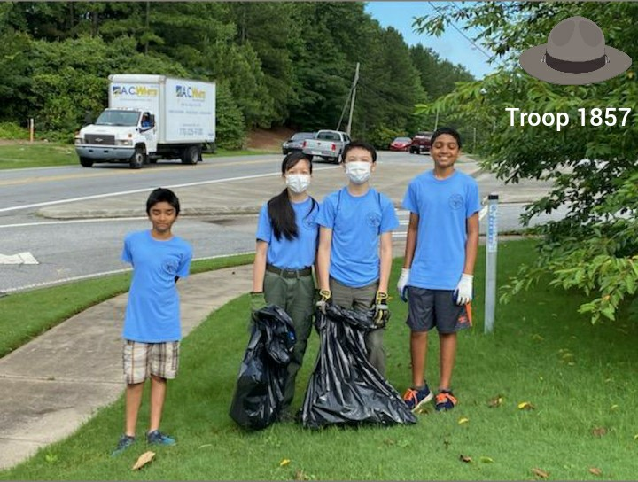
Branding:
Have a Troop/Pack hashtag
  #Troop1857
  #Lerskeylife
Have a logo that can be recognized.
Make your Post dependable.
Troop 1857

Slide 3
Stop the scroll:
White Space
Emojis
  https://emojipedia.org/search/?q=ghost
Short Posts
Tag other people/pages
Add a video, picture or a link.
Is a post better used as a public or private post?

Slide 4
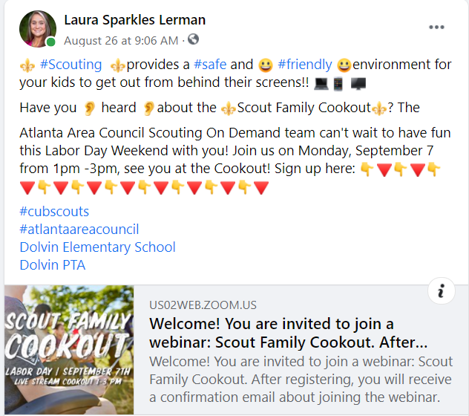
Post:

Slide 5
5 x 5 x 5:
5x5x5 – that is 5 posts on other people’s pages, five words or more in 5 minutes are less
You will want to have your post ready with tags. That way as soon as you are finished with the 5x5x5 you can post

Slide 6
Online Advertising:
Geofencing
Paid Facebook Adds
  Video Ads
  Photo Ads
  Slideshow Ads
  Carousel Ads
  Canvas Ads
  Dynamic Products Ads
  News Feed Adds
    Location
    Key Words
    Banners
    News Feed

