Slide 1

PLAN your
Best Year Ever!
Notes:
Resources at https://www.southfultonscouting.com/node/4577.

Slide 2
Today’s Take-a-ways
Key Scouting + Other Guidance on Activities
An Annual Activity Calendar You Can Use
A Menu of Activity Ideas (Build Your Calendar)
Planning Methods – Surveys and Sharing
(Ways to) Help Your Local Den Leader
Budget, Awards and Other Tools
Resources for All of the Above

Slide 3
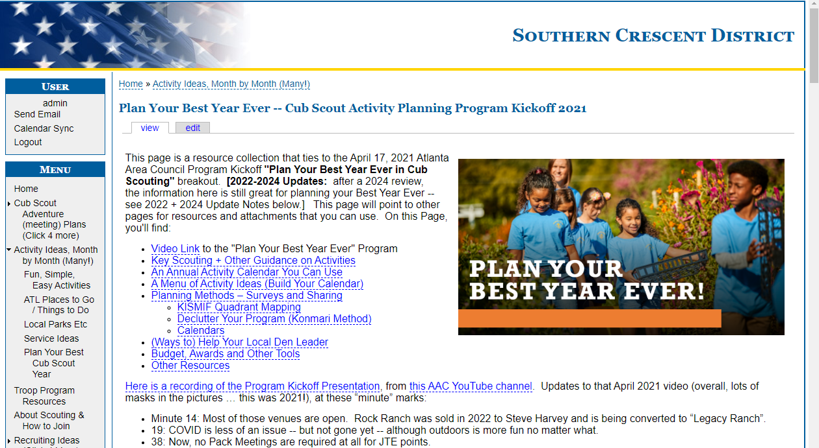
Takeaway Page

Slide 4

Today’s Take-a-ways
Scan this QR Code for that Page of Resources

Slide 5
Goal No. 1:
Build Your Best Plan
(There is no “One” Best Plan)
All Scouting is Local

Slide 6
Goal No. 2:
KISMIF, not KICMEH
Keep It Simple – Make It Fun
not
Keep It Complicated – Make Everything Hard (Kick Me)

Slide 7
Goal No. 3:
Know This:
If it’s Fun for Kids, Fun for Families, and Safe
Then it’s Cub Scouting!

Slide 8
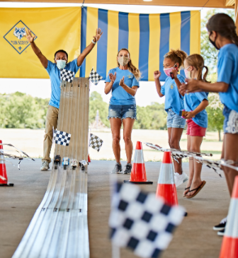
AIMS
Character growth
Citizenship training
Personal fitness
Notes:
Say (in your own words – Very Briefly):
All good things that we would like to see in our children.
8

Slide 9
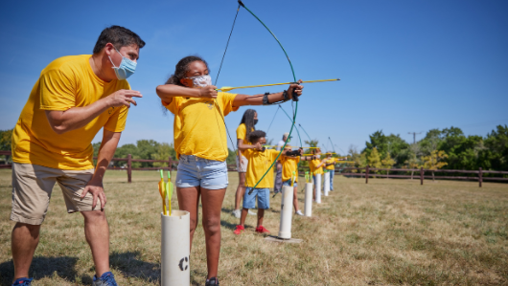

Living the Ideals
Belonging to a Den
Advancement
Family Involvement
Activities
Serving the Community
The Uniform
METHODS

Slide 10
For Your Best Year:
Scouting = Outing!
(Be Outdoor Dens + Packs)
(Make That Our Brand)

Slide 11
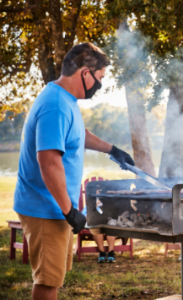
An Annual Activity Plan
April: Easy For Next Week
  Hike Near Home
May: Flying Things
  Kite Fly / Rocket Launch
  End of Year Party (B&G?)
June: Out ‘n’ About
  Day / Twilight Camp
  Night-time Star Saunter
July: Scout it Out
  4th of July Picnics
  Resident Camp
August: Back to Pack
  Swim Party(ies)
  Day with the Braves
September: Outdoor Sports
  Soccer? Golf? Discs? Kickball? Rackets?
October: To The Tents!
  Hikes at Camp(s)
  Bert Adams Campout
November: Salute!
  Veteran’s Parade
  Marbles Mania
December: Holidaze
  Holiday Party
  Family Cooking
January: Big Overnight?
  Boat/Zoo/Space/Cave?
February: Serve/Race
  Scouting 4 Food
  Pinewood Derby
March: Madness: Go Fish
  Fishing Outing

Slide 12
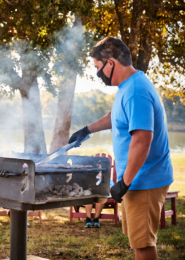
Alt Annual Activity Plan
April: Outdoor Sports
  Soccer? Golf? Discs? Kickball? Rackets?
May: End of the Year
  Fishing Fun Day
  Graduation Park Picnic
June: Dive In
  Pools Open (we hope)
  Day / Twilight Camp
July: Scout it Out
  Parades / More Sports
  Resident Camp
August: School Days
  Bike Ride Roundup
  Fishing Party
Sept: Ease into the Outdoors
  Hikes Near Home
October: Outdoors @Nite!
  Woodruff Campout
  Campfire
November: Button Up
  Bike Rodeo
  Outdoor Cooking
December: We Wish You…
  Eldercare Service
  Ski Trip to NC
January: Derby Daze
  Cutting + Racing
February: Faith + Fun
  Scout Sunday
  Nite @ the Museum?
March: Away and Awards
  End of Winter Walk
  Blue + Gold Banquet

Slide 13
Those are Just Two Examples
Your Plan Will Be Better
Use Your Resources

Slide 14


Myth: Blue & Gold Timing
Q: A Blue & Gold Banquet in May! Doesn’t B&G have to be in February?
A: Nope. A Pack can do this event at any time, or not at all. It’s your Pack.
B&Gs started as a birthday party for the BSA (DOB 2/8/1910) back when advancement work was done at home – before rank work became a den leader job. B&Gs later came to be a target date for awarding Rank badges.
Problem: Many Den Leaders face a crisis – it’s often hard to complete a Rank by February. (More on this later.)
Solution: If setting up a B&G as THE Big Rank Award night brings Advancement Anxiety, do it later. It’s OK.

Slide 15

Outdoor Ideas
Hikes (Walks)
Camping
Fishing
Biking
Boating
Swimming
Scooters
Skateboards
Skiing
Snowboards
Sledding
Spectator Sports
Kickball
Soccer
Ultimate
Disc Golf
Four Square
Croquet
Badminton
Volleyball
Geocaching
Orienteering
Scavenger Hunt
Softball
Tennis
Table Tennis
Golf
Skating
Horse Rides
Cornhole
Horseshoes
Basketball
Rain gutter Regatta
Flag Football
Cricket
Lacrosse
Bouldering
Archery
BB Shooting
Slingshots
Track/Field
Skygazing
Yoga
Kites

Slide 16
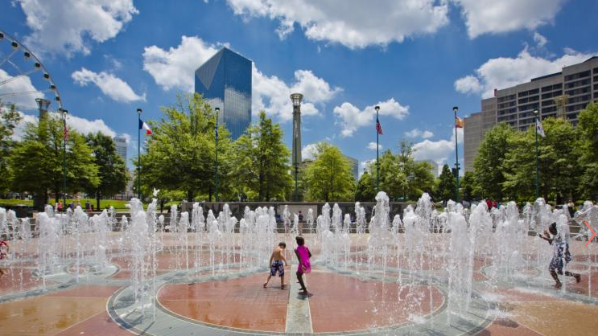
Around Town Places to Go
Georgia Aquarium
CNN Center
Civil Rights Museum
College Football Msm
Arabia Mountain
Stone / Kennesaw Mtns
Botanical Gardens
Fernbank Museum
Bike on the Beltline
SE Railway Museum
Atlanta History Center + Cyclorama
Tellus Museum
Atlanta Zoo
King Center
Conyers Monastery
Reynolds Nature Center
Oakland Cemetery
Sweetwater St. Park
Centennial Park
High Museum of Art
Children’s Museum
World of Coca-Cola
Wren’s Nest
Center for Puppetry Arts
Your Local Parks
Chattahoochee Nature Center
Skyline Park (PCM)
Peachtree-DeKalb Airport
Neighborhood Festivals
Mini Golf / Bowling
Movie Nights!
Climbing Gyms
Local Parades
Tour d’ Playgrounds
Where do your Families want to go?

Slide 17


Overnight Destinations*
Space Camp – Huntsville, AL
Patriots Point – Charleston
Zoo & Museum Overnights – ATL, Birmingham, Chattanooga, etc.
GA State Parks:
Group Camps
The “Hike Inn”
Yurt Camps
Cave Tours – TN, AL
Battleship - Mobile

Slide 18
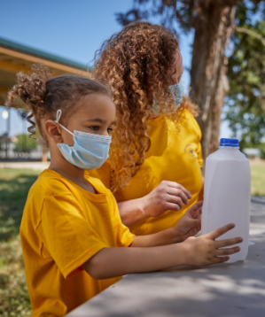
Pick Activities that are:
Fun For Kids
Fun For Families
and Safe

Slide 19
Sweet Sixteen of BSA Safety
1. Qualified Supervision
2. Physical Fitness
3. Buddy System
4. Safe Area or Course
5. Equipment Selection and Maintenance
6. Personal Safety Equipment
7. Safety Procedures and Policies
8. Skill Level Limits
9. Weather Check
10. Planning
11. Communications
12. Plans and Notices
13. First Aid Resources
14. Applicable Laws
15. CPR Resource
16. Discipline

Slide 20
Number One Safety Rule
Use Common Sense

Slide 21
Myth: G2SS is Only Safety Rules
For example, “Overnight camping by Lion, Tiger, Wolf, or Bear Cub Scouts as dens is prohibited”, says the Guide to Safe Scouting?
Q: Is this because it is unsafe?
A: No. It is a statement of a “program” decision about camping.
Does This Mean:
A Pack of only 10 Tigers cannot camp? They can.
A Pack Campout with a 25-person attendance limit must cancel if only Wolf families sign up? No. Camp with your BALOO Trained Leader.

Slide 22


Pandemic Safety
Are We Allowed? (Chartered Org, Event Location)
How Will We Do It Safely?
Guidelines:
Outdoor Better than Indoor
Smaller Better than Larger
Masks and Physical Distancing
Adult Health Supervision
More Parent Participation “Eyes”
Hygiene, Cleaning and Disinfecting
Will People Attend?

Slide 23
Planning Routes
What Did We Do Last Year? Let’s Plan a Sequel!
What Did He Have On Slide 11 – Or Slide 12 – Do We Need To Do One of Those?
Let The Leaders Plan It Out
Let’s Collect Ideas + Feedback From Everyone – Leaders and ALL PARENTS

Slide 24
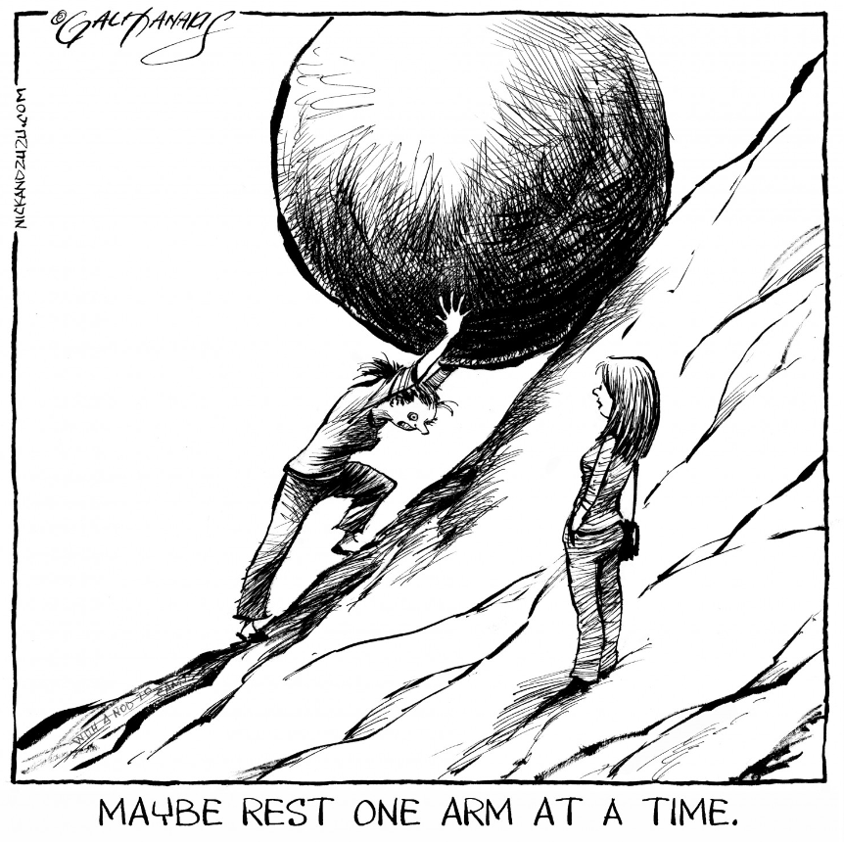
If It’s Really Hard
Planning Tip:
Why Are We Still Doing It?

Slide 25
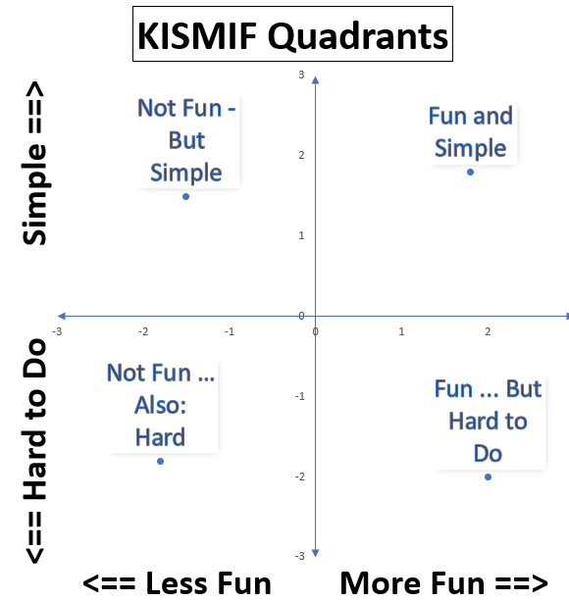
Where Should You Want to Be?
Poll your Families: What Events Are Fun?
Poll your Leaders: What Events are Hard to Lead (not Simple)?

Slide 26
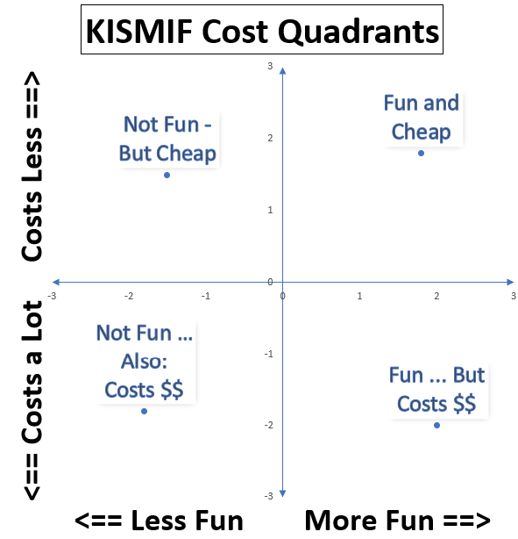
Cost Aspects of “Simple”
Disney World is Fun, but it Costs a Ton
Exploring a Park on a Hike is Free

Slide 27

Do Your Events Spark Joy?
The “KonMari” method of “decluttering” or “tidying up” your life is:
Gather your things, evaluate each, one by one: Does It Spark Joy?
If it does, keep it. If it does not, thank it for its service, and let it go.
You can de-clutter your Pack Activity Calendar too – does it spark joy?

Slide 28

What Does Joy Have To Do With Pack Planning?
More Joy means More Participation and Retention

Slide 29
Pack Program Planning
Pack Chair leads, working closely with Cubmaster, Den Leaders, Assistants, Pack Committee, Parents
Pick dates convenient for leaders!
Invite all parents to attend and participate
They have ideas about what to do
Did You Know?
Cubmaster, Den Leaders + Assistants are automatically part of the Pack Committee!

Slide 30


When To Hold Your Program Planning Conference?
Or: How Soon is Now?
Spring … to Foster Next “School Year” Planning Now!
Develop and Share Summer + Fall Highlights
Finalize all in June (July)
Winter: Update Again

Slide 31
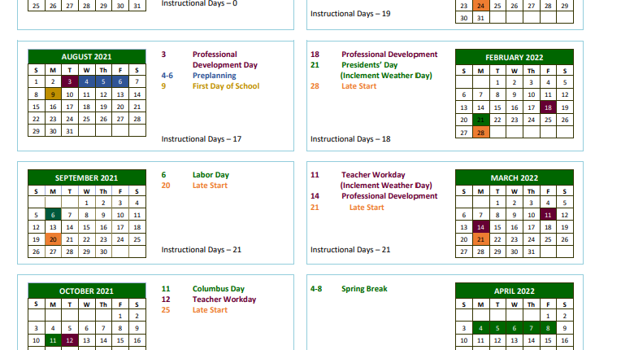
Pre-Planning: Key Dates
School Calendars:
  Open House, Start Day, Holidays, Last Day
Council and District:
  Key Events You Might Do
  Training, Fundraiser Dates
Other Organizations:
  Church, Community Events
  Religious Holidays
Leader Calendars:
  Block Out Dates When Key Leaders Can’t Attend

Slide 32

Pre-Planning: Surveys
Feedback is a Gift …
  … Surveys Can Deliver
Feedback After Events:
  Did you like it?
  Scale: 1 = Awful to 10 = Love It!
  If we repeat, how to change?
Before Annual Planning
  What would you like to do?
  Where would you like to go?
  When would you like to go?

Slide 33
Myth: No Out-Of-Council Activity
Q: We’re Only Allowed To Camp at AAC Camps, Right?
A: Nope. You can attend events and camp in other Councils.
Now, Atlanta Area Council events and camps are excellent, but other Councils have fine events too. It’s OK to “Scout Out New Places”.
Just sign up on their websites and follow their rules.
What This Means: You’ll get to do something different.
And probably you’ll tell other Packs “you gotta check out our camps”. (Thank you for being an Ambassador.)

Slide 34

Invite Everyone to Give Their Ideas and Attend
How Many People Needed To Plan?

Slide 35
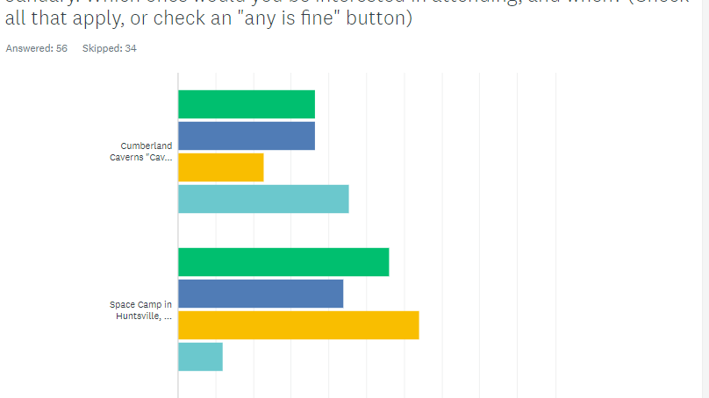
Frame The Planning Conference
Pre-Conference Planning:
Mesh Dates and Survey Results:
  Survey May Be Clear
  Or Narrow to Final Choices
Add Other Elements
  Event Leaders / Teams
  Open Den and Pack Leader Roles
  Den Meeting Dates
Budget and Fundraising
Other Pack Policy Issues

Slide 36
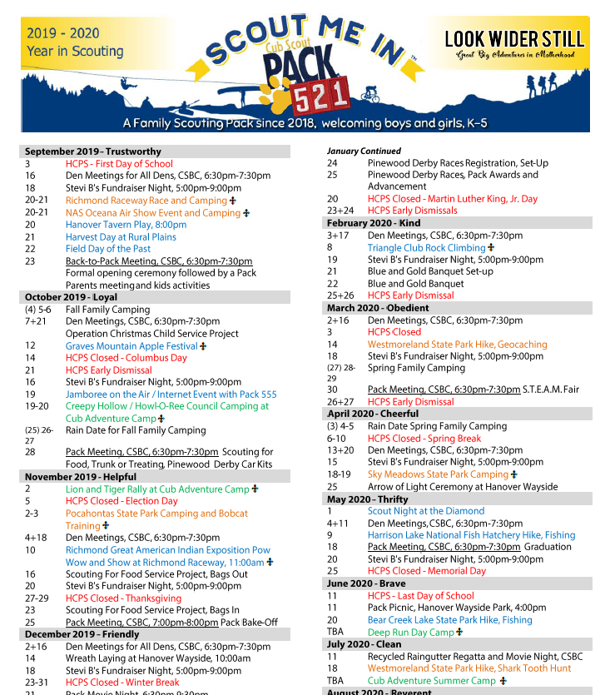
Fill the Calendar
Pack-wide Events
  Month by Month
  Activities? Meetings?
  Advancement Activity?
  Recruiting Events
Other Events
  District/Council/School
Den Activities (“meetings”)
  All Same Day/Time?
  Or Each Den Decides?

Slide 37
Myth: Must Do Pack “Meetings”
Q: Didn’t Journey to Excellence (JTE) standards require holding some number of pack meetings every year?
A: It did. But … no more. That’s gone.
There are requirements for Pack Activities. But not “Meetings”.
What This Means: A Pack Activity schedule of Pool Party> Bike Ride> Hike> Campout> Park Service Project> Derby> Scouting 4 Food> Fishing> Campout > B&G> Kites/Rockets > Fun Field Day … need not add indoor Pack “meetings”.

Slide 38

Obligatory
Pack Meeting Statement
I am all in favor of Pack Meetings.
If they are fun.
I like Awards and Cheers and Skits and Songs and Walk-Ons.
So:
If you like Pack Meetings, and they are fun, do them!
If they are a struggle, and not fun, consider maybe … not.
P.S.: I like Awards, Cheers, Skits, Songs + Walk-Ons most at a Campfire! Fire Good!!!!

Slide 39
Den Gatherings:
Which is Better?
Meetings? … or Adventures?
Indoors? … or Outdoors?

Slide 40

Apply the Funmeter!
As you finalize your calendar:
Look at your Calendar of Activities
Is it Exciting and Appealing to Kids and Families?
Will New Families Want to Join You?

Slide 41
Den Gatherings:
Which is the Right Way?
Once a Week
Every Other Week
Once a Month
Answer: That’s a Trick Question.
Each is fine if that works for your Den Families and Leaders.

Slide 42
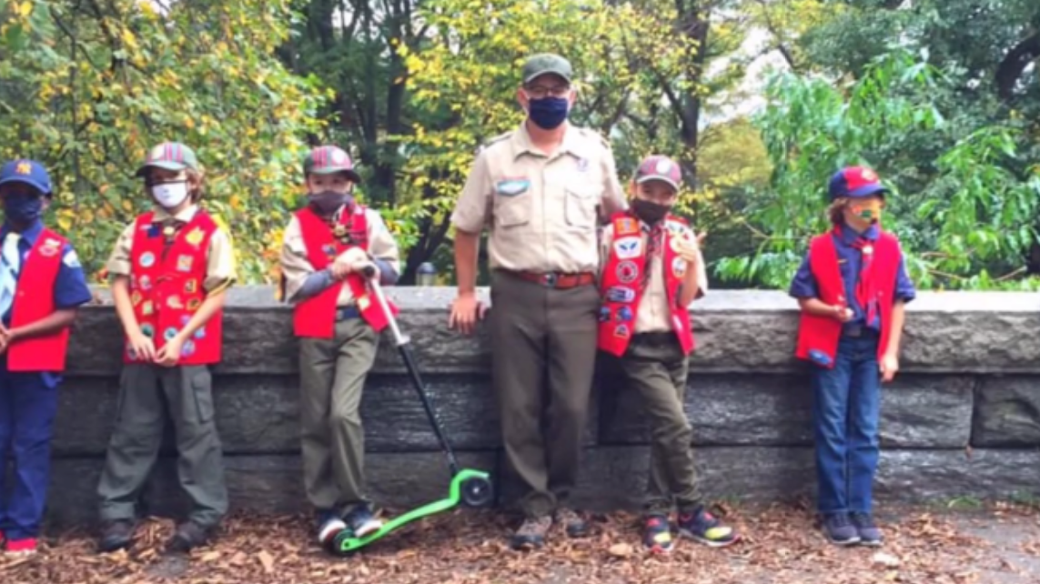
Program Planning + Den Meetings
(Den Adventures)
Pick a Plan – or Plans:
Maybe All Dens Meet at One Time in One Place (spread out safely)?
Maybe They Pick Their Own Time and Place (or Places to “Scout out”)
Maybe Some (Lions + Tigers?) Can Do a “Tour de Playgrounds”
Maybe some Weekday Dens and some Weekend Dens
Sports Team = A Den?

Slide 43
Supporting Family Led Activities ➔
Many More Atlanta Area Council Resources for All:
Cub Scout Advancement Resources:
Adventure by Adventure Resources
Help includes videos, website resources and more – helps Parents lead Dens
www.atlantabsa.org/CubScoutAdvance
Recruiting Resources:
Ways to Help Turn Parents into Helpers …
… and Helpers into Leaders
www.atlantabsa.org/RecruitingLeaders

Slide 44
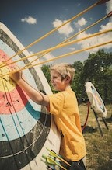

How Do Successful Packs Recruit?
There Is No Single Silver Bullet
But We Have Many Arrows To Hit The Target!
Guide to Cub Scout Family Recruiting
AAC Recruiting Resource Web Pages
Notes:
Given all that, recruiting is hard. There is no “one thing” that will result in sustainable success, no “silver bullet” you can use. But in the Guide and in our Recruiting Resource pages we’ve collected – from Atlanta and around the country – many ideas that work. Not all the time, not in every Pack or Den, but we’ve got many arrows you can put in your quiver as you aim at recruiting families.
We have a Guide to Cub Scout Family Recruiting to show how recruiting can be successful.

Slide 45

Steps for
Successful Recruiting
Calendar
Build a Calendar of Fun Activities!
Promote
Pack People Promote Their Pack Program
Leaders
Recruit Helpers and Leaders. Everyone.
School
Pack Builds Close Relations with School
Sign Ups
Fun Events and School Sign-Up Nights
More Fun
More Den + Pack Activities + Joining
Notes:
These are the Six Steps. And School Sign-Up Night or other big Sign-Up events doesn’t come into play until Step Five, after you’ve built a foundation from the first four steps. Truth be told, if you work the first four steps, you can have great recruiting results well before any Sign-Up Event. Let’s dive into those steps.

Slide 46

Share How to Help

Slide 47
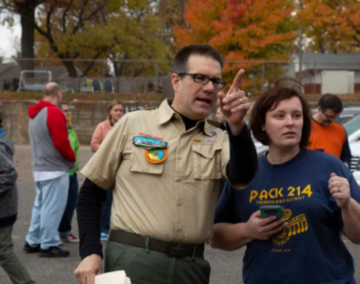
Support Your Local Den Leader
Pack “Every Parent Helps” Policy
Share Adventure (meeting) Resources
  Share with Leaders
  And with All Parents

Slide 48
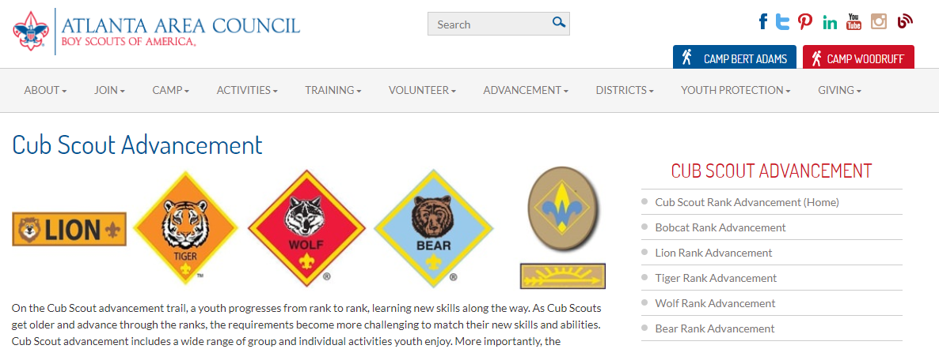
Adventure Resource Pages
Rank by Rank, Adventure by Adventure – including Plans for “Mixed Grade” Dens

Slide 49
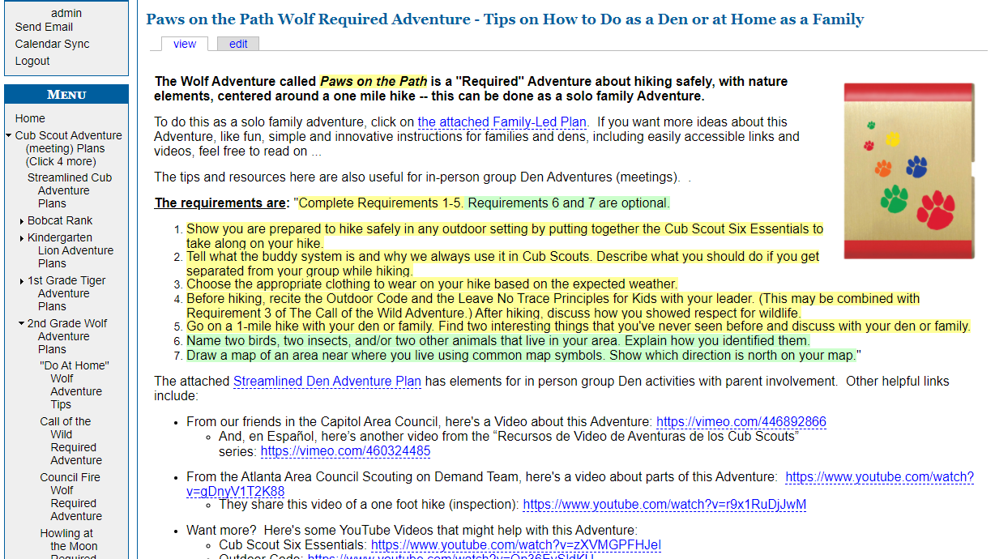
Adventure Website Pages
Requirements
Den Leader Guide Plans (other versions as needed and written)
Videos and Other Links

Slide 50
“Out Of Handbook” Adventures
Someone Says: I know your Scouts love Pets – but only 3rd Graders can earn the Critter Care Loop, because the only Adventure about Pets is in the Bear Handbook. Nobody else can earn that Loop!!!
Response: Lighten up, Francis. Gee whiz, if other Scouts complete the Requirements, recognize them and award it! For them, it’s just a Loop.
Keep It Simple, Make It Fun – if there is a Loop or Pin you like:
Just do it.
It’s just a loop.
Easier than making up different requirements + awards.

Slide 51


Pack Budgeting
After All, Somebody’s Got To Pay For All This

Slide 52

Budget Basics
Treasurer Budget Process:
Project your costs
Determine dues/revenue
Collection Options
Annual Payment? Monthly Dues?
Payments for individual items?
Fundraiser (Popcorn, Camp Cards)
Accounting Reports
Budget, Collections, Payments

Slide 53
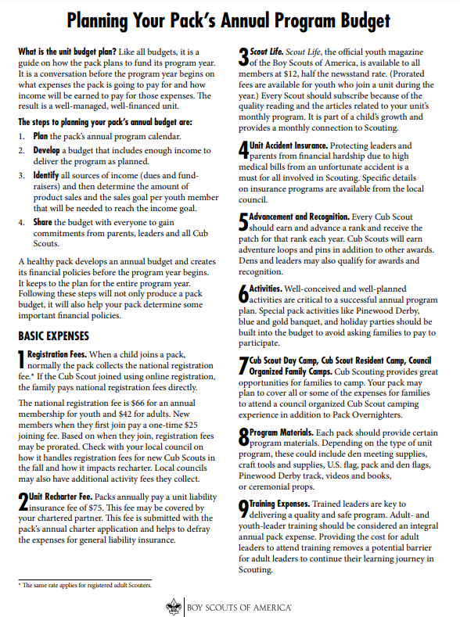
Expenses A Pack Must Pay
A Program Year Budget Must Include:
BSA Registration Fees for the Next Program Year:
  Unit Recharter Fee = $100
  Youth Registration Fee = $85*
  Adult Registration Fee = $65*
* = could be paid directly by the family
There are more costs you will likely want to include in the budget.

Slide 54
Expenses A Pack Might Pay Directly
Out Of Pack Budget
Handbooks
Badges, Loops, Pins
Other Awards (JTE Patch? AoL Arrows?)
Some Uniform Parts
Scout Life Magazine
Adult Registration Fees, Training Costs
Program Stuff (Books, Kits, Admissions)
Admin Stuff (Website, Photo Site, Software)
Pack T Shirts
Event Costs (Key Events)
  B&G Banquet
  Derby
Other Events?
  Key Campouts
Stuff Costs (Trailer, Gear, Flag, Décor)
Pack Funding Help
Leader Awards / Thank You Gifts

Slide 55

Revenues
Choose (combine) from these:
Pack Dues (annual, monthly or other)
  Consider ease of collection/administration
Council-Approved fundraising:
  Camp Cards and Popcorn Sales
  others need plans and approval (no “soliciting”)
  Fundraising offsets Pack Dues otherwise due, event costs
Goal: make Scouting affordable to everyone:

Slide 56

Balancing the Budget
Granular Details on Expenses:
Project Your Pack Size – that $100 Unit Fee is:
  $1 per Scout w/100 Scouts
  $10.00 per Scout w/10 Scouts
Advancement Bling:
  How Many?
  Every Adventure?
  Or “enough for the Rank plus 1, 2 or 3”?
Other Pack Expense Items
Dues Calculation – Start With:
(Total Projected Expenses) divided by (Total Scouts)
Equals: Per Scout Cost
No Fundraiser? That’s Your Dues!
Fundraiser? ☑ Then Estimate Total Per Scout Collections for Your Net Dues Number
Individual Scout Accounts?

Slide 57

JTE: Will This Plan Score?
Probably. Guaranteed Points With This Plan:
1. Planning + Budget ☑ (Share Calendar/Budget for Bronze. Add a planning event for Silver, orientation and ScoutBook for Gold)
2. Recruiting ☑ (Recruiting event and BeAScout = Bronze. New Lion + Tiger dens get you to Gold)
4. AoL-to-Scouts BSA ☑ (2 events with a Troop = Bronze. 60% crossover for Silver, 80% for Gold)
6. Activities ☑ (1 = Bronze. 2 for Silver. Add Derby and B+G for Gold. Still too few activities!)
8. Service Projects ☑ (One if recorded! 30 minutes per person for Silver, 50% participation = Gold)
9. Volunteer Opportunities ☑ (Share a List = Bronze. Return Den Leaders for Silver, Succession Plan for Gold)

Slide 58
JTE: Other Categories
Likely Points – Depending on Attendance and Leaders getting Trained:
3. Retention ☑ (a fun for kids and family program should retain 62%/70% at least, plus parents helping)
5. Advancement (90% earning Bobcat Adventure, 80% with 6 Adv. for Silver, and 75% with Rank for Gold)
7. Outdoor Activities (One BALOO = 51% Cub Scout participation. More of both for Silver/Gold.)
10. Trained Leadership (Cubmaster, Chair + 2 Committee = Bronze, more by DLs for Silver and Gold)

Slide 59
Takeaway Page

Slide 60
Today’s Take-a-ways
Scan this QR Code for that Page of Resources

Slide 61
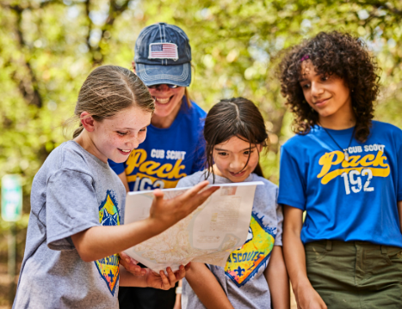
Questions?

