Slide 1


2026-27 Atlanta Area Council Membership Plan
Notes:
Minor updates from the 2025-26 version previously posted … mostly related to AAC Swag.

Slide 2
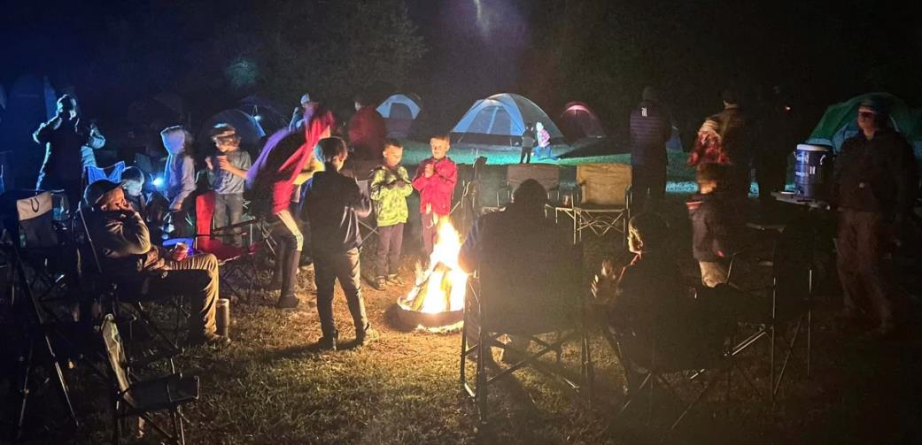
– You Are Why We Will Grow Scouting
First … Big Thanks to Our Adult Leaders
Notes:
The Scouting Program succeeds – and grows – because of the efforts of Volunteers at the local unit level. The roles of District, Council and National personnel is to support local units.

Slide 3
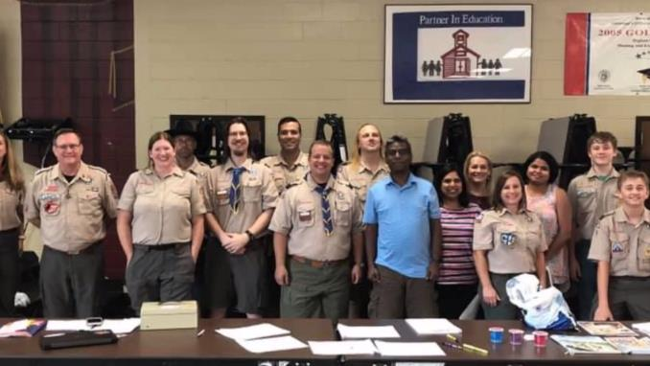
What Units Need to Know Now
Big Change started in 2024 – Pack Run Recruiting
Steps to Successful and Sustainable Recruiting
Details of Pack-Run School Sign-Up Nights
Year-Round Recruiting: Seasons of Cub Scouting
Notes:
Summary of the Big Topics Tonight:
Switch to “Pack Run” Recruiting, not “Professional Run”
Review of What Works: Six Steps to Successful and Sustainable Recruiting
For Units, a dive into details of putting on Pack-Run School Sign-Up Nights and other Joining Events
Recruiting Year Round? Right. We’ll look at the seasons of recruiting.

Slide 4
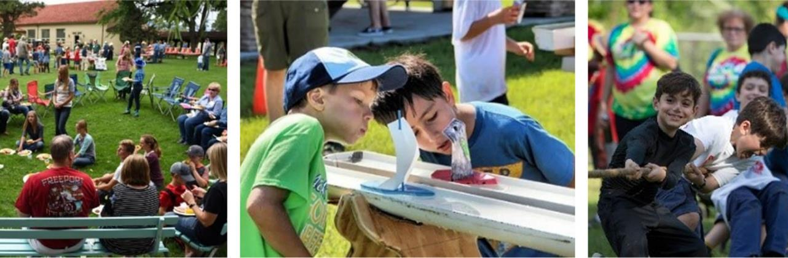

Big Change Started in 2024:
Pack Run Recruiting

Slide 5

How School Sign-Up Nights Were (Too Often) Run
Often – No (or not enough) Pack Participation
Notes:
Too often “Recruiting” was done mostly by a District Executive, working alone with Schools, and leading – sometimes with only 1 Pack Leader, sometimes with No! Pack Leader – the School Sign-Up Night.

Slide 6
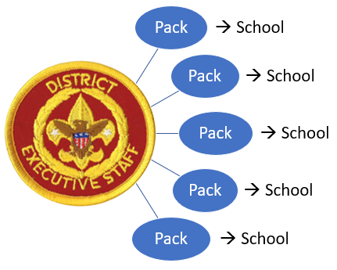
A Better Way?
Empowering Packs = A Recruiting Force Multiplier
Notes:
Maybe Using District Professionals Differently can have a big payoff. DEs can train and coach Pack Volunteers about how to Recruit, and those Pack Volunteers can (with any needed DE coaching) work with Schools and run and lead Sign-Up Events.

Slide 7
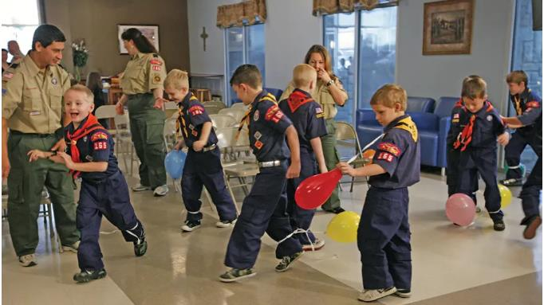
Why Do We Want To Put Packs In Charge?

Slide 8
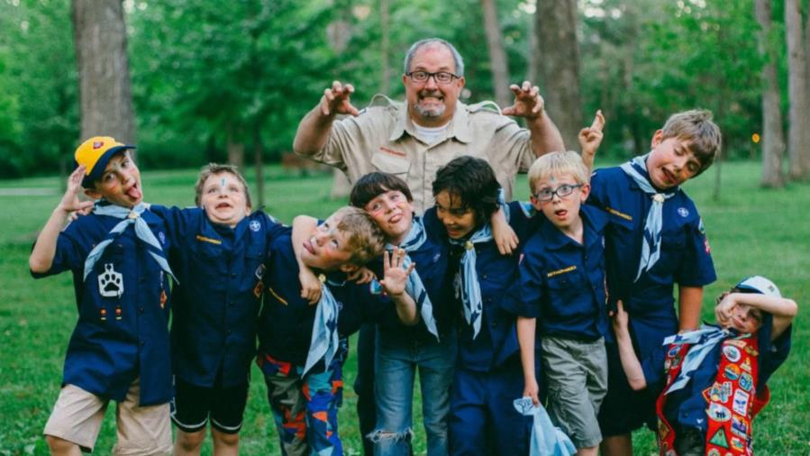
It’s Your Local Pack Program!

Slide 9
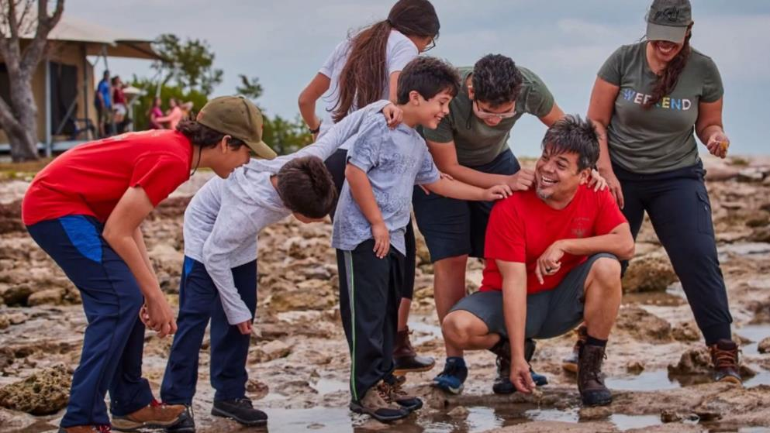
Your Pack People Can Sell What You Do Better

Slide 10
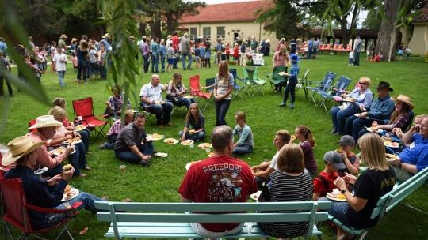
Packs Know Their Local Needs Best

Slide 11
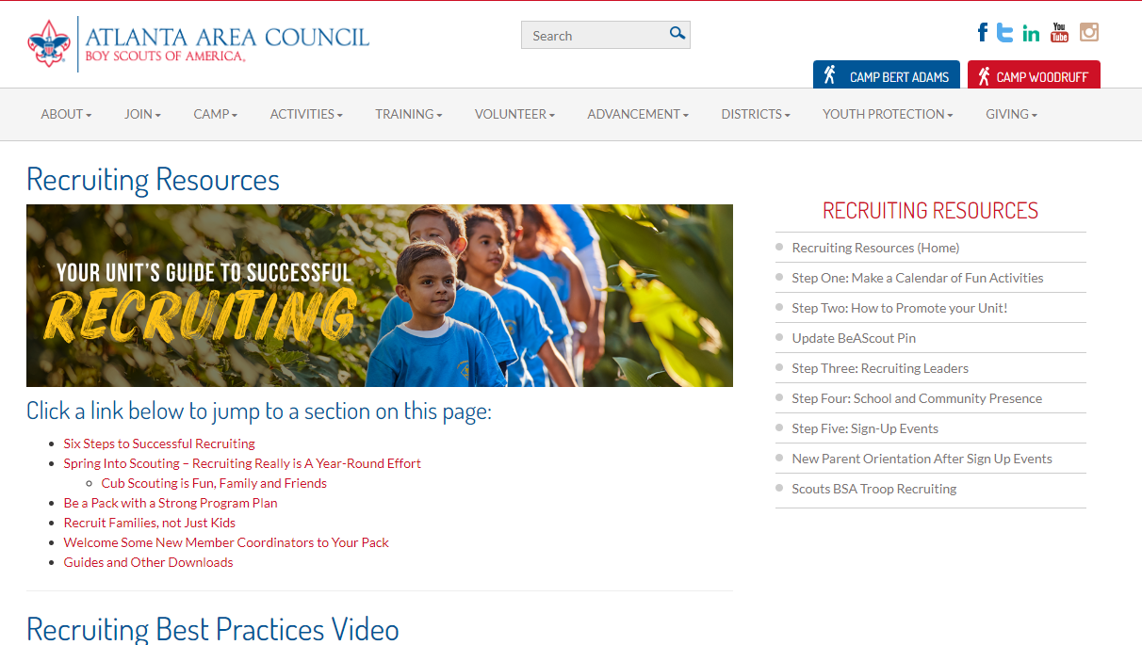
Many Packs Already Apply The Plan
Notes:
The Six Steps to Successful and Sustainable Recruiting are still pretty much the same – only School Sign-Up Night leadership has changed. Why? Those Six Steps were found in successful Packs – we’re just promoting what works.

Slide 12

Recruiting Steps Help Packs Plan + Succeed
Notes:
If a Pack isn’t using those Best Practices, getting District training and coaching will help Units be more successful.

Slide 13
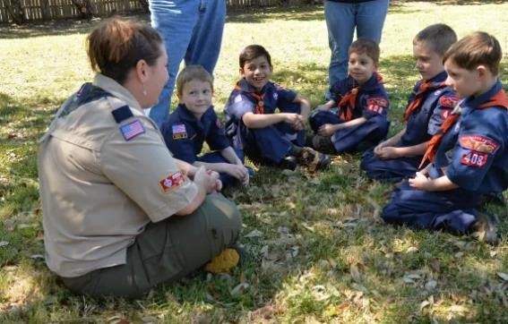
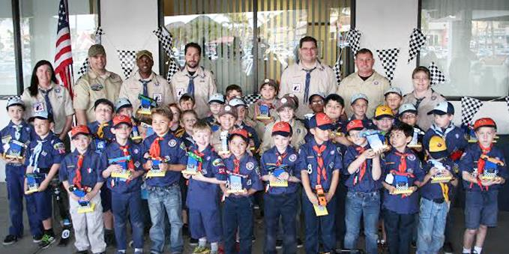
Pack Needs – or Capacity – Varies
Main Issue: How Many Engaged Leaders
Notes:
A common need – and a primary driver of Unit Success – is having enough trained and engaged leaders to lead the Scouts.

Slide 14
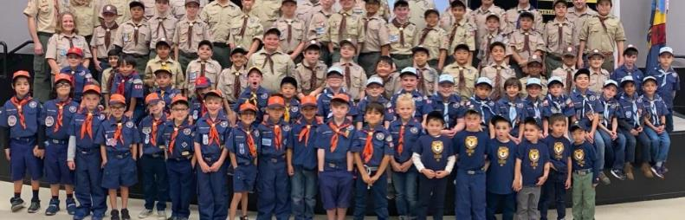
Can 2 Leaders Lead 70 Scouts?
Should We Recruit 70 Scouts To A 2 Leader Pack?
Notes:
Many Packs have just 5 leaders on the Roster – the bare minimum number of leaders. And often only a few are directly leading Scouts as Den Leaders and Cubmasters. Can that Pack absorb 40 or 50 or 60 new Scouts? Data and experience says: No.

Slide 15
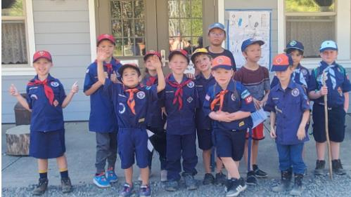
Too Many Youth + Not Enough Adults = Trouble
Notes:
Youth want to have the fun of Scouting but need Leaders to be successful.

Slide 16

District Executives Did Great School Sign-Ups – Lots of New Youth
Notes:
Let’s pause to note a fact … AAC has fantastic District Executives. They have a proven track record of successful recruiting, or, as the kids say, they have “mad skills”.

Slide 17
It Is Professional + Volunteer Collaboration
Pack-Run Approach is not “Pack Goes It Alone”
Notes:
The new approach does not take the District Professional “out” of recruiting and put the Pack “in” to sink or swim. Instead, like a double helix DNA, there will be a joinder of the two strands – Professionals and Volunteers.

Slide 18

Professional Recruiting Role – Coach + Support Unit Leaders
Notes:
For District Executives, instead of setting up, running and being the sole or main speaker at School Sign-Up Nights, the District Executive will train and coach and support Pack Leaders.
That way, Pack Leaders will be able to set up, run and be the speakers at School Sign-Up Nights.

Slide 19
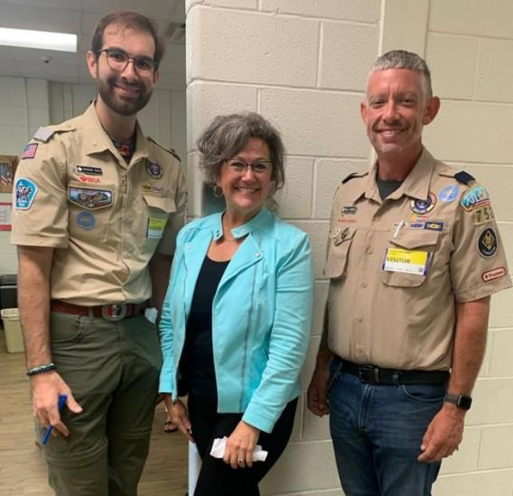
District Professional Coaching of Leaders
District will Share and Review:
Guide to Cub Scout Family Recruiting
Plan and Script for Sign-Up Events
School Playbook: Coaching for School Sign-Up Nights
AAC Recruiting Resource Pages
Notes:
District Professionals will still be very busy working on Recruiting. But instead of running and leading School Sign-Up Nights, the primary focus will be on training and coaching Pack Volunteers to be successful at Recruiting – by sharing and coaching about these resources found on the Atlanta Area Council Recruiting Resources pages.

Slide 20

Steps for
Successful Recruiting
Calendar
Build a Calendar of Fun Activities!
Promote
Pack People Promote Their Pack Program
Leaders
Recruit Helpers + Leaders. Everyone.
School
Pack Builds Close School Relations
Sign-Ups
Fun Events + School Sign-Up Nights
More Fun
More Den + Pack Activities + Joining
Notes:
These are the Six Steps. And School Sign-Up Night or other big Sign-Up events doesn’t come into play until Step Five, after you’ve built a foundation from the first four steps. Truth be told, if you work the first four steps, you can have great recruiting results well before any Sign-Up Event. Let’s dive into those steps.

Slide 21
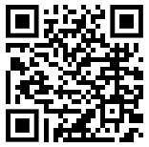

Recruiting Step One:
Build a Calendar of Fun Family Activities
Notes:
Step Number One is: what do you do in Cub Scouting. No, not “when do you meet”, but what do you do – what’s fun and exciting and appealing to kids and parents, that will make them perk up at your Pack Program and say: “Scout Me In!”
Because that’s a great hook for families, especially families that want to be engaged and active, and not just dropping their kids off every other Tuesday for an hour while they run errands.

Slide 22

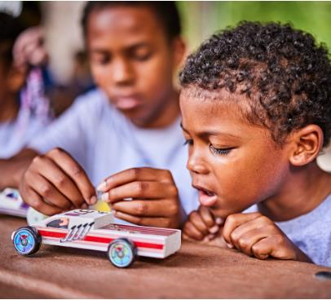


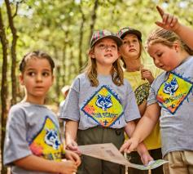

What You Do …
What You Do …
Is Why They’ll Join
Notes:
Unless a Parent has fond memories of Cub Scouting, they need to learn about “What You Do”. Not “when you meet” (though please share your plan for that) but “What You Do” when you do get your Den and your Pack together.

Slide 23

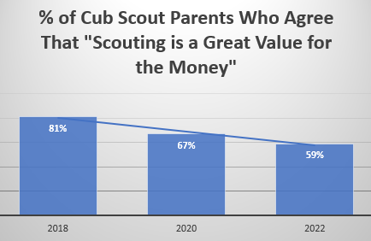
We Need To Show Value To Families
It’s A Fact
Notes:
Selling up front “What You Do” helps address the growing concern that Scouting is Not A Great Value for the Money”. Note that from 2018 to 2022 there was a 22% drop in this “Value for the Money” concern … and that was before a family had to pay up front for a full 12 months.

Slide 24
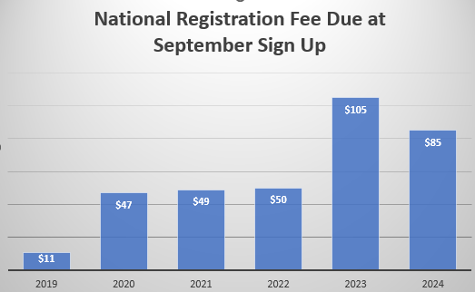
Initial Cost is a Barrier to Joining
At these costs, fewer Families are willing to “Take a Flier” on a Cub Scout Program that may – or may not – take off.
Notes:
Once upon a time, a family could drop a much smaller amount at a Fall Recruiting event – and many would, even if it wasn’t clear that the Pack would have enough leaders or launch a robust program.

Slide 25
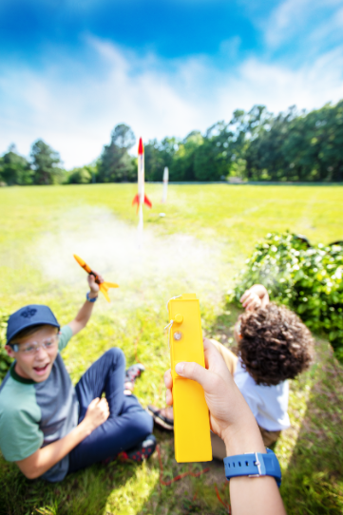

To Show Value – Build Your Program
Notes:
So, Packs should build a plan now to show Value. Ideally by seeking feedback from all current families, like “what do you want to do this year”.
Now, you could do the “lather, rinse, repeat” method of program planning, where this year’s plan is a sequel to last year’s plan, but don’t get stuck in a rut. Scout out new places. On the next slide is one way to come up with a plan.

Slide 26

One Annual Activity Plan
August: Back to Pack
  Swim Party!
  Night with the Braves!
September: Get Out + Scout
  DragonCon Parade
  Walk in the Woods Day
October: Tents! Trunks!
  Bert Adams Scout Camp
  Trunk or Treat
November: Salute!
  Veteran’s Day Parade
  Bike Ride Day
December: Holidaze
  Holiday Party with Family Cooking Potluck
January: Big Fun Overnight!
  Patriot’s Point? Cave?
February: Serve/Race
  Scouting 4 Food
  Pinewood Derby
March: Take Off!
  Kites + Rockets
April: We’re Gonna Shine
  Nature Center Hike
  Spring Camp
May: End of School
  B&G Awards Banquet
  Fishing Outing
June: Out ‘n’ About
  Day Camp
  Boating Day
July: Scout it Out
  4th of July Picnics
  Resident Camp
Notes:
This example was put together by one person. Not that you should put a plan together with just one person – do invite all to participate – but it does take one person to pitch even one event idea and prime the pump for others to participate.
Review some of the points on the Calendar.
Note the wild idea of a May Awards Party/Blue & Gold Banquet. What? Don’t we have to do that in February? Since Scouting was born on February 8? Nope. May is fine. End of the Program Year. Scouting is Kind and is OK if you hold the Birthday Party for Scouting after February 8 and at a time that is easier for Den Leaders and families. (Scouts who wrap up Rank can be recognized earlier, and again at the B&G.)
And this isn’t a perfect plan – while I’d be happy putting this on a “Pack Packet” flyer (more on this later), I know that I’m not going to be the lead on all these events, and what I put out there will add a legal disclaimer like “events need leaders and plans for us to pull these off – but we have a great start of ideas”. But when people see the ideas, they’ll react to them, maybe even suggest new activities.

Slide 27

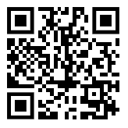
Resource Page with YouTube Link ➔

Slide 28

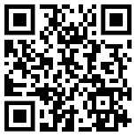
Recruiting Step Two
Promote Your Pack Program
Notes:
You can have the Perfect Pack Program, but if it is only “announced at meetings” or written into Committee Minutes, we’re missing the mark.

Slide 29
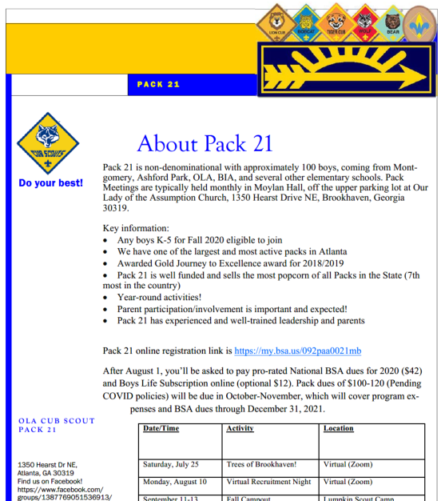
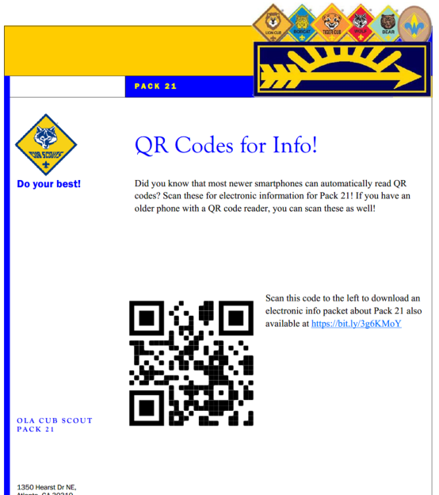
Share Your Story – Flyers, Social Media and More
Notes:
Promoting Your Pack Program Starts with your current families – let them know what the plan looks like, get their feedback, maybe more ideas.
Then reach out to those who started with you in 2019, and dropped. Share how you’re Back with the Pack, and invite them to come back in.
Then reach beyond those current and former families, not just by the Cubmaster and Den Leader, but by giving Power to the Parents: give them encouragement and tools to share your Pack Program with friends, neighbors, and fellow class parents.

Slide 30

Many Messaging Methods
“Pack Packet” Flyer with your Pack Fun Activity List
  And Photos of your Cubs
  And QR Codes – Website + Email
Social: FB, Insta, Twitter, TikTok, Pinterest & More
  Videos and Pictures of What Your Pack Does!
Newsletters, Websites + Bulletin Boards at:
  School and Church and Neighborhoods
Yard Signs / Standees / Posters / Tri-Folds / Stickers
Peer to Peer Cards / Letters / Post Cards
School Delivery – Inside, Carpool, PTA
Parent to Parent Calls and Chats
Emails and texts: blast and personal
Notes:
There is no one way to deliver information today. But a key tool is to have a handout – we call it a “Pack Packet” – that you can give to parents to let them know who you are, what you do, and lead them to both more information and how to sign up.
You can share that in many ways – hard handouts, emails, texts with a link, websites (not just a Pack website or FB page, but also on school, church and community sites like NextDoor and more).
From the Atlanta Area Council, you can get Yard Signs, Standees, Flyers, Posters and more.
When school comes back, if you’ve got good rapport with the school, you can get delivery of both (1) a general Pack Packet Flyer, and (2) Sign-Up Event flyers. Or not. Maybe they won’t distribute them inside. You can ask if you can distribute outside, like in the Car Pool line. Or at PTA/PTO events. Or have your parents email to others.

Slide 31

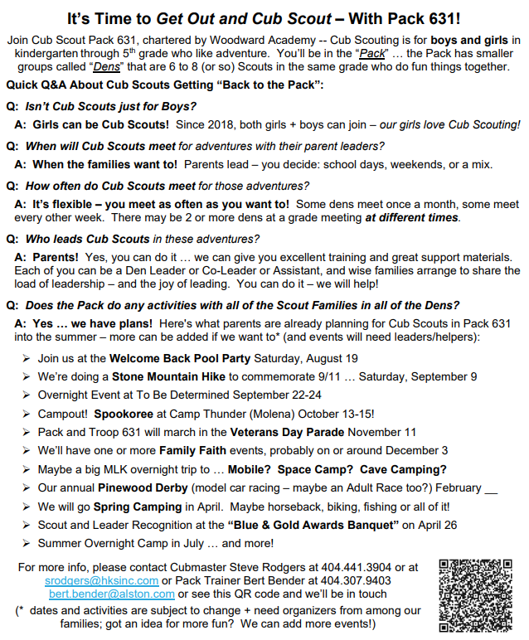
Make A Pack Packet Flyer
Notes:
We mentioned a “Pack Packet”, and while this is a reduced view and you’ll have to look close to read it in this slide, this is actually the simplest form of a “Pack Packet” because it’s one sheet of paper, two sides, and includes a QR code that takes you to the FAQ page on this Pack’s website.
Don’t have a Website? Maybe then your Packet will be bigger, to include calendar of activities, leader and family roster, and other information.
But get this: you do have a Website! You have a BeAScout Pin, and can copy the link to the “Want More Information” part of that Pin, and that can be on a QR Code so that you can get back to someone who pings you on BeAScout.
This is one example of a DIY Flyer, and that Pack will create more versions at Back-to-School time with pictures at each Den Level so that Scouts can be fired up seeing their own pictures and their friends will see them.

Slide 32


Empower Pack People to Promote
  Peer to Peer Recruiting!
Empower Your Parents
  Parent to Parent Recruiting
  Pass Out Pack Packets!
Empower Your Scouts
  Kid to Kid Recruiting
Notes:
You’ve got your Pack Packet, a simple one-page flyer. Now it’s time to Power up Parents with that Packet One Pager, so that they share with friends, families, neighbors, on social media, email and more.
And you can enlist any parent to be a “Greeter” at any Den or Pack event. They don’t need to be registered, they just need to be friendly, courteous, and kind – greeting both returning families and new families, plus passing on those Pack Packet flyers.
This way, the Den Co-Leaders and Cubmaster don’t have to do this – others can. And it’s very powerful to hear “Welcome!” Get some greeters / New Member Coordinators.

Slide 33

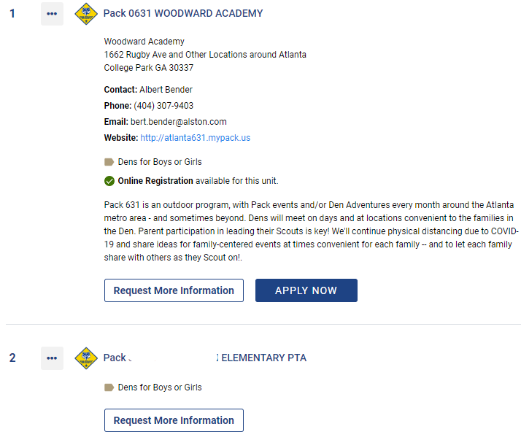

Get a Better BeAScout Pin
Families Google “Scouting Near Me”
  They Will Land At BeAScout
Use all data and description options in BeAScout to share how you Scout
  Use all 500 Characters!
Make Helpful Online Registration “Welcome Emails” and “Fee Emails”
  Tailor to Your Program!
The QR Code Will Show You How!
Online Registration Simplifies Application Intake and Payment
Notes:
We mentioned BeAScout Pins, and that is a powerful part of promotion, because families looking up “cub scouting” online will get that link very high up in their search results. You can pitch your pack in your pin, put in links to a website or FB page, add contact information, and craft both a “Fee Email” to explain how your Pack operates and pays for Scouting, and a “Welcome” email for when people join. Key Three Leaders and delegates have the power to update this 24/7.

Slide 34

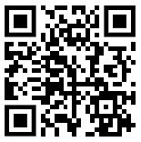
Recruiting Step Three
Recruit More Leaders and Helpers
Notes:
OK, so we’ve got a great Program, we’re Promoting it and Picking Up Interest, but we only have a few returning leaders – some moved, some crossed over to a Scouts BSA troop, some have crazy long work hours now and have to back away from being a Den Leader, so to build on that you need a foundation of leaders and co-leaders to do Cub Scouting.

Slide 35
👏 “Our 👏 Den/Pack 👏 Had 👏 Poor 👏 Leadership!” 👏
Why Is Recruiting Leaders So Important?
Voice of the Scout Survey asked: “Why is your child no longer in Cub Scouts?” – the Number One Answer was:

Slide 36
Want More Data About The Need for Leaders?
Q: “Why is your child no longer in Cub Scouts?” – after “Poor Leadership” (31%), the next answers were:
“Other” (28%) -- with highlighted concerns of “leader”, followed by “meeting”, “covid” and “leadership”.
Next (after aged out) were “our family did not feel welcome” (20%) and “my child was no longer interested in the program” (18%).
Then “too expensive” (16%), then “never received communication from leaders / not contacted about meetings” (15%).

Slide 37
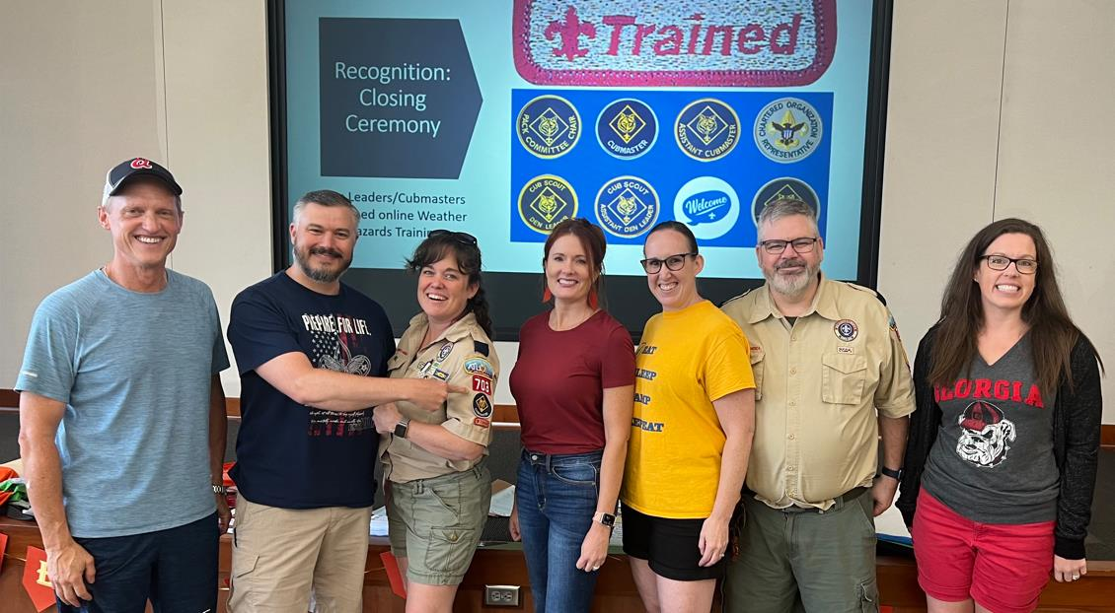
We Need To Turn Parents into Helpers
And Turn Helpers Into Leaders
Create a Team of Parent Leaders
And Do Team Training
Be an “Every Parent Helps” Pack
Notes:
This is no doubt the hardest part of recruiting. Because if you ask someone “will you be Cubmaster? How about Den Leader?”, most people will say “no”, either because they don’t know what it involves, or they do know – and they are afraid they’ll need to do it all.
A first step to help solve for this is to make it clear that Cub Scouting is a family program that needs parent help, and then create a culture of helping and leading. While it is true that “many hands makes light work”, it doesn’t happen unless you plan for it and work your plan … and we’ve got tools to make it work.

Slide 38

Stronger Families Through Scouting
Help Every Parent Be a Superhero
Notes:
Now, if you get parents engaged, let them lead (even just a little), give them tools to lead and succeed, recognize them and maybe give them an overstock patch as a recognition item, the parent should appreciate it (some might be embarrassed), but their child will feel proud: my dad was a hero. They love him. That builds stronger families right there.
And that Scout may bug his dad or mom and say: “can you come next time and help again – maybe you’ll get another patch”. Hey, if the patch recognition motivates a Scout to bug his parent to help you, use it.
Also, recently, I’ve thought about the Cubmaster as Hero image, and realized there is a downside: Some Cubs will look at their Cubmaster or Den Leader and may say to dad or mom: “I wish you could be as awesome as my Den Leader”. Some parents (especially dads) may feal threatened by that comparison, and less keen on doing Cub Scouting – but if you as a Cubmaster or Den Co-Leader elevate the other parents, your Scouts will see their parents as Superheroes, even if the parents don’t have a Khaki Superman outfit. Or don’t have it yet.

Slide 39
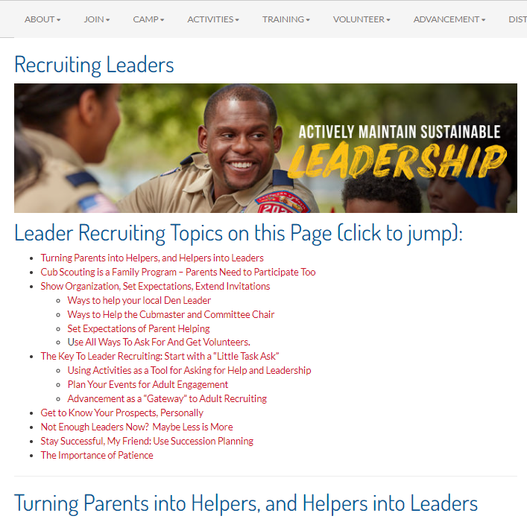

Fifty Ways to Lure a Leader …
Communication with Adults
Activities as the Lure for Adults
Recognition of Leaders + Helpers
Your Local Org Chart or Wish List
Right Size Your Jobs
Right Size Your Program
Everything Else (80 Plus Ways)
Notes:
We have a presentation posted at https://www.atlantabsa.org/RecruitingLeaders that is based on a document called “Fifty Ways to Lure a Leader” (apologies to Paul Simon):
There must be fifty ways / To lure a leader …
You ask the whole Pack, Jack
Every woman and man, Stan
You don't need to be coy, Roy
Not just one, two or three …
The list – there is also a PowerPoint – is up to 80 ways now, but there’s no song for that. To sort through these arrows in the quiver, we’ve put them into the following groups:
Communication: Have, Share and Hammer Home your “Every Parent Leads” policy / have sign-up sheets and online versions / use talent surveys and chat with parents to get a sense of how they can help / ways to make the right ask, the small ask, and then the big ask so that the answer will be “yes” / different themes and heartstring tugging methods to soften up your volunteer targets / ways to break down barriers between parents and leaders / and some hardball voluntold efforts like “Job Lottery” or Job Roulette.
Activities as the Bait. Put a bunch of activities up that you “might” do, and see who hits the bait / do KISMIF activities / do new ideas that new parents offer / more in a second
Recognition. If you make a big deal out of leaders and helpers, they will appreciate it, others will take note and their Scouts might nudge their parents to earn some swag too. / Many different ideas there to let leaders know you care.
Organize. Have an Org Chart that is broken down into bite sized bits, so that people can volunteer from day one. / maybe a pledge card? / Implement Term Limits / and more.
Right Size Jobs: Create small jobs people can take on / Activity and meeting planning should include planning “what parts of this will I assign to others” and give them tools to succeed / create teams for tasks / rotate the lead as a den collective / and more.
Right Size your Program. Meeting every week? Burning people out? Sometimes less is more. / If it hurts, stop doing it! / Outdoors and active is more fun than indoors – it’s Cub Scouting, not Cub Schooling!
And more … including the Godfather method, (who helped people out and said “Someday, and that day may never come, I will call upon you to do a service for me”)

Slide 40


Are We Helping Parent/Leaders Enough?
Are The New Adventure Resources Simple and Easy For Parent Leaders?
(A Quick Review)

Slide 41
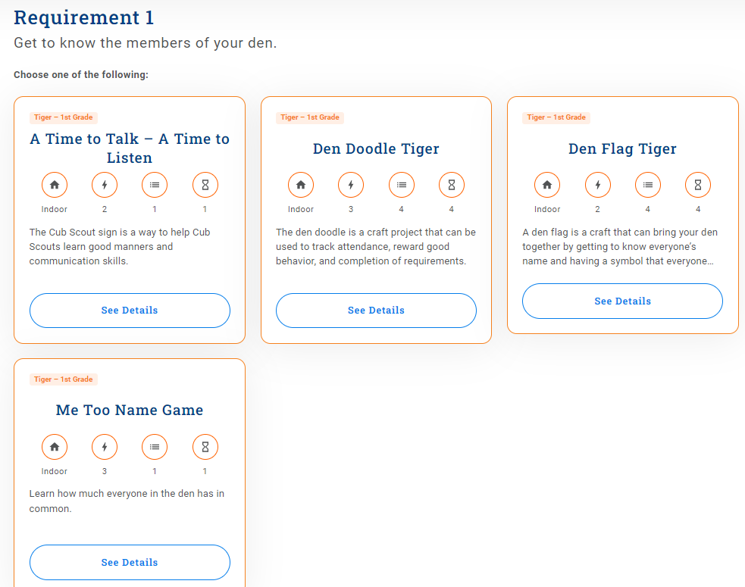
National Den Meeting Resource
Pages
From Tiger Bobcat
Snapshot (Overview)
Requirements (often 4-6 – no need to choose)
+/- 3 “Activity Cards” for each Requirement (now must choose!)
No Den Leader Guide
Main Meeting resources are Activities Choices
Look Elsewhere For “How To Den Meeting”
Notes:
Here’s an example of an “Activity Card”. While the Requirements for every Adventure are simplified to eliminate “options” and simplify things by eliminating any struggle to choose “which option”, most requirements have 3 Activity Card options, so … a leader would need to struggle to choose “which option”.
Also, although the resources say “Choose one of the following:” about the Activity Card options, that’s misleading – you don’t need to do any of the Activity Cards if you have a different way to complete the Requirement.
In this example of “get to know the members of your den”, you don’t need to make a Flag or a Doodle or play a game or do the “pairing off” get to know you … you can just share in a circle to “get to know the members of your den”. Simple.

Slide 42

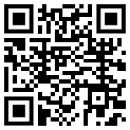
To Put It All Together …
… see … Assembled Den Meeting Plans
Notes:
Now, if you want a simplified approach to a Den Meeting, one see https://www.southfultonscouting.com/node/3163 and the pages that open under it for “Assembled Den Meeting Plans” that pick and choose among the optional Activity Cards or alternative simple ways to complete the Requirements and put it in the context of a Den Meeting.
Each Den Meeting Plan is at a page that adds links from the National Resources and other sources.
The Den Meeting Plans follow the approach of Successful Den Meetings that have several parts -- what you do before, during and after a Meeting -- namely, Preparation (planning + collecting materials needed and communicating with the Den), Gathering (something for early arrivals to do), Opening (a ceremony to start), then Activities (an Activities Intro chat, then alternate energetic and learning activities + add fun), Closing + Recognition (ceremony), and After the Meeting (follow up as needed).

Slide 43
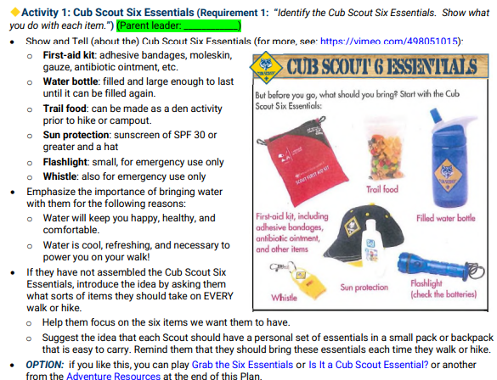
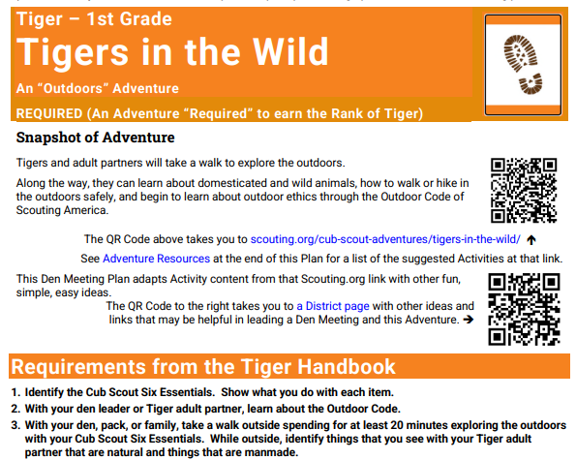
“Assembled” Meeting Plan Excerpts
“Snapshot” Summary and Website Links
Requirements
Simple Suggestions for Preparation, Gathering, Opening
One Activity per Requirement
Prompts for “Parent Leaders” of Activities
Simple Closing Ideas

Slide 44
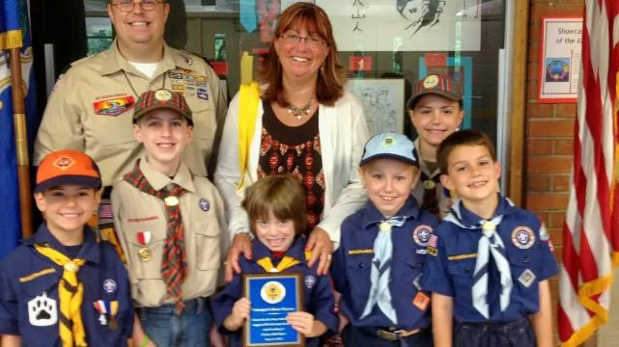
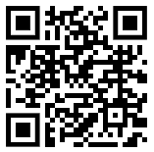
Recruiting Step 4
School + Community Presence
Notes:
Got Activities, doing Promotion, fining Leaders, now expand your profile through your School and any Community groups. You need friends – like for meeting space – and Scouting Units can help Schools and Community Groups and get some support in return.

Slide 45
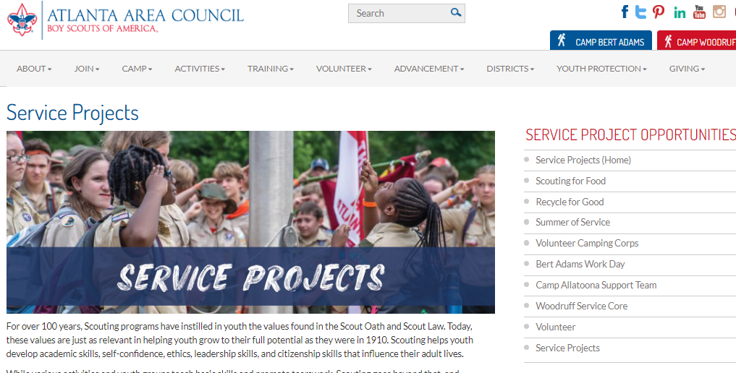
Serve Your School and Community
Build Relationships
Do Service Projects like “Adopt a School”
Share Project Pictures + Stories!
Notes:
As you promote, promote to your School and Community – make sure they know who you are and what you do.
Maybe Adopt a School and do a service for them – and when you do, don’t be shy about showing others that Scouts Serve.
Many Parents will really dig that.

Slide 46
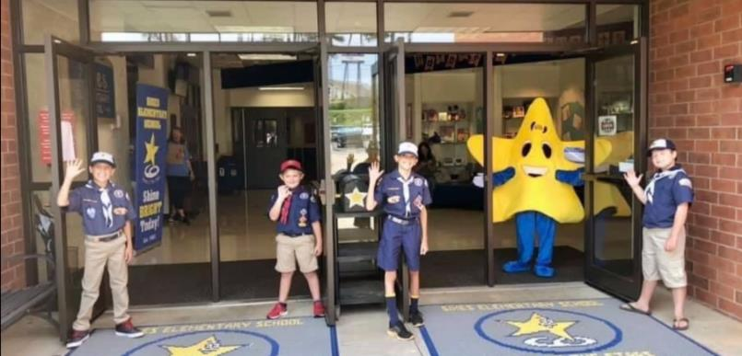
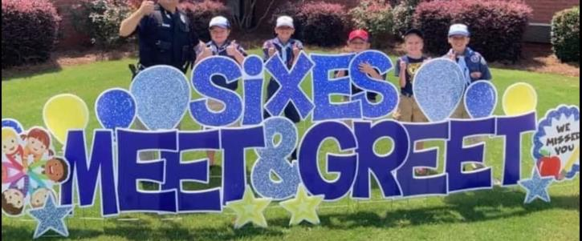
How Can Your Pack Help Your School?
How Can Your School Help Your Pack?
Notes:
Sometimes service is simple … welcoming families to the Back to School “Meet + Greet”? Raising/lowering the flag? Thank you Cubcakes?

Slide 47
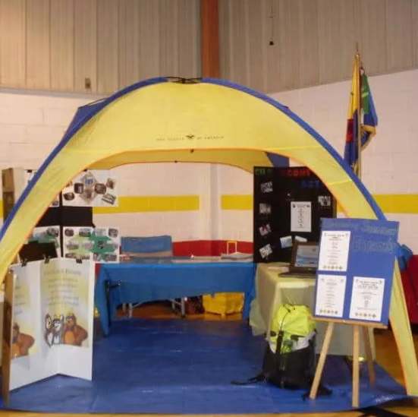
School Recruiting Relationships
Know Key School Contacts
  Principal + Staff
  PTA/PTO … Parents!!!
Plans and Dates
  Be At Open House / Meet + Greet / Registration Days!!
  School Sign-Up Night
Notes:
In schools, work all your contacts. It might be the Principal, but it might also be another staff member, a teacher, and you’ll want to have the maintenance staff on your side too.
Empower your Parents to Promote the Pack at the PTA or PTO – if you’re a leader whose kids are no longer in the school, you’re not in those meetings – if you are in the school, you can help guide your parents there to promote. Please empower your parents to say: “we love Cub Scouting – this is what we’re doing – come join us!”
And keep track of opportunities, like Open House / Meet and Greet / Registration Day / Meet the Teacher Day (or whatever it’s called at your school if they have an event like this). You can make great one-on-one contacts, peer to peer.
What can you do? Where can you be? Can’t be inside? Ask about outside!
Can you have a Derby Track, Tent, Fire Pit? If you don’t ask, they can’t say “yes”.
Adjust your recruiting for both wild kids and shy kids – because in a one-on-one pitch, you can fit the family.
For the shy kid clinging to Mom, sell the safe nurturing activities with the parents, the field trip to a puppet show, decorating your Derby Car.
For wilder kids, you might ask them: “Do you have what it takes to be a Scout?” Whether they say yes or no or don’t know, you tell them: I have to ask you three questions:
Do you like to stay up late?
Do you like fire?
Do you like to stay up late melting marshmallows over a campfire?
If they say yes (adjust your approach if they are not sure), say: “Congratulations! You’ve got what it takes! You’ll be a great Scout!”
Size up parents as possible leaders.
Your DE will be working to set up a Sign-Up Night if possible, so please work together on a date, and try to meet together with the school staff.
And see if you can get space in newsletters, emails, websites, bulletin boards, etc.

Slide 48
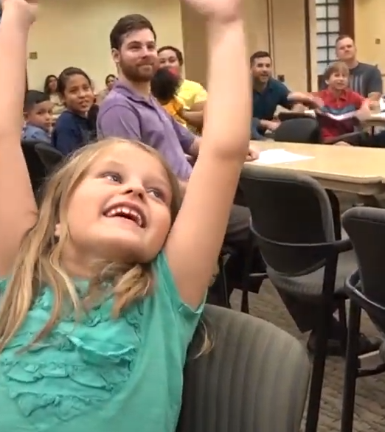
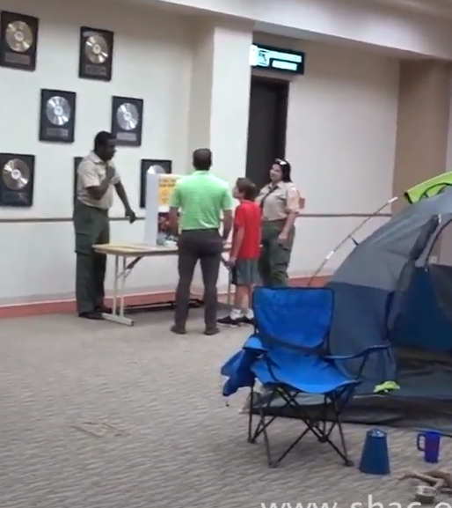
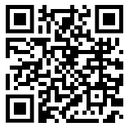
Recruiting Step Five:
Sign-Up Events – School + Fun
Notes:
With those Four Steps planted – we have a strong foundation for great Sign-Up Events.
Maybe it will be a presentation to a big group, or a station-to-station event like in these pictures. It may be an outdoor event, either a big group or station-to-station. All Scouting is Local, so fit to your Local situation. For example, if you don’t have a lot of leaders, you probably won’t do a station-to-station event.

Slide 49
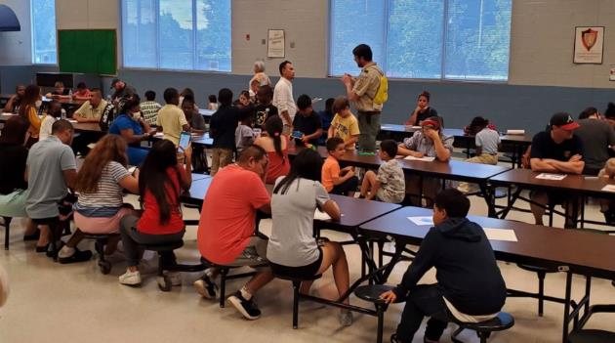
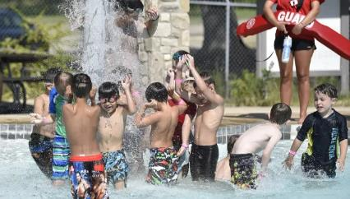
School Sign-Up Night
Fun Pack Joining Events
and
Notes:
Yes, Sign-Up Events is Plural. Do both School Sign-Up Night and one or more Fun Pack Joining Events that are a great “test drive” of Cub Scouting.

Slide 50

Every Fun Den and Pack Family Event Can Be a Joining Event
Invite Families to Take a “Test Drive” with Your Den or Pack
Be sure to Welcome! Welcome! Welcome!
Peer to Peer – Parent to Parent and Kid to Kid
Empower Parents to Welcome + Share The Pack Packet
When they like your Den or Pack … Sign ‘em up!
Notes:
Any event can let a family “test drive” Cub Scouting.
With a Pack Packet handout given by a greeter parent, new families can get what they need to know, and you can have one-on-one peer to peer parent to parent kid to kid connections made that will make new families stay with you.
50

Slide 51
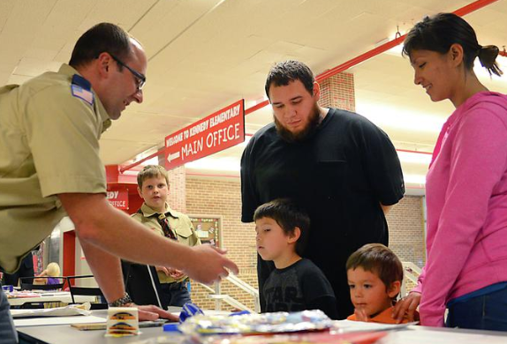
School Sign-Up Will Be Different
Run by Pack + Den Leaders
Encourage Current Families to Attend – Peer to Peer and Scout to Scout Recruiting
Have Fun on the Side for Kids – Get Parents / Troop to Help
Professionally Coached (also by District Volunteers)
Key Tool: Plan and Script for Pack to Tailor to Their Needs
Notes:
School Sign-Up Night will be different … Pack Run Recruiting.

Slide 52
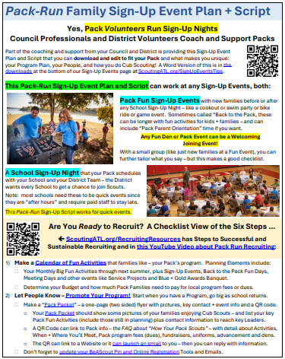
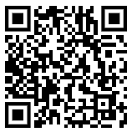
Resources for Sign-Up Events
Word Version of Plan and Script is on the AAC Sign-Up Events Page
Edit to fit your event (Fun Event or School Sign-Up Night) and your Pack Program
Notes:
Want Help With Plans and a Script for your Sign-Up Events? We’ve got it in a form anyone can download and tailor to fit their Pack Program.

Slide 53
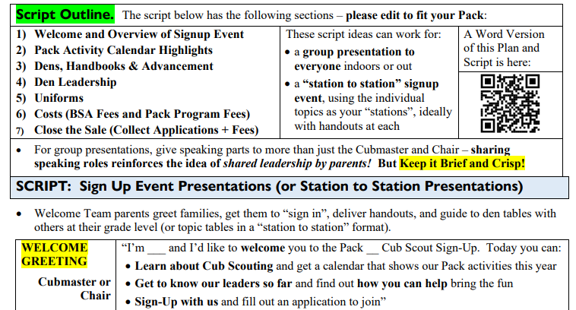
Notes:
Here’s the Start of the Script. Seven Sections or Topics, so it’s easy to share among 7 leaders or 7 stations.

Slide 54
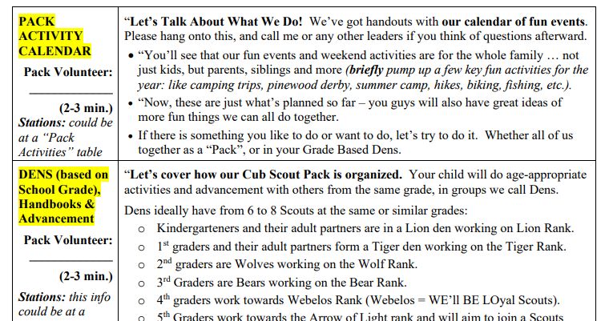
Notes:
After a Welcome, highlight your big fun activities. That will be a big draw to make Parents pay attention and help kids get excited about the places you’ll go and the fun you’ll have.
Remember: those new to Scouting will have NO IDEA about things like Dens and Ranks and what is Webelos, so a brief description is in order.

Slide 55
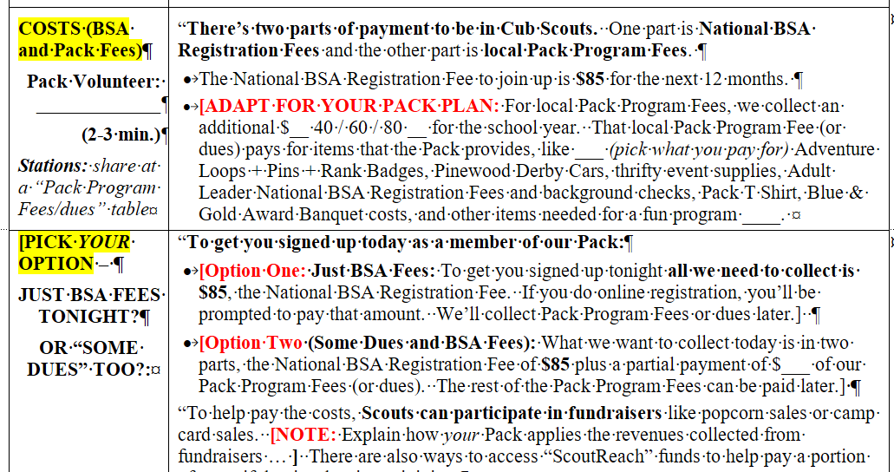
Notes:
As you get to the end and need to close the sale, you need to disclose the costs. We know what the 12 Month National BSA Registration Fee is for 2024, but you’ll need to describe your Local Pack Program Fees (sometimes called dues).
We have options for how to pay … many Packs just collect the BSA Fee at a Sign-Up Event, but you need to disclose the rest.
Also worthy of disclosure is how you raise funds, since that can reduce or eliminate the “out of pocket” cost for families.

Slide 56

National Fees – Effective in 2026
Youth Fee is $85; Adult Fee $65
“Council Funded” Units are $30 and $30
Scouting America National Registration Fees Still Run for 12 Months from Registration
Families will be invited to renew subscription in 12 months by emails from Scouting America National Organization
Notes:
Here’s the National Scouting America Fee Structure effective April 1, 2024 – as of 2/24/2026, no change yet announced (could be announced later).

Slide 57


Packs can Download Other Support Items
Notes:
More Sign-Up Support is found in the Downloads on the Sign-Up Event Resource page.

Slide 58


Word Sign In Sheet – Edit as You Like
Maybe Add a QR Email?
Notes:
One item you may like is this Sign In Sheet in Word where you collect information. You can edit it as you like, maybe by adding a “QR Email” option where you get an email from the parent and can then exchange information without deciphering poor penmanship.

Slide 59


Parent Skill Survey
Updated + Easy to Share Online
Notes:
We have a new, focused Skill Survey for parents … updated to reflect activities in the new program launching in the Summer of 2024.

Slide 60

Other Sign-Up Event Tips
Build a Tight Script – Long Stories are for Late Campfires, not Sign-Ups!
Script Needs to Sell THIS Pack’s Activities Program (Build One if Needed)
Multiple Leaders / Speakers Shows “We Have A Team” and “Join Our Team”
Start on Time
Stay on Script
Few Questions at the End – General for the Group, Individual After
End on Time
Notes:
Keep in mind these other essential Sign-Up Event tips.

Slide 61

Pack Preferred Sign-Up Dates – If The School Approves
More Dates Early in August?
Packs “Ready to Recruit” Might “Free Solo” On Their Own
Not Limited to Tues/Wed/Thurs
Subject to School Requirements (when will they let you) and Common Sense (like, start no earlier than 6 and no later than 7)
Notes:
Pack Run School Sign-Up Nights can also mean “Pack Picked” School Dates. Under DE run School Nights, some Packs might have to wait until September or even October for the DE to get a Tuesday, Wednesday or Thursday night at your School. Now, if you’re ready to “Free Solo” a School Sign-Up Night, you can go much earlier. Also, if your Pack meets on Monday and your School will let you do Sign-Up Night on Monday, you can pick a Monday night for Sign-Up. One Caveat – a School Buzz Up might be less effective with a Monday Sign-Up Night, because the best timing for Buzz Ups is the day before Sign-Up Night – so the Buzz built on Friday may fizzle by Monday.

Slide 62

What About School Buzz-Ups?
Depends on:
Can DE Attend? Most Buzz-Ups Must Be Done By Pros
When Is Sign-Up Night?
Whether Pack can Deliver a “Tight 90 Seconds” Buzz Up
Whether/How School Permits
CCTV? Video (YouTube)?
Notes:
Buzz Ups are still a valuable Tool. These are quick – 90 seconds or less – classroom visits by a District Professional. Why Professionals? First, they practice their Buzz Up pitch to be sure they are to the point and in + out in 90 seconds. Second, most Pack leaders are at work. Some Packs might have volunteers practice a pitch and get approved to Buzz Up – but the Council needs to be sure they will be on time, because teachers complain when a Buzz Up runs long, and then Principals complain to the Superintendent and then we may lose School Access.

Slide 63


Council Materials
Professionals Will Provide Packs With:
Backpacks with Slime Toys + More for New Paid Signups
Cub Scout Handbooks will be available
Waffle House Coupons
Parent Orientation Guides
Braves Bookmarks,
As you request: Yard Signs, Standees, Peer to Peer Cards, Stickers, Flyers, Feather Banners
100 Dutch Ovens for incentive contest
Notes:
What About Stuff the Council Will Provide? Pretty much like past years, but where the DE will not attend Sign-Up Night, the DE and Pack will need to coordinate on the handoff of items.

Slide 64
Pack Prepares and Brings
Write and Bring:
Your “Pack Packet” of Information to Share with Families
Your Pack’s Revised Script
Sign In Sheet and Pens
Parent Skill Survey
“How to Sign Up Online”
Paper Applications
Financial Aid Forms?
Treasurer’s Credit Card Reader
Also:
Current Leaders + Families for “Peer to Peer” Recruiting
Also Bring:
Side Activity for Kids (+ Scouts BSA Troop to Lead?)
Easy Den Adventure Plan (example to share)
Notes:
Some items must be prepared by the Pack – your Pack Packet and your Script.
Some items must be printed by the Pack – Sign In Sheet, Skill Survey, etc.
To collect Money, your Treasurer is well advised to have a credit card reader that connects to your Pack Bank Account.
You might also arrange for a Scouts BSA Troop to come help you by taking kids to the gym or playground while the Parents hear about the Pack.

Slide 65


This is New … and That’s A Lot … Who Can Help Us and Coach Us?
Answer: District Volunteers and Professionals!
Notes:
This Presentation is probably not enough for Pack Volunteers … so there are people who can help your Pack. Your District Professional and District level volunteers can train and coach you about the Recruiting Steps, and help you on the night of Sign-Ups if calendars sync up.

Slide 66


District Coaching Calendar Opportunities
District Kickoffs in late April, May, or early June
  Review Guide Steps and “School Playbook for August School Sign-Up Nights”, part of the AAC Membership Plan to help Units
District Back to School Recruiting Prep Parties in July
Roundtable + Commissioner Support any time
District Pro + Volunteer “Coaching Coffees” (or “Planning Pints”)
Notes:
Training and Coaching can happen now, at scheduled District Events, and through Roundtable, Commissioner contacts, plus District Executives and/or Volunteers meeting you and your fellow leaders over a beverage of your choice.

Slide 67

Sign-Up Follow-Up
Get Applications as they say “yes”
  But many families will not say “yes” right away
  After any Sign-Up Event … promote your next Fun Events
Call, Text + Email the “maybes” – invite to your next Fun Den + Pack Events to “test drive” Cub Scouting in your Den + Pack
  At Fun Events, reel them in!
Notes:
At any event, whether a School Sign-Up Night or a Pack Park Picnic Joining event, follow up with people to submit their applications.
If you use online registration, they can register and pay on their phone right there.
If you collect paper applications, you’ll need to be sure it’s correctly filled out plus collect the registration fee too.
And don’t forget those who didn’t sign up. Keep in touch with the “maybes” so that they come to your next fun Den or Pack event, and hopefully sign up then. Just because they didn’t sign up yet, doesn’t mean they’ll never sign up – maybe Mom thought Dad was doing the registration and Dad thought Mom was since Mom always takes care of the kid stuff. So keep in touch.

Slide 68





Step 6: More Activities
Keep It Simple Make It Fun
Notes:
Now, to Step Six. Simple. More Fun Activities. That spark joy. That build Stronger Families Through Scouting.
That’s the key to sustainable recruiting: retention of those you sign up.

Slide 69





Year-Round Recruiting?
Yes – Recruit When You Want
Notes:
Our goal isn’t just to retain those Scouts from August Sign-Up Events, it’s to grow from those Scouts:
Those Scouts invite their friends.
Their Parents invite their peers.
More Scout and Families join.
Your retention percentage isn’t 37% or 60%, but it jumps to 110% - yes, this is a place where 110% is possible.
Or more – with enough fun activities and parent involvement, we can grow Scouting after Sign-Up Events.

Slide 70

Our Six Steps
It is a Cycle Starting with Activities – Ending with More Activities
Recruiting is not “One and Done”
Notes:
Other than “School Sign-Up Night”, Recruiting Steps can and should repeat year-round. Activity Planning starts before the School Year starts, but needs to continue through the rest of the year.

Slide 71

Promote Your Den + Pack Year Round
What You Did (Share Pix + Video)
What You’re Going to Do
Empower Parents
Notes:
Then as you have More Activities, keep Promoting them … Recruiting Step Two works both after you do something fun and before the next fun event.

Slide 72

Find More Helpers and Leaders
Notes:
And as you do more, promote more, have more people attend, keep an eye out for helpers and leaders. Recruiting Step Three will be part of your year-round program, because that’s how we build “Stronger Families Through Scouting” plus if you need help or want more on your team, you’ve got to press that.

Slide 73

Thank Your School + Community Leaders
Notes:
Make “thank you” to your School, your meeting place host, your Chartered Organization, and your neighborhoods and community part of your program. Recruiting Step Four – building better School and Community Presence – can be better program.

Slide 74

Every Fun Den and Pack Family Event
Can Be a Joining Event
Notes:
Sign-Up Events – or Step Five – in Winter and Spring and Summer won’t be “School Sign-Up Night”, but if you want more families, find events where they can join in and sign up.

Slide 75

Year-Round Recruiting
Season By Season View
Notes:
Here is a Season by Season view of Year Round Recruiting. Right now, we’re approaching a “Relax and Retool” time in the Spring and Summer, which will become a Back to School Roll Out of a new Program Year and intensive recruiting, then lead to the Winter months of Running Program and Retaining Scouts.

Slide 76

Spring and Summer
  Relax
  Retool
Relax – and just do Fun*Simple*Easy family activities
Retool – and plan + recruit for coming year
Notes:
Our suggestion for Dens and Packs after completing Ranks this Spring is: keep Scouting, but just do Fun, Simple and Easy activities with family and friends.
As you relax, you’ll also retool for the coming program year in many ways.

Slide 77

Happens Too Often … Packs Rank Up + Shut Down ☹
Notes:
Continuing Den and Pack program after completing rank is something we hope Dens and Packs will do, but so very often it isn’t done.

Slide 78


This is a Pack Program Suggestion
Keep It Simple
Make It Fun
Just Do Super Fun Simple Activities
Relax!
Notes:
And our suggestion isn’t to seek some new awards or do complex meeting plans with rigid requirements. It’s to Keep It Simple, Make It Fun. Seriously. Just relax and have fun with Family + Friends. After all, we know that families and parents want connection with other families and parents. We can help with that.

Slide 79

Why Relax With Fun*Simple*Easy Activities?
It’s the Right Reward for Current Families and Leaders
Cub Scouting Is Too Complicated!
So … Relax with Fun*Simple*Easy
Notes:
Doing Fun, Simple and Easy is intended to put no or limited stress on current leaders. Leaders don’t need more work but they can use some time to chillax.

Slide 80

And …
Spring/Summer Relax/Retool
Can Be A Recruiting Time Too
Any Fun Den or Pack Activity Can Be a Welcoming and Joining Event
… If the Den or Pack is Prepared
Welcome New Families
Find New Leaders from Current Non-Leader Families
Find Leaders from New Families Excited About the Program
Collect Ideas for Pack Activities
Notes:
And if you have pure social fun time with other families … this can be a way to informally get ideas for next year’s activities, to get to know current parents better and maybe recruit them to your team, and to welcome new families.

Slide 81

Just Because We Suggest Fun*Simple*Easy Activities …
Doesn’t mean you can’t do more Advancement Activities + Awards
You Do You!
Notes:
Just to be clear … we are not saying DON’T do more advancement in the spring and summer. If you want to earn all the electives, go for it. If a simple bike ride isn’t enough and your families want a full bike rodeo, ride on!

Slide 82

Retool in Spring + Summer Is Also Planning For Fall
Time to Plan Pack Activities for the New Program Year
Notes:
Whether you relax or not, you’ll need time in Spring and Summer to plan for the upcoming Pack year.

Slide 83

Spring + Summer Pack Planning
Retool Time For Your Pack includes Progress on Guide Steps:
  Calendar of Activities
  Pack Promotion
  Leader Recruiting
  School Contacts
Sign-Up Event Readiness - Need District Support?
Sign-Up Event Plans: School + Fun
Notes:
Spring and Summer are the time to Retool for the upcoming year – and lay the foundations for a great Pack program. Now, wouldn’t you like to do some of this alongside fun*simple*easy activities like pool parties and game days and cookouts?

Slide 84

Roll Out + Recruit – New Program Year
Fall:
Recruiting Event Times:
School Days: Registration / Meet + Greet / Meet the Teacher Days
“Back to the Pack” Fun Joining Events
School Sign-Up Night
More Fun Events + Cub Scout Program
Notes:
Before you know it, Summer’s gone and School has started, so it is time to Roll Out your Program and as you do that it’s time to recruit new families.

Slide 85

Back to School District Coaching Check Ins
Follow Up on Summer Check In Open Items
Week Before School Sign-Up Night – Confirm Needs
If You Need Help, Seek Help – Your District Professionals and Membership Team Want To Help You Succeed
Notes:
As School approaches, be sure you and your parents and leaders are lined up to launch your program, including recruiting. Your District Professionals and Membership Volunteers should be in touch to confirm your readiness and help with any final coaching – but if you need help, seek help!

Slide 86

Late Fall + Winter
Run (Program) + Retain (Scouts)
Winter Recruiting? Really?
Really.
If Dens and Packs run strong local programs, they will (1) Retain Scouts who signed up in August, and (2) Recruit New Families who want to join the fun.
Any Den or Pack Event can be a “test drive” for new families
Notes:
Yes, Winter Recruiting, because if you have good Den and Pack activities, you can empower your parents who like what their Scouts are doing to invite others.
Den Leaders: don’t shy away from recruiting new families because you fear you’ll need to redo everything – if the new Cub Advancement program doesn’t show how families can catch up, we’ll create those tools.

Slide 87

Seasons Summary
Notes:
These are the Seasons.

Slide 88
Steps for
Successful Recruiting
Calendar
Build a Calendar of Fun Activities!
Promote
Pack People Promote Their Pack Program
Leaders
Recruit Helpers + Leaders. Everyone.
School
Pack Builds Close School Relations
Sign-Ups
Fun Events + School Sign-Up Nights
More Fun
More Den + Pack Activities + Joining
Notes:
These are the Six Steps.

Slide 89



Thank You!
Qs? bert.bender@alston.com or email through this QR ➔
Notes:
Questions?

