Slide 1
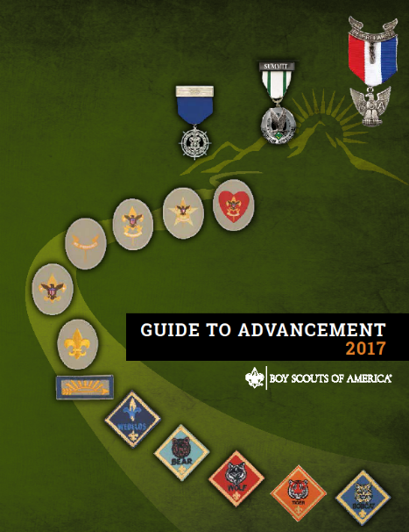
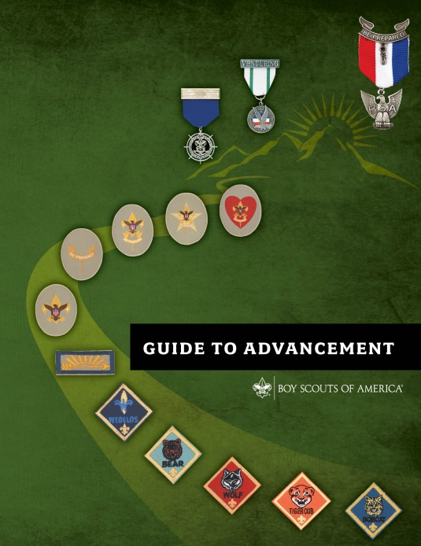
Merit Badge Counseling
Procedures AAC
Unit Leaders
January 24, 2023

Slide 2

Agenda
Scouting overview: mission, objectives, and methods
Merit Badge Counselor qualifications
New Merit Badge Counseling procedure AAC
Notes:
[Presenter Notes: Ask participants to review this slide and then invite them to bring up any specific details or issues they would like to be sure are addressed. List these on a flip chart or white-board. At the end of the session you can go back and pick up any topics that were not covered.]

Slide 3
Boy Scouts of America
Mission Statement
The mission of the Boy Scouts of America is to prepare young people to make ethical and moral choices over their lifetimes by instilling in them the values of the Scout Oath and Scout Law.
Notes:
[Presenter Notes: Hold up your copy of the Guide to Advancement, opening it to the inside of the front cover. Point out the BSA Mission Statement found there.
If your class includes people who are learning about Scouting, point out the signs or flip chart sheets showing the Scout Oath and Scout Law.
Explain that all merit badge counselors should have a copy of the Guide to Advancement and should carefully study section seven.]

Slide 4
Objectives of the Scouting Program
Character development
Citizenship training
Leadership
Mental and physical fitness
Every activity in Scouting should support
one or more of these aims.
Guide to Advancement topic 2.0.0.3
Notes:
The BSA mission and the objectives of the Scouting program that appear on this slide represent the desired outcomes of the merit badge program.
The skills and knowledge developed through merit badges are important, but not so much so as achievement of the objectives and mission. The mission and objectives of Scouting, for the most part, are accomplished through the merit badge process, as opposed to the learning that’s related to the subject matter. This doesn't mean the subject matter is unimportant. It is important. But it does mean that the process of learning and interacting with others in successfully challenging and completing all the requirements is the key to success. This is why we do not “retest” in Scouting. We’re more interested in what the Scout experiences along the way.

Slide 5
Methods of Scouting
Scouting ideals
Patrol method
Advancement
Association with adults
Outdoors
Leadership development
Uniform
Personal growth
Guide to Advancement topic 2.0.0.4
Notes:
Scouting uses eight specific methods to achieve its objectives. Since earning merit badges is included in rank requirements, the merit badge program primarily relates to the advancement method. But it has the potential to make use of the other seven as well. For example:
Association with adults takes place through unit leader discussions, working with merit badge counselors, and any specialists or guest speakers who assist them.
Many merit badges include requirements that take place in the outdoors.
And opportunities for leadership development and personal growth abound as Scouts grow in knowledge and self-confidence and work through requirements that require teaching and leading others.

Slide 6
Qualifications to Become a
Merit Badge Counselor
At least 18 years of age
Criminal background check with recheck every 5 years
New signed Background Check Authorization submitted to unit
Good character
Recognized as having skills and education in the subject area
Good rapport with leaders and Scout-age youth
Guide to Advancement topic 7.0.1.1
Notes:
In order to qualify as a merit badge counselor, prospective volunteers must have the education and skills needed to provide instruction and to evaluate performance. It is also important they are older than the Scouts and are able to set that positive example. This calls for both good rapport and good character.
These are the only qualifications the BSA National Council places on merit badge counselors—regardless of the merit badge. Local councils, however, when approving counselors, may look for more, but they are not allowed to accept less.
6

Slide 7


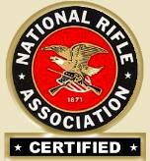

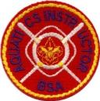

Special Certifications and Trainings
Specific training is required for some BSA activities, including merit badges.
A counselor must hold the specific certification or work with someone who does.
Guide to Advancement topic 7.0.1.1
Notes:
The BSA considers some merit badge activities riskier than others. A list of these badges is provided in the Guide to Advancement, topic 7.0.1.1, “Qualifications of Counselors;” along with the specific qualifications required of those supervising the activities. For example, most of the requirements for the shooting sports merit badges require BSA National Camp School or National Rifle Association certification; and scuba diving activities must be presented by a trained instructor sanctioned by an agency such as PADI, the Professional Association of Diving Instructors. Of course, for the aquatics badges, all Swimming and watercraft activities must be offered in accordance with BSA Safe Swim Defense and BSA Safety Afloat, respectively.
If the merit badge counselor does not meet the specific qualifications listed, then he or she may use the services of others who do meet them. This is supported in topic 7.0.3.2 of the Guide to Advancement, where it says, “It is permissible for guest speakers, guest experts, or others who are not merit badge counselors to assist in the counseling process.”
As a side note, it must be remembered that any activities that take place within the merit badge program must be conducted in accordance with the Guide to Safe Scouting.
[If you are asked, the Guide to Safe Scouting is available at www.scouting.org/health-and-safety/gss/toc/; Aquatics : www.scouting.org/health-and-safety/gss/gss02; the URL for shooting sports and climbing is: https://www.scouting.org/health-and-safety/gss/gss08/#a; and for Winter Sports, the URL is: https://www.scouting.org/health-and-safety/gss/gss12/#b.

Slide 8
Registering as a
Merit Badge Counselor
Even if already registered, every counselor must submit a BSA adult application for the position of merit badge counselor (code 42). There are no exceptions.
Merit badge counselors who are re-registering need not complete a new adult application.
“Merit badge counselor” is a council or district position.
Approval of merit badge counselors is the responsibility of the council advancement committee, not the unit.
Guide to Advancement topic 7.0.1.5
Notes:
[Note to the presenter: We anticipate most of your participants will already be registered and approved as merit badge counselors. For others who may be attending to discover if counseling is a good fit, it would be helpful to have information about local council procedures on hand.]
You must submit an adult application for registration with your local council as a merit badge counselor. This must be done even if you’re already registered in another position. You must complete a new registration form in order to serve. Be sure to use position code 42.
This goes for merit badge counselors working at summer camp or at merit badge “colleges,” “fairs,” or “midways” as well. There are no exceptions. This is important because of the resulting background check that occurs upon registration.
Local councils establish the procedure for submitting applications. [Explain the procedures for the council(s) with participants involved in this session]
The cost to register is zero dollars. That’s right, it is free!
8

Slide 9
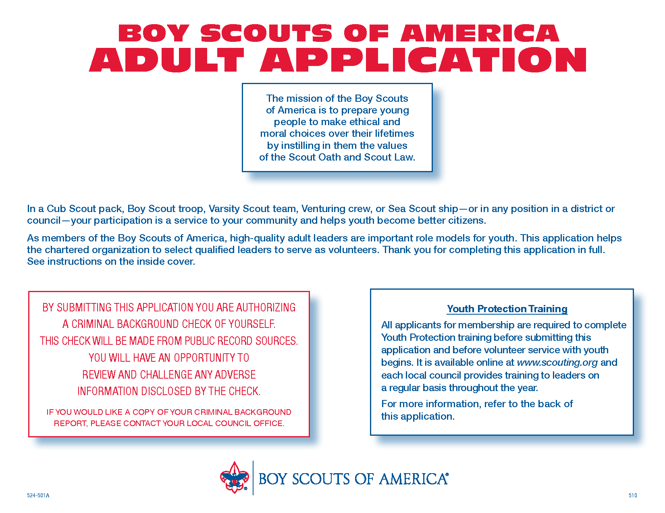
Form Needed to Register as a
Merit Badge Counselor
Use position code 42.
Guide to Advancement topic 7.0.1.5
Notes:
Here are the forms that merit badge counselors submit. The first is the standard BSA adult application form and the other is the Merit Badge Counselor Information sheet that lists each badge the counselor wishes to counsel. This is the form upon which the council bases its approval of a counselor.
The Merit Badge Counselor Information sheet is where counselors have the opportunity to describe their skills and education related to each badge they wish to counsel. The description could include college degrees, formal training, various certifications, jobs held, specific life experiences, and so forth.
Multiple forms may be used if counselors are applying to counsel more badges than will fit on just one form. This same form is used if a counselor wishes to add or remove merit badges when it comes time to reregister.
Note that the National Council has established no limit on the number of merit badges for which one may be approved to counsel except to the extent that a person lacks skills and education in the given subjects. But that said, it is permissible for councils to limit the number of badges as a method to assure that only those with sufficient skills and education are approved. It is not advised that there be a hard and fast rule, however, such as no more than 10 badges to a counselor. It is better to be flexible in order to be sure there are adequate counselors for all the badges.

Slide 10
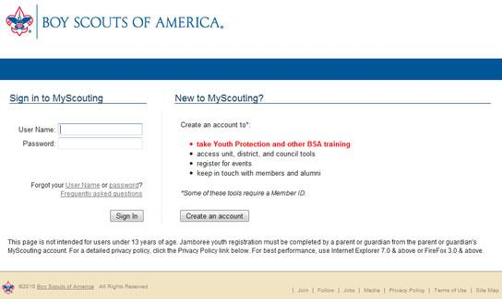


Complete
Youth Protection Training
Good for
www.my.scouting.org
Guide to Advancement topic 7.0.1.1
Notes:
Before working with Scouts, counselors must complete Youth Protection training and practice the policies as stated in the Guide to Safe Scouting located at https://www.scouting.org/health-and-safety/gss/gss01/. The online course is available by logging into my.scouting.org. Counselors, who live in states that require face-to-face, instructor-led training, are encouraged to contact their local councils for training dates and times. Be sure to check your state’s laws regarding youth protection.
They must be familiar with the Youth Protection and Adult Leadership: Scouting’s Barriers to Abuse policies as stated in the Guide to Safe Scouting located at https://www.scouting.org/health-and-safety/gss/gss01/
When completing the course, volunteers should attach a copy of their certificate to their adult registration application and information sheet, and follow council guidelines for submitting these documents.
10

Slide 11
Merit Badge Counselor Procedures AAC
Local councils establish procedures for registration, re-registration, approval, and for reviewing:
  Background checks
  Youth Protection training
  Any council-required certifications
Approval is for specific merit badges.
Counselors may work with just one unit, but registration and council advancement committee approvals are still required.
Guide to Advancement topic 7.0.1.4
Notes:
When you submit your adult application and information sheet, your council advancement committee has the responsibility to review and approve your service as a counselor. Merit badge counselors must be approved for each badge they plan to counsel.
The council will do a background check, ensure your Youth Protection certification is on file, and check additional certifications if the council requires them. Remember, your Youth Protection training must be renewed at least every two years.
Just as with any other registered BSA volunteer, merit badge counselors must re-register annually. The local council establishes the procedure for this process, and it may be as simple as confirming a desire to remain a counselor. The re-registration process as spelled out in the Guide to Advancement under topic 7.0.1.5, includes the opportunity to update contact information and the merit badges to be counseled during the coming year, as well as a reminder to renew Youth Protection training if it has expired.
As a merit badge counselor, you may request that you work only with selected units (see the Guide to Advancement, topic 7.0.2.3). We urge you, however, to leave yourself open to all. In this way you allow more Scouts to broaden their horizons and work with people outside their own units.
[Note to presenter: This is a good place to cover any local council procedures as appropriate.]
11

Slide 12
New applicant submits information to Council Program Center
- BSA Application, code 42
- Copy of YPT
The MBC Procedure
Fill out online application with desired merit badges
Allow 1-3 business days for approval
If denied, the applicant is notified by email
If application has been approved
Allow 1-2 days to be entered into My.Scouting
After that, allow 24 hours to be uploaded to Scoutbook

Slide 13
Addendum A
Merit Badge Counselor Check List
New Merit Badge Counselors only ◻
Original Adult Application ◻
Disclosure Statement ◻
SSN ◻
Background info ◻
New and updated Counselor information ◻
Merit Badge Counselor Training ◻
Youth Protection Training ◻
Merit Badges requiring Special Certifications
Archery ◻
Canoeing ◻
Climbing ◻
Kayaking ◻
Lifesaving ◻
Motor Boating ◻
Rifle Shooting ◻
Rowing ◻
Scuba Diving ◻
Shotgun Shooting ◻
Small Boat Sailing ◻
Snow Sports ◻
Swimming ◻
Water Sports ◻
Whitewater ◻

Slide 14
Training MBC Counselors
Per the 2019 Guide to Advancement, it is the Council Advancement Committee responsibility to ensure that each Merit Badge Counselor understand the BSA Aims, Methods and Mission. Furthermore, we need to ensure that each MBC know how each scout can learn and grow through the Merit Badge process.
All New Merit Badge Counselors are expected/encouraged to do one or both of the following:
Have administered/presented to the Essentials of Merit Badge Counseling either by the DAC or Designee(s) or a Unit Designee.
2. Merit Badge Counselor completes the Online course for Merit Badge Counselors. https://my.scouting.org/dashboard-legacy.
- Log in, From Menu on top left dropdown to My Training.
- Then click on Training Center in the middle.
- Then Scouts BSA. First box is MBC Training.
- Complete courses SCO_430,431,433,434,435, and 448
Notes:
Training for MB Counselors
Per the 2019 Guide to Advancement, it is the Council Advancement Committee responsibility to ensure that each Merit Badge Counselor understand the BSA Aims, Methods and Mission. Furthermore, we need to ensure that each MBC know how each scout can learn and grow through the Merit Badge process. To that end, effective October 14, 2019, each new applicant for Merit Badge Counselor is encouraged to do ONE of the following before they administer a Merit Badge course:
1. Have administered/presented to the Essentials of Merit Badge Counseling either by the DAC or Designee(s) or a Unit Designee.
2. Merit Badge Counselor complete the Online course for Merit Badge Counselors. https://my.scouting.org/dashboard-legacy. Log in, From Menu on top left dropdown to My Training. Then click on Training Center in the middle. Then Scouts BSA. First box is MBC Training. Complete courses SCO_430,431,433,434,435, and 448
3. Be a Trained Registered Leader

Slide 15
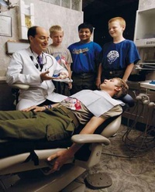
Merit Badge Counselors
Share passion
Teach skills
Touch lives
Notes:
As a merit badge counselor, you will have the opportunity to share your passion with Scouts. You will teach skills that may last a lifetime and you will positively touch—and in some cases, dramatically change—the lives of many men and women. You may not get to know this as you work directly in the program, but it will happen.
Enjoy the opportunity you have in front of you! And thank you for your commitment.

